Slide 1
A selection of problems used
in the lessons
The first slide (Discussion problem) may be useful as a starting point for discussion at a department meeting.
The next set of slides display a problem (all from unit 1 lessons) chosen from each of the three different approaches* used in the design of the project lessons. These may generate useful discussion for teachers when considering the teaching of these topics or engaging with these PD materials
*(The lessons have been designed to reflect three different research approaches and these are discussed in other sections of the microsite)

Slide 2
Which Dog has grown the most?
Discussion problem:
Caesar has grown from 5 kg to 8 kg
Brutus has grown from 3 kg to 6 kg
and Tiberius has grown from 4 kg to 7kg
Explain your thinking
What maths are you using?
What might the issues/responses be from children?

Slide 3
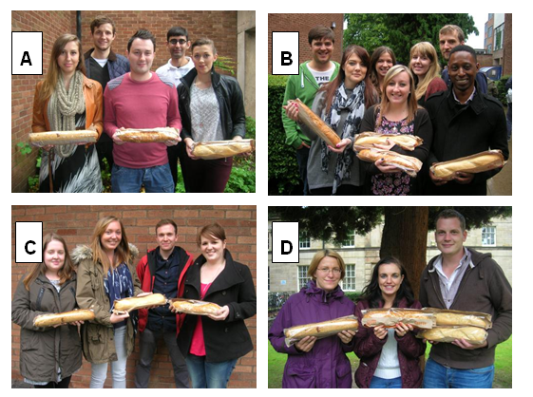
Problem from a lesson representing design approach A
(RME)
Groups of trainee teachers are sent out to a check the suitability of venues for school trips. Large sandwiches are provided for lunch.
Q1 a) In which group do the teachers get the most to eat? Explain your thinking
b) In which group do the teachers get the least to eat? Explain your thinking

Slide 4
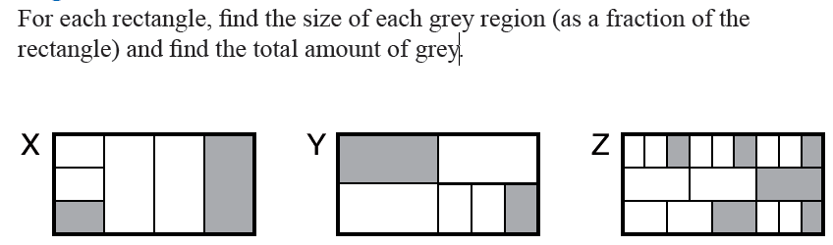


Problem from a lesson representing design approach B
(constructivist)
A
B
C
D
E

Slide 5

Comparing Milkshakes
Problem from a lesson representing design approach C
(Enquiry/cognitive conflict)
Two batches of milkshake are made by mixing cartons of juice with cartons of milk:
Determine whether the two batches will taste the same.

Slide 6


Comparing Milkshakes
Two batches of milkshake are made by mixing cartons of juice with cartons of milk:
Both batches have two more cartons of milk than juice so they will taste the same
In Batch 1, of the milkshake is juice,
whereas in Batch 2, of the milkshake is
juice so they will taste different
Beth and Charlie can’t agree on whether the two batches of milkshake will taste
the same. Determine whether the two batches will taste the same, commenting
on the two reasons given.

