Slide 1
Numberblocks
Support Materials
Series 2, Episode 15
Numberblock Castle

Slide 2
Practitioner Notes

Slide 3
Episode Description
Numberblocks One to Four explore Numberblock Castle and have to find a way to make every Numberblock from Five to Ten as they go. They cross a moat by a drawbridge and open secret doors with help from Six and Seven. The floor gives way near to them, so they have to turn into Eight to get across by swinging on flagpoles like monkey bars. Nine barges a door open and they find a crown room but get locked in, so they make Ten, who turns into a rocket and flies through a hole in the ceiling before landing safely outside.

Slide 4
Maths in the Episode
Developing the concept of addition through combining 2 or more numbers to make a new quantity
In this episode, 2 or more Numberblocks combine to make the Numberblocks Five, Six, Seven, Eight, Nine and Ten, in order to solve a problem. This demonstrates the part-part-whole structure of number.

Slide 5
Using Mathematical Language
During this episode children will experience combining numbers to make another quantity.
Children could describe this process by using these stem sentences:
“1 and 4 together make 5.”
“Five is made from one and four.”
Children could also describe this process using the part-part-whole structure.
“7 is the whole: 4 is a part, and 3 is a part and 7 is the whole.
(with actions – holding the 4 in one hand and the 3 in the other, bringing together and separating to show the whole and the parts).

Slide 6
Talk and Discuss Together

Slide 7
Talk and Discuss Together
Watch the episode of Numberblocks. First ask the children what they noticed and allow them to talk to you and each other. The following slides are designed to stimulate children and adults to talk about the episode and draw out some key aspects of the mathematics.

Slide 8
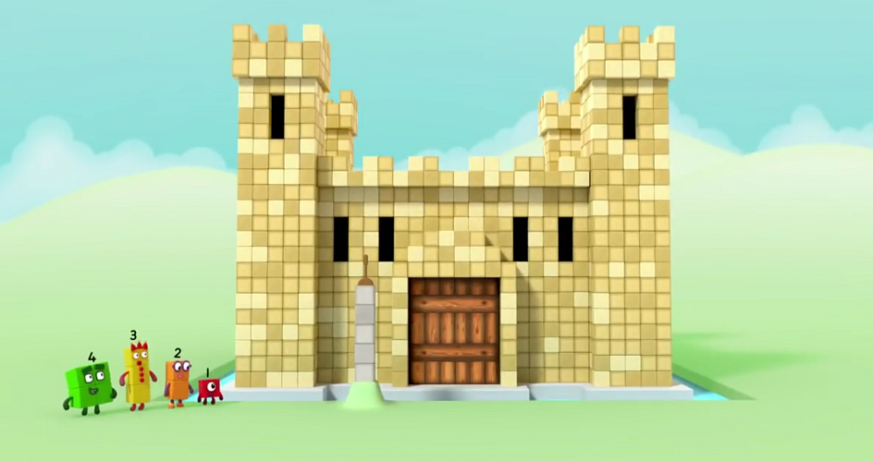
Images © 2017 Alphablocks Ltd. All Rights Reserved.
Notes:
Discuss the episode. Who has been to a castle? What was it like?
What did you notice in the episode? One, Two, Three and Four had some problems to solve. What sort of problems were they?
Hand out a set of Numberblocks made from linking cubes: One, Two, Three, Four, Five, Six, Seven, Eight, Nine, Ten.
Print slide 9 to make a spinner (this slide is ‘hidden’ so will not show when you run a slide show). Place a pencil in the centre of the circle and use a paper clip around the bottom of a pencil to spin to a colour.
Children work with partners to find 2 Numberblocks that will combine to make the colour the spinner lands on. (The colours represent the Numberblocks 5-10).
Combine one Numberblock on top of another and compare to the whole.
Practise these stem sentences: “One and Four together make Five” and “Five is made from One and Four”.

Slide 9
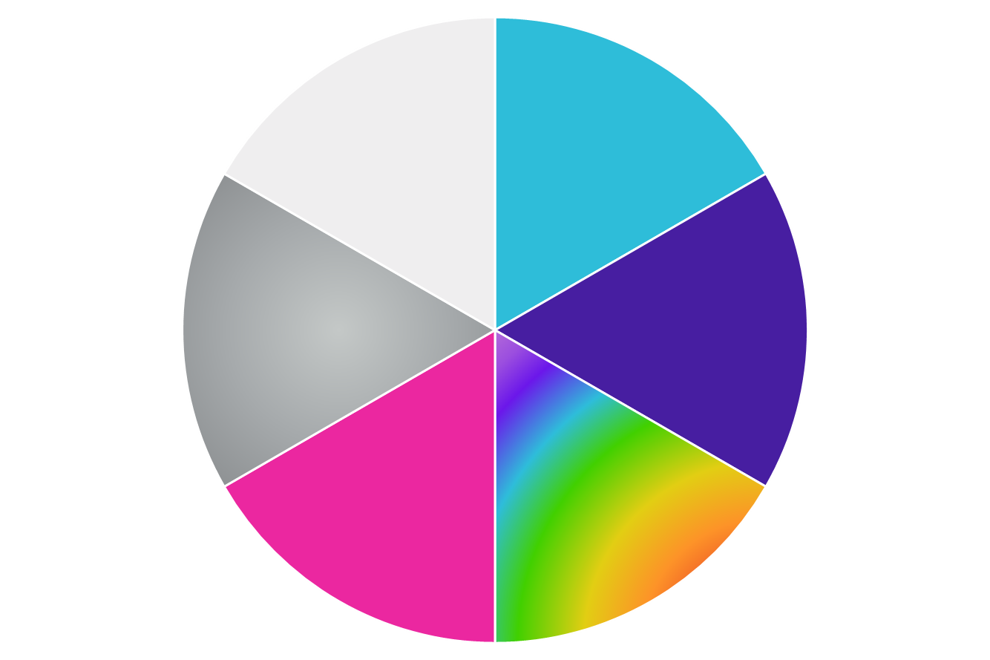

Slide 10
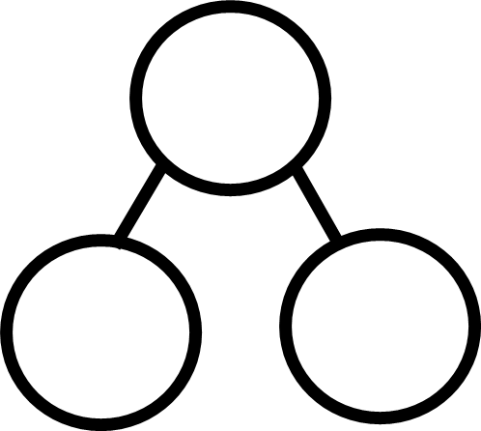
Images © 2017 Alphablocks Ltd. All Rights Reserved.
Notes:
Use this slide to present the part-part-whole model as a way of representing the partitioning and combining of parts to make wholes.
This and the next slide are animated.
Accompany the animations with the stem sentence:
“5 is the whole: 1 is a part, and 4 is a part and 5 is the whole.”
Arrange 3 PE hoops on the floor as a part-part-whole model and ask 5 children to move from one circle into the other two – to show how they are partitioned and then jump back again to re-combine.

Slide 11
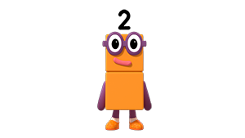
Images © 2017 Alphablocks Ltd. All Rights Reserved.

Slide 12
Enabling Environments

Slide 13
Enabling Environments
Playing and Exploring
Provide a part-part-whole model drawn in chalk outside for the children to explore partitioning themselves when they are in groups, or to throw a collection of bean-bags to (i.e. 5 beanbags are thrown, 2 into one circle, 3 into the other).
Active Learning
Notice when children partition a group of two objects from a collection they are playing with, e.g. carriages in a train set being separated.
Creating and Thinking Critically
Provide a feely bag with the Numberblocks 1,2,3 and 4 in. Leave out Numberblocks 5, 6, 7, 8, 9 and 10. Take two or three Numberblocks from the bag and match the Numberblock that they make when combined.

Slide 14
Learning Together in Y1

Slide 15
Images © 2017 Alphablocks Ltd. All Rights Reserved.
Notes:
Discuss the episode. Who has been to a castle? What was it like?
What did you notice in the episode? One, Two, Three and Four had some problems to solve. What sort of problems were they?
Hand out a set of Numberblocks made from linking cubes: One, Two, Three, Four, Five, Six, Seven, Eight, Nine, Ten.
Print slide 9 to make a spinner (this slide is ‘hidden’ so will not show when you run a slide show). Place a pencil in the centre of the circle and use a paper clip around the bottom of a pencil to spin to a colour.
Children work with partners to find 2 Numberblocks that will combine to make the colour the spinner lands on. (The colours represent the Numberblocks 5-10).
Combine one Numberblock on top of another and compare to the whole.
Practise the stem sentences: “One and Four together make Five” and “Five is made from One and Four”.

Slide 16
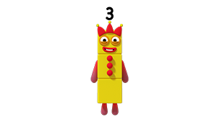
Images © 2017 Alphablocks Ltd. All Rights Reserved.
Notes:
This and the next slide are animated. Use them to demonstrate how an equation such as 5 = 4 + 1 can be represented in multiple ways. For each of the new representations revealed in the animation, compare them by identifying what is the same and what is different between the representations, and what the different parts mean within the representation. The imagery moves from concrete, to concrete/pictorial, to pictorial, to abstract. Each demonstrates that even though the parts are represented by different images they still combine to the same whole.
Use the imagery to practise the stem sentences given in slide 5.

Slide 17
Images © 2017 Alphablocks Ltd. All Rights Reserved.

Slide 18
Images © 2017 Alphablocks Ltd. All Rights Reserved.
Notes:
Use this slide for the children to explore the different representations for 7 using Numberblocks 1, 2, 3, or 4.

Slide 19
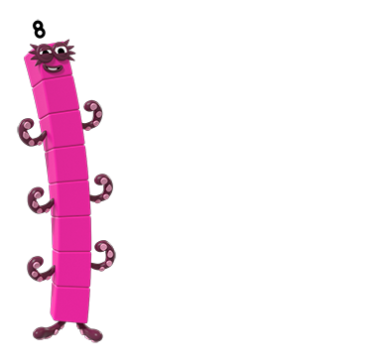
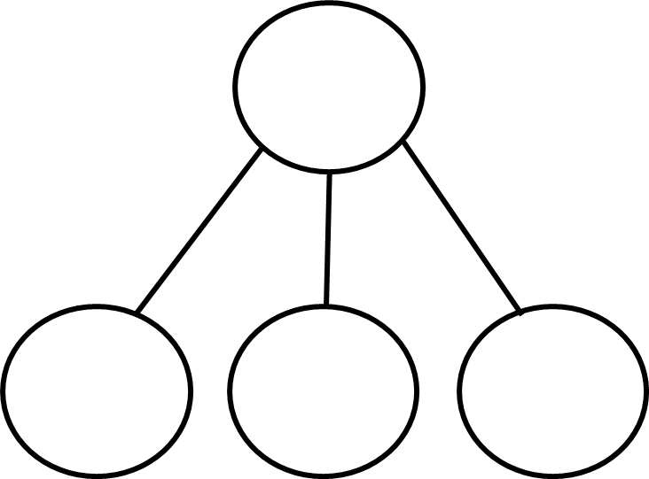
Images © 2017 Alphablocks Ltd. All Rights Reserved.
Notes:
Use this slide for the children to explore the different representations for 8 using Numberblocks 1 ,2, 3, or 4.

