Slide 1
Series 3 Episode 26
Fourteen

Slide 2
Practitioner Notes

Slide 3
Episode Description
Four is on a square-wheeled skateboard and struggling to skate. He bumps into Ten to make Fourteen. Fourteen sings a song about how he wants to be a great skater. He demonstrates how he is made from Ten and Four and also from double Seven. The other even Numberblocks join in to find out what their lucky double is.

Slide 4
Maths in the Episode
Composition and properties of 14
In this episode the fourteen is made by combining ten and four. Fourteen can also be partitioned into 1 ten and 1 four. Fourteen is also double seven and so this episode introduces doubles.

Slide 5
Using Mathematical Language
Use these stem sentences to rehearse the mathematical ideas in the programme:
“<14> is made from one ten and one <4>.”
“Double <7> makes <14>.”
“<14> is double <7>.”
Notes:
Text inside < > indicates what can be changed in the stem sentence.

Slide 6
Talk and Discuss Together

Slide 7
Talk and Discuss Together
Watch the episode of Numberblocks. First ask the children what they noticed about Fourteen and allow them to talk to you and each other.
Fourteen is a lucky double.
The following slides are designed to stimulate children and adults to talk about the episode and draw out some key aspects of the mathematics.

Slide 8
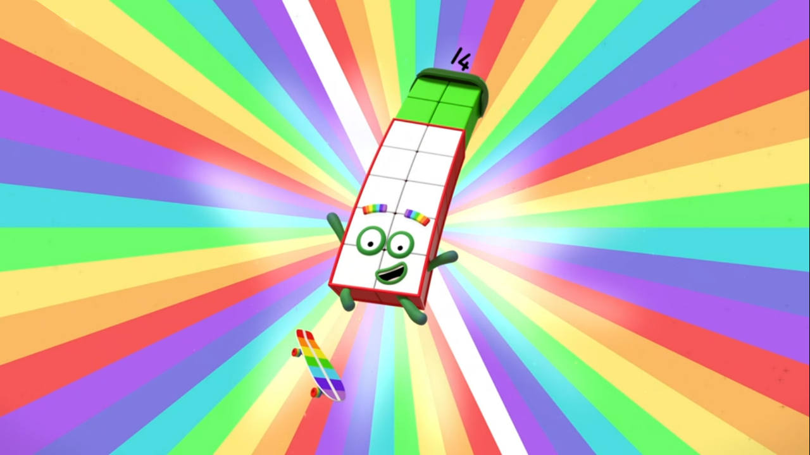
Images © 2017 Alphablocks Ltd. All Rights Reserved.
Notes:
Use this picture as the stimulus for Talk and Discussion (slide 7).

Slide 9
Enabling Environments in Reception

Slide 10
Enabling Environments
Playing and Exploring
Set up a doubles treasure hunt. For example, leave two plates of five biscuits or pieces of fruit in two different parts of the setting; 2 buckets each with 3 spades in, 2 identical toy cars (each with 4 wheels). Bring the collections together and discuss the doubles they represent.
Active Learning
Young children like the idea of doubles. They may use their fingers to represent doubles to 10 when you ask them to represent ‘double 1’. Use mirror images of hands to represent doubling.
Creating and Thinking Critically
Play a bingo game with Slide 11 as a baseboard. Take turns to roll a 0-5 dice. Use connecting cubes to find double the number rolled and match the quantity to the picture of the same amount on the baseboard. The first person to cover all their block shapes is the winner.

Slide 11
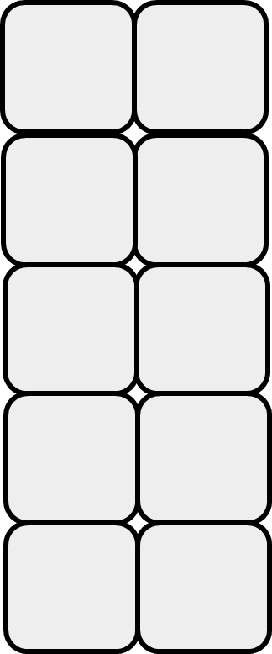
Notes:
Hidden slide. Print off and use as baseboard for game described on slide 10.

Slide 12
Learning Together in Y1

Slide 13


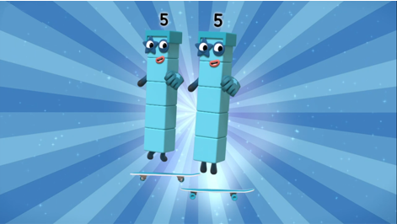




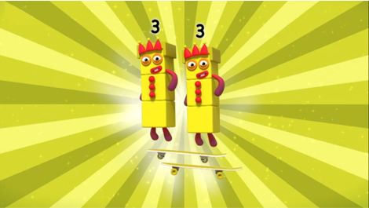

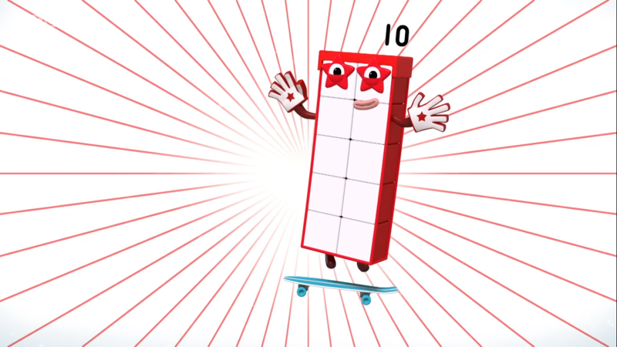
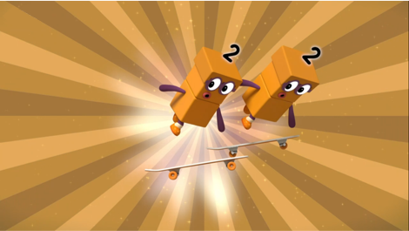


__ is double __
__ is double __
__ is double __
Images © 2017 Alphablocks Ltd. All Rights Reserved.
Notes:
Use this slide to practise the language and stem sentences for doubles.
Clicking on the picture on the left reveals an arrow to the matching picture. Clicking reveals speech bubbles with missing numbers.
Discuss:
Which double makes Six? (Double 3 makes 6.)
Can you check/show on your fingers that double 3 makes 6?
Say the stem sentence together: 6 is double 3.
(Repeat with 4 and 10.)

Slide 14


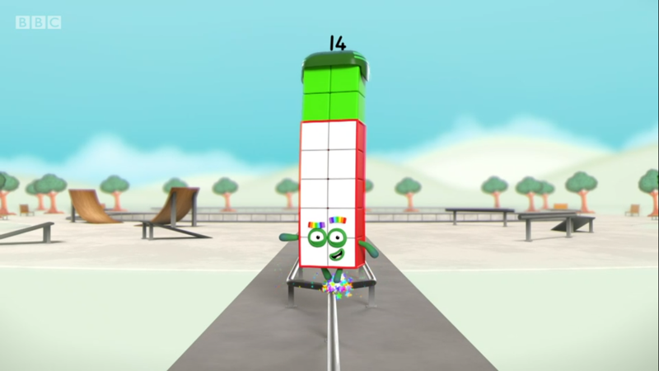
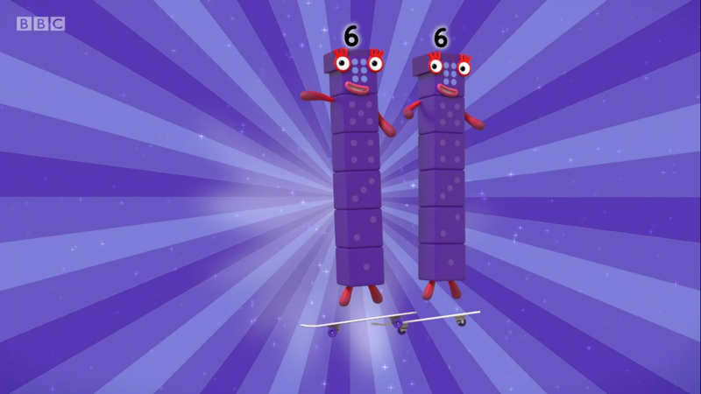
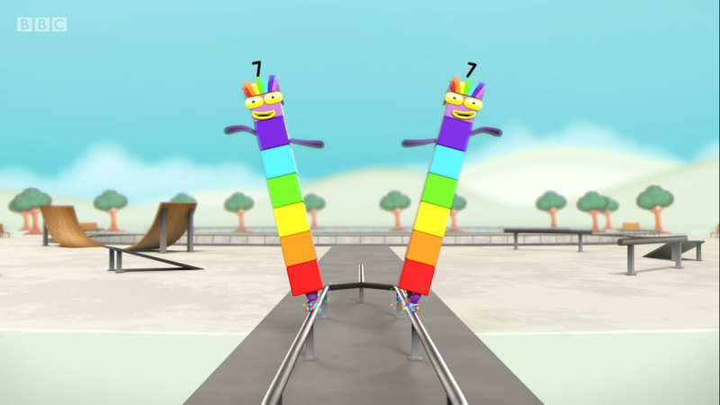
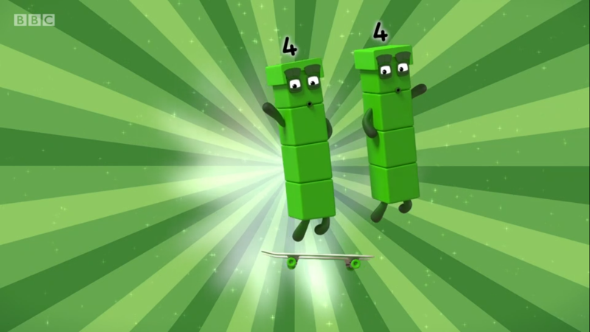
Images © 2017 Alphablocks Ltd. All Rights Reserved.
Notes:
Use this slide to find matching pairs using the coloured stars to identify a pair of cards to turn over.
Click on a card (not the star) to flip it over. Click on them again to turn them back over.
Use this as an opportunity to rehearse the stem sentences for doubles.

Slide 15
Further activities for Y1
Play a matching-pairs game.
Play bingo with images of even quantities to 10 on baseboards. Call out a number to 5. Cross off or cover the number that is double the number called.
Use a mirror and counters to explore doubles.
Draw pictures to represent doubling (the same quantity in 2 sets).
Complete missing information sentence. “ __ is double __” and “double __ is __ ”
Represent doubles to 10 with fingers on each hand.

Slide 16
Learning Together in Y2

Slide 17
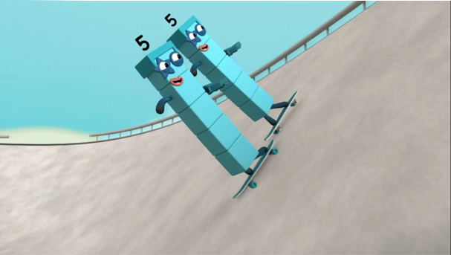
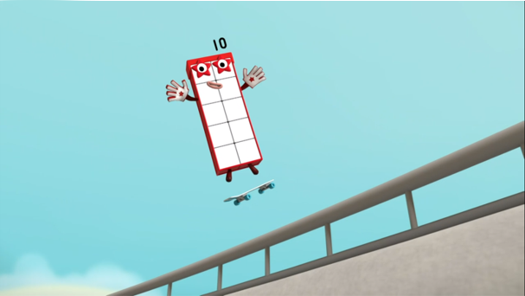


Double ___ makes ____
Images © 2017 Alphablocks Ltd. All Rights Reserved.
Notes:
Use these next 3 slides to practise recalling doubles quickly.
Can you say the double before the Numberblock appears?
What equations could we write to represent this double?

Slide 18
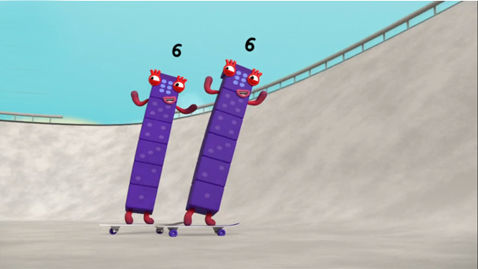
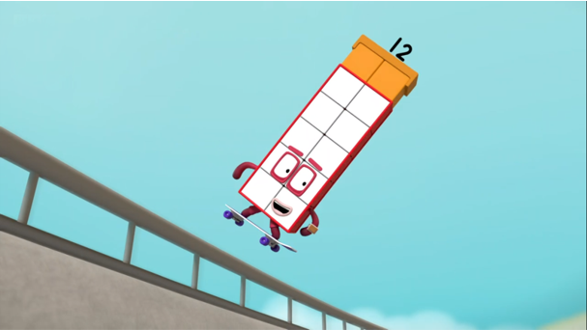

Double ___ makes ____
Images © 2017 Alphablocks Ltd. All Rights Reserved.
Notes:
Can you say the double before the Numberblock appears?
What equations could we write to represent this double?

Slide 19
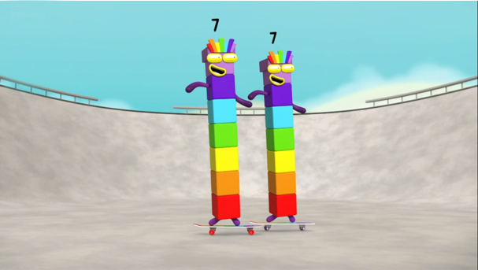
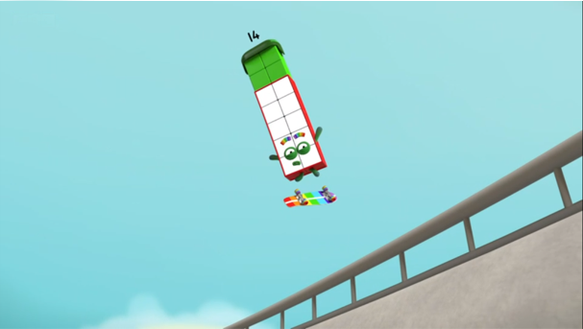

Double ___ makes ____
Images © 2017 Alphablocks Ltd. All Rights Reserved.
Notes:
Can you say the double before the Numberblock appears?
What equations could we write to represent this double?

Slide 20

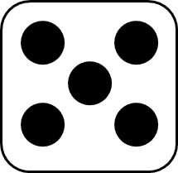

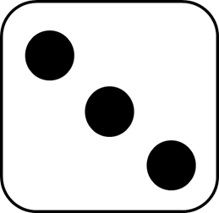
Doubling Dice!
roll the die!
double it!
Images © 2017 Alphablocks Ltd. All Rights Reserved.
Notes:
Use this slide to introduce and play this Doubling Dice game.
Each number rolled is doubled and added to the previous number until the correct number is rolled to make 20.

Slide 21
Further activities for Y2
Play the game Doubling Dice in pairs.
Adapt the game by choosing any even target number between 10 and 20.
Work out what dice rolls are needed to get from the 0 to 20 in 3 rolls: when 2 dice rolls are given, or when one dice roll is given.
Investigate different ways to get to 20 with doubling dice in any number of steps.
Continue to show doubles using fingers. For doubles past ‘double 5’, ask children to work in pairs to show the doubles. Encourage them to put their hands together as if in a mirror so that they can see that double 6 is made of double 5 and double 1 combined; double 7 is made of double 5 and double 2 combined, etc.

