Slide 1
1.23 Composition and calculation: tenths
Representations | Year 4
Number, Addition and Subtraction

Slide 2
How to use this presentation
You can find the teacher guide 1.23 Composition and calculation: tenths by following the link below.

Slide 3
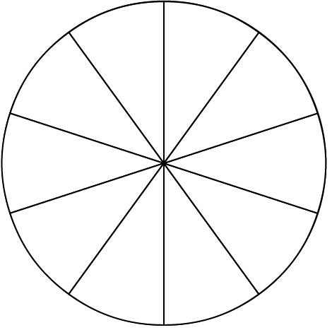
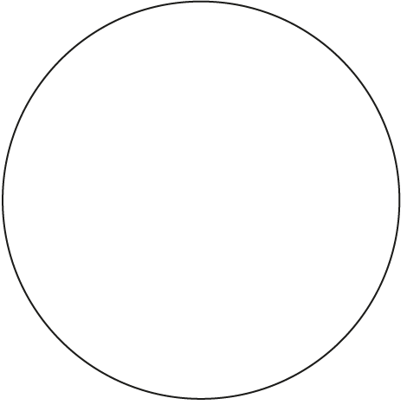
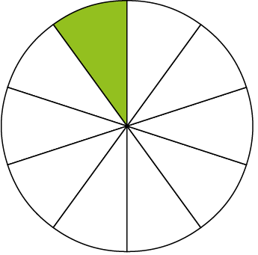
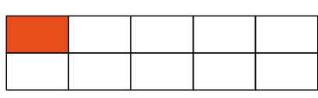
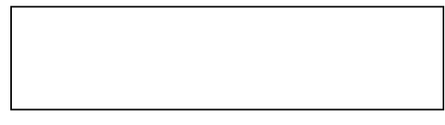
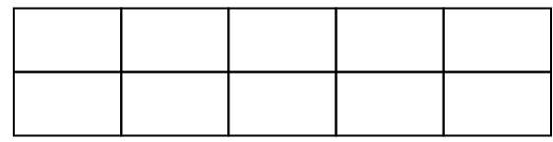
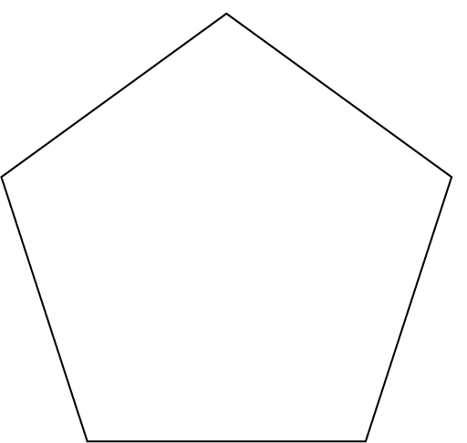
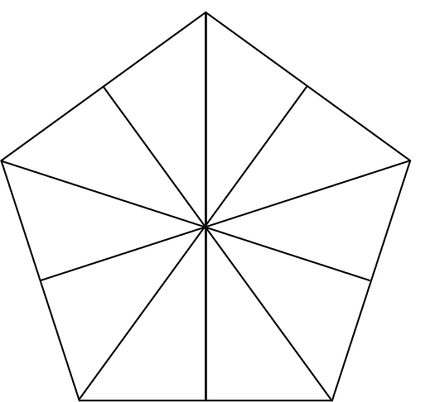
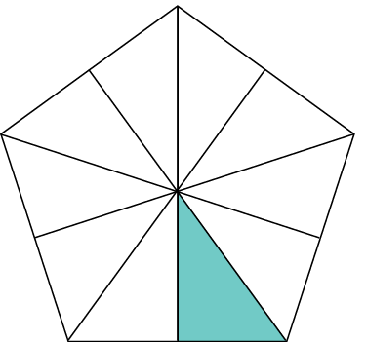

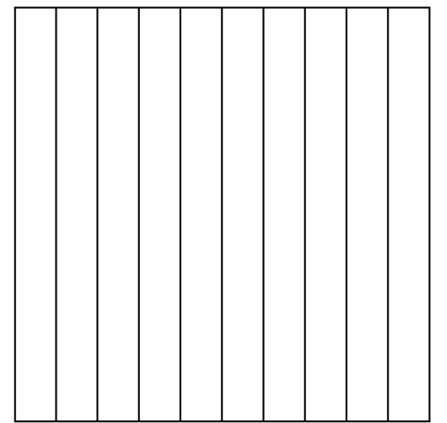
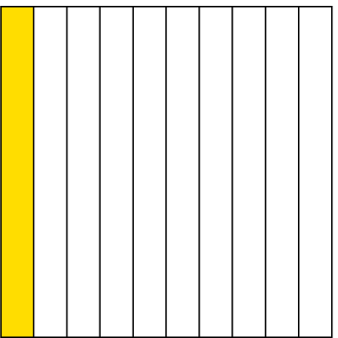
1.23 Tenths – step 1:1

Slide 4
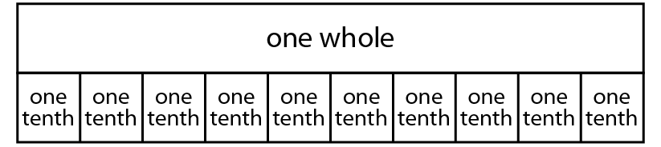
1.23 Tenths – step 1:1
one
tenth

Slide 5


1.23 Tenths – step 1:2

Slide 6

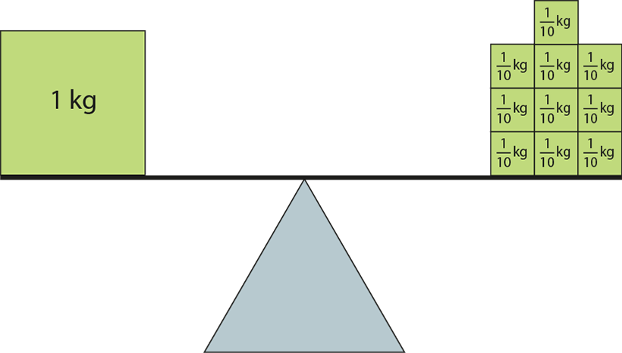
1.23 Tenths – step 1:2

Slide 7
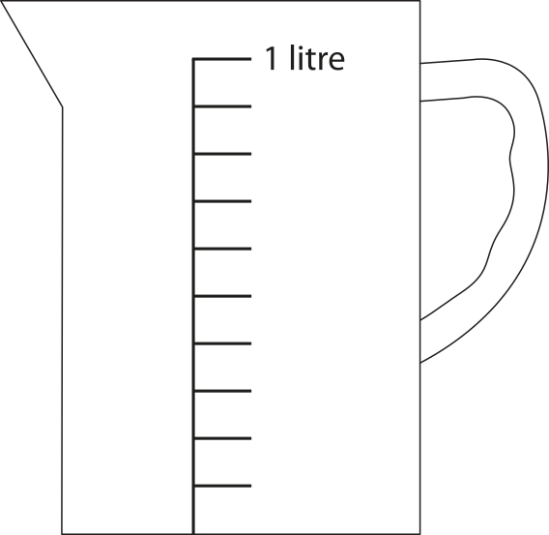



1.23 Tenths – step 1:3
four tenths
seven tenths
three tenths

Slide 8


1.23 Tenths – step 2:1
1,000s | 100s | 10s | 1s
ten times
smaller
one tenth
the size
ten times
smaller
one tenth
the size
ten times
smaller
one tenth
the size

Slide 9
1.23 Tenths – step 2:1
1,000s | 100s | 10s | 1s
1
1
1
1
1
1
1
ten times
smaller
one tenth
the size
ten times
smaller
one tenth
the size
ten times
smaller
one tenth
the size

Slide 10
1.23 Tenths – step 2:2
1,000s | 100s | 10s | 1s | tenths
1
0
0
0
•
0
1
0
0
•
0
1
0
•
0
1
•
0
0
•
1

Slide 11
1.23 Tenths – step 2:3
1,000s | 100s | 10s | 1s | 0.1s
1,000s | 100s | 10s | 1s | 0.1s
 |  |  |  | 3
 |  |  |  | 3
•
 |  |  | 0 | 3
•

Slide 12
1.23 Tenths – step 2:4
1,000s | 100s | 10s | 1s | 0.1s

Slide 13
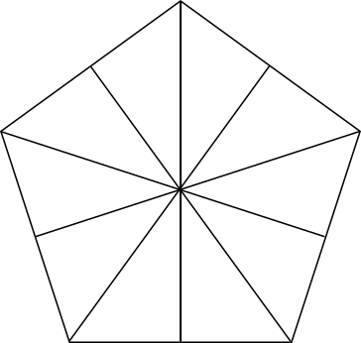
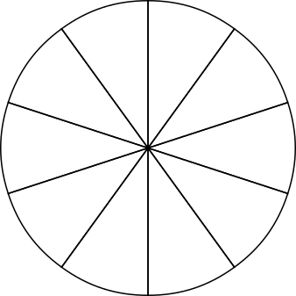


1.23 Tenths – step 2:4
0.4
0.7

Slide 14
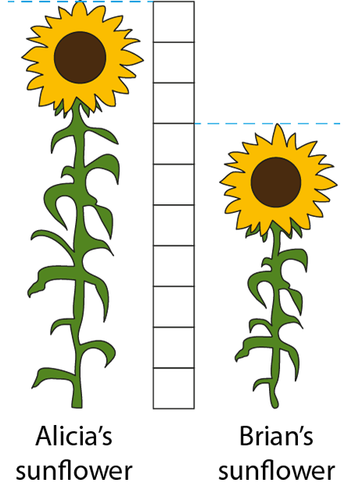
1.23 Tenths – step 2:4

Slide 15
1.23 Tenths – step 3:1
ten tenths
one
1.0
nine tenths
zero-point-nine
0.9
eight tenths
zero-point-eight
0.8
seven tenths
zero-point-seven
0.7
six tenths
zero-point-six
0.6
five tenths
zero-point-five
0.5
four tenths
zero-point-four
0.4
three tenths
zero-point-three
0.3
two tenths
zero-point-two
0.2
one tenth
zero-point-one
0.1

Slide 16


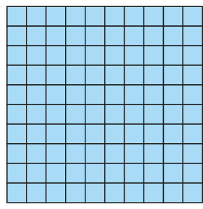
1.23 Tenths – step 3:2
0.1
0.2
0.3
0.4
0.5
0.6
0.7
0.8
0.9
1

Slide 17
1.23 Tenths – step 3:2
0
0.1
0.2
0.3
0.4
0.5
0.6
0.7
0.8
0.9
1
0.0
1.0

Slide 18
1.23 Tenths – step 3:2
100.0 | 200.0 | 300.0 | 400.0 | 500.0 | 600.0 | 700.0 | 800.0 | 900.0
10.0 | 20.0 | 30.0 | 40.0 | 50.0 | 60.0 | 70.0 | 80.0 | 90.0
1.0 | 2.0 | 3.0 | 4.0 | 5.0 | 6.0 | 7.0 | 8.0 | 9.0
0.1 | 0.2 | 0.3 | 0.4 | 0.5 | 0.6 | 0.7 | 0.8 | 0.9

Slide 19
1.23 Tenths – step 3:3

Slide 20
1.23 Tenths – step 3:3

Slide 21
1.23 Tenths – step 3:4
1,000s | 100s | 10s | 1s | 0.1s
1
7
1.7

Slide 22
1.23 Tenths – step 3:7
1,000s | 100s | 10s | 1s | 0.1s
4
2
2
0
5
3
1
7
7
4251.7
203.7
This is two hundred and three and seven tenths.
We can also say two hundred and three-point-seven.
This is four thousand two hundred and fifty-one
and seven tenths. We can also say four thousand
two hundred and fifty-one-point-seven.

Slide 23
1.23 Tenths – step 3:9
1,000s | 100s | 10s | 1s | 0.1s
30.2

Slide 24

1.23 Tenths – step 3:9
1.6 litres
Autumn 2018 pilot

Slide 25
1.23 Tenths – step 3:9
 | 0.3
 | 1.0
 | 1,056.9
3
10
7
0.7
10
10
10
4
302
302.4
10
9
1,056
10

Slide 26
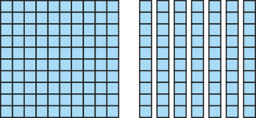
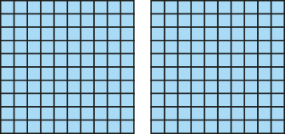
1.23 Tenths – step 3:12
1.7
<
2
100s | 10s | 1s | 0.1s
1
7
2

Slide 27
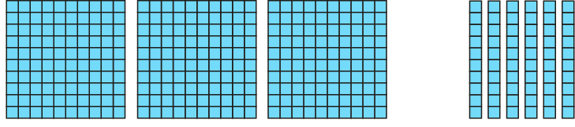
1.23 Tenths – step 4:1
3.6 =
3
+
0.6
6
3.6 =
3
+
10
3.6
3.6 = 3 + 0.6
3.6 − 3 = 0.6
3.6 = 0.6 + 3
3.6 − 0.6 = 3
3
0.6

Slide 28


1.23 Tenths – step 4:2
+ 0.6
0
1
2
3
3.6
4
5

Slide 29
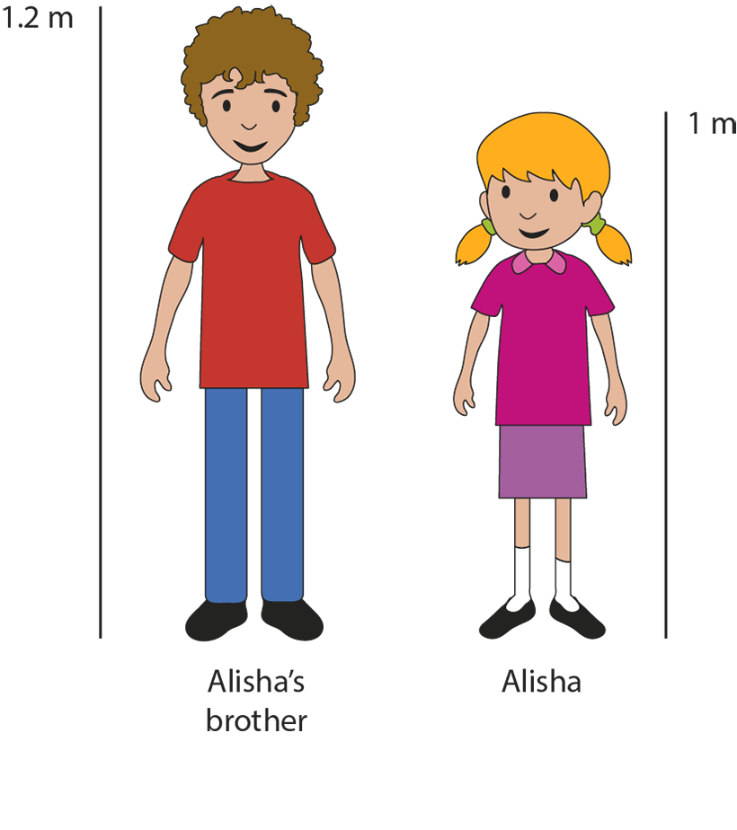
1.23 Tenths – step 4:2
1.2 − 1 = 0.2
Notes:
How much shorter is Alisha than her brother?

Slide 30






1.23 Tenths – step 4:4

Slide 31
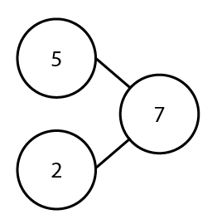
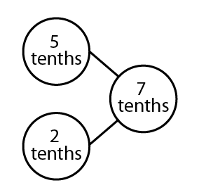
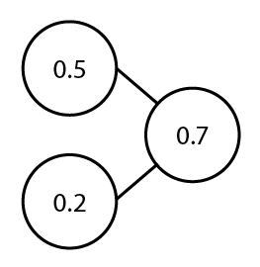
1.23 Tenths – step 5:1
Five tenths plus two tenths is equal to seven tenths.
Seven tenths minus two tenths is equal to five tenths.
0.5 + 0.2 = 0.7
0.7 − 0.2 = 0.5

Slide 32
1.23 Tenths – step 5:1
0.5
+
0.2
=
0.7

Slide 33
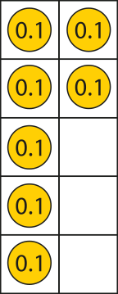
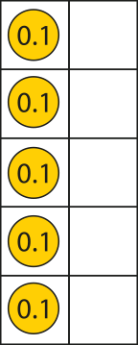

1.23 Tenths – step 5:1
0.7
−
0.2
=
0.5

Slide 34
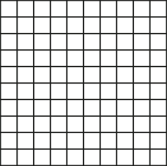
1.23 Tenths – step 5:2
0.1 + 0.9 = 1
0.2 + 0.8 = 1
0.3 + 0.7 = 1
0.4 + 0.6 = 1
0.5 + 0.5 = 1
0.6 + 0.4 = 1
0.7 + 0.3 = 1
0.9 + 0.1 = 1
0.8 + 0.2 = 1

Slide 35
1.23 Tenths – step 5:2
0.6
+
0.4
=
1
Six tenths plus four tenths is equal to ten tenths,
which is equal to one.

Slide 36
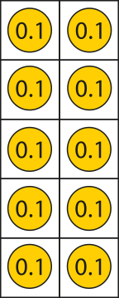
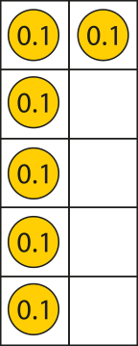
1.23 Tenths – step 5:2
1.0
−
0.4
=
0.6
One is equal to ten tenths;
ten tenths minus four tenths is equal to six tenths.

Slide 37
1.23 Tenths – step 5:3
0.6
+
0.7
=
1.3
Six tenths plus seven tenths is equal to thirteen tenths,
which is equal to one-point-three.

Slide 38



1.23 Tenths – step 5:3
− 0.4
− 0.3
0.0
0.1
0.2
0.3
0.4
0.5
0.6
0.7
0.8
0.9
1.0
1.1
1.2
1.3
0
1
− 0.7
1.3 − 0.7
= 0.6

Slide 39
1.23 Tenths – step 5:4
45
+
32
=
77
75
30
2
4.5
+
3.2
=
7.7
3
0.2
7.5

Slide 40


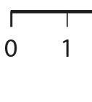
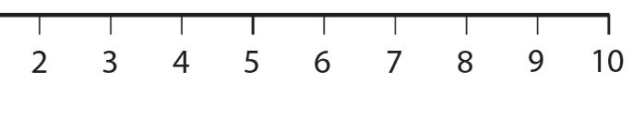

1.23 Tenths – step 6:1
0
1

Slide 41



1.23 Tenths – step 6:2
For each letter on the number line, say which two whole numbers the value is between.
1
a
2
2
b
3
4
c
5

Slide 42


1.23 Tenths – step 6:3

Slide 43


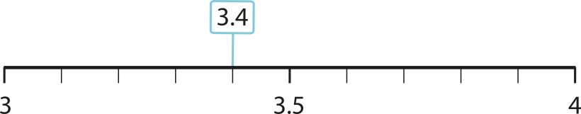
1.23 Tenths – step 6:4
Which whole number is 3.4 closest to?
3 + 0.4 = 3.4
4 – 0.6 = 3.4

