Slide 1
1.13 Addition and subtraction: two-digit and single-digit numbers
Representations | Year 2
Number, Addition and Subtraction

Slide 2
How to use this presentation
You can find the teacher guide 1.13 Addition and subtraction: two-digit and single-digit numbers by following the link below.

Slide 3
1.13 Calculation: two-digit +/− single-digit – step 1:1
one more
one less

Slide 4
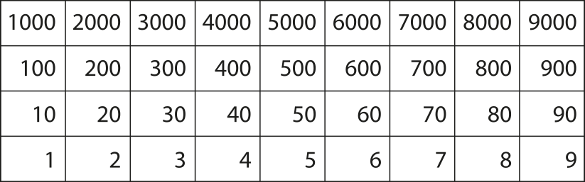
1.13 Calculation: two-digit +/− single-digit – step 1:1

Slide 5
1.13 Calculation: two-digit +/− single-digit – step 1:2

Slide 6
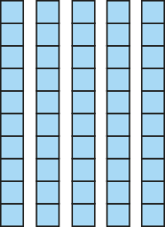

1.13 Calculation: two-digit +/− single-digit – step 1:2
10s | 1s
5
3
4
53 + 1 = 54
54 – 1 = 53

Slide 7
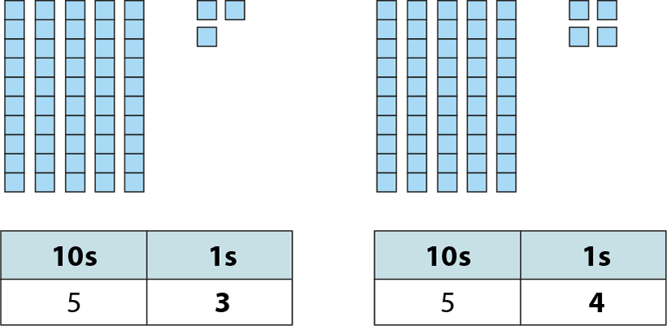
1.13 Calculation: two-digit +/− single-digit – step 1:2

Slide 8
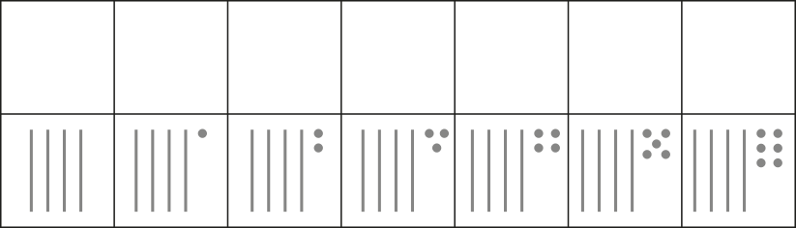
1.13 Calculation: two-digit +/− single-digit – step 1:3
40
41
42
43
44
45
46

Slide 9
1.13 Calculation: two-digit +/− single-digit – step 1:4
1
35
34
?

Slide 10

1.13 Calculation: two-digit +/− single-digit – step 1:5
39

Slide 11
1.13 Calculation: two-digit +/− single-digit – step 1:6
+1
– 1

Slide 12

1.13 Calculation: two-digit +/− single-digit – step 1:6

Slide 13
1.13 Calculation: two-digit +/− single-digit – step 1:6
19
+
1
=
20

Slide 14
1.13 Calculation: two-digit +/− single-digit – step 1:6
20
–
1
=
19

Slide 15
1.13 Calculation: two-digit +/− single-digit – step 1:6
20
19
1

Slide 16

1.13 Calculation: two-digit +/− single-digit – step 1:7
+1
+1
+1
+1

Slide 17
1.13 Calculation: two-digit +/− single-digit – step 1:7
+1
+1
+1
+1

Slide 18
1.13 Calculation: two-digit +/− single-digit – step 1:7
+1
+1
+1

Slide 19
1.13 Calculation: two-digit +/− single-digit – step 1:7
+1
–1
+1
–1
+1
–1
+1
–1

Slide 20
1.13 Calculation: two-digit +/− single-digit – step 1:7
+1
–1
+1
–1
+1
–1
+1
–1

Slide 21
1.13 Calculation: two-digit +/− single-digit – step 1:7
+1
–1
+1
–1
+1
–1

Slide 22
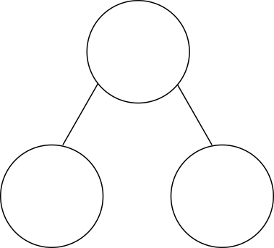
1.13 Calculation: two-digit +/− single-digit – step 2:1
3
+
6
=
9

Slide 23

1.13 Calculation: two-digit +/− single-digit – step 2:1
23
+
6
=
29

Slide 24

1.13 Calculation: two-digit +/− single-digit – step 2:1
3
+
6
=
9
2
3
+
6
=
2
9

Slide 25

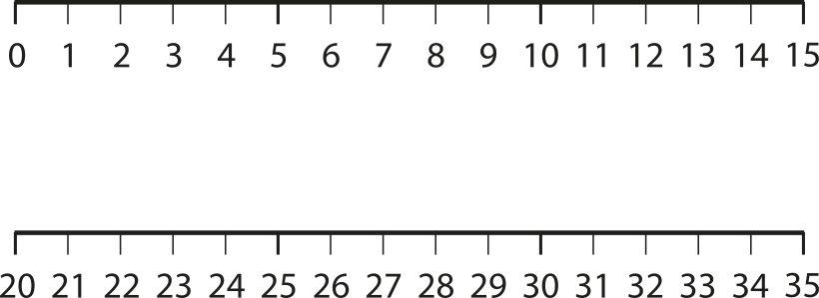
1.13 Calculation: two-digit +/− single-digit – step 2:1
+6
+6

Slide 26





1.13 Calculation: two-digit +/− single-digit – step 2:2
+3
4 + 3 =
7
+3
14 + 3 =
17
+3
24 + 3 =
27
+3
34 + 3 =
37

Slide 27



1.13 Calculation: two-digit +/− single-digit – step 2:2
+3
4 + 3 =
7
+3
44 + 3 =
47
+3
54 + 3 =
57
+3
64 + 3 =
67

Slide 28



1.13 Calculation: two-digit +/− single-digit – step 2:2
+3
4 + 3 =
7
+3
74 + 3 =
77
+3
84 + 3 =
87
+3
94 + 3 =
97

Slide 29
1.13 Calculation: two-digit +/− single-digit – step 2:3
1
2
3
4 + 3 = 7
1
2
3

Slide 30
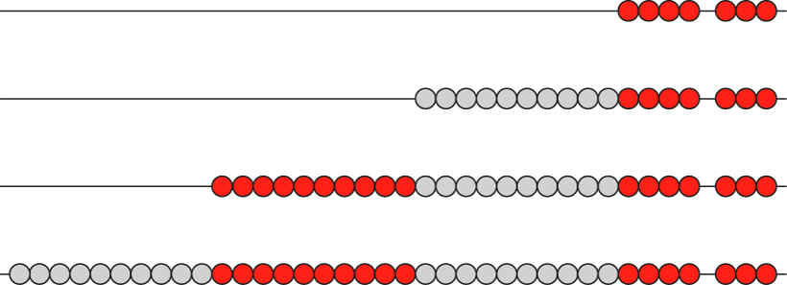
1.13 Calculation: two-digit +/− single-digit – step 2:3

Slide 31
1.13 Calculation: two-digit +/− single-digit – step 2:4
–3
9 – 3 =
6
–3
19 – 3 =
16
–3
29 – 3 =
26
–3
39 – 3 =
36

Slide 32
1.13 Calculation: two-digit +/− single-digit – step 2:4
–3
9 – 3 =
6
–3
49 – 3 =
46
–3
59 – 3 =
56
–3
69 – 3 =
66

Slide 33
1.13 Calculation: two-digit +/− single-digit – step 2:4
–3
9 – 3 =
6
–3
79 – 3 =
76
–3
89 – 3 =
86
–3
99 – 3 =
96

Slide 34
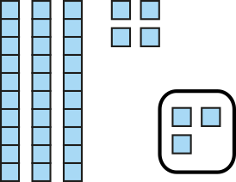
1.13 Calculation: two-digit +/− single-digit – step 2:5
34
44
54
47
37
57
3

Slide 35
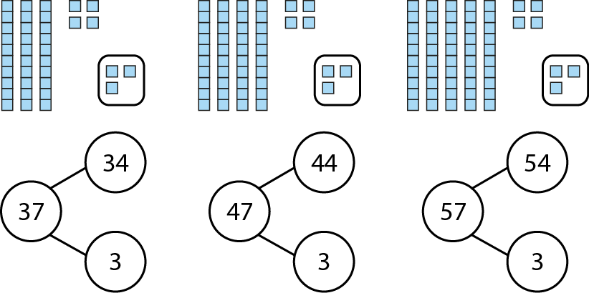
1.13 Calculation: two-digit +/− single-digit – step 2:5

Slide 36
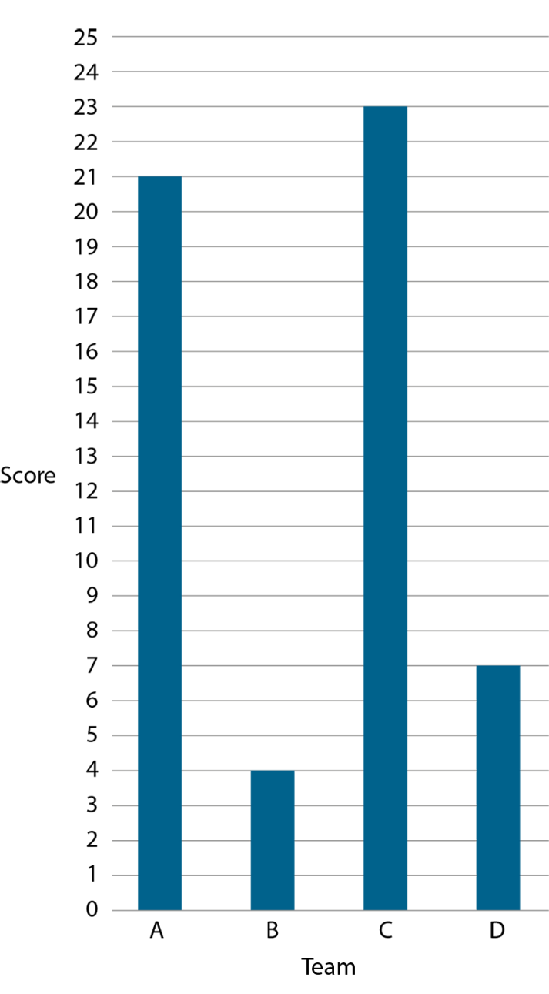
1.13 Calculation: two-digit +/− single-digit – step 2:7
Notes:
What is the total of Team A and Team D’s scores? Which addition fact can help us answer this? Why?
What is the difference between Team B and Team C’s scores? Which addition fact can help us answer this? Why?

Slide 37


1.13 Calculation: two-digit +/− single-digit – step 3:1
1
2
6
+
4
=
2
3
1
0

Slide 38
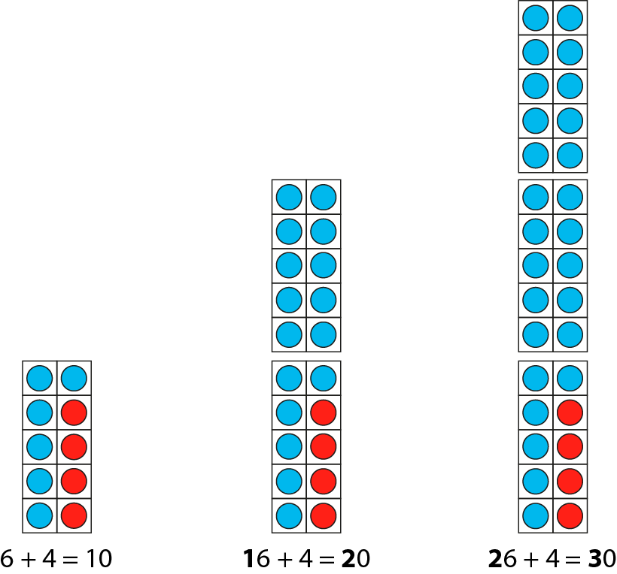
1.13 Calculation: two-digit +/− single-digit – step 3:1

Slide 39
1.13 Calculation: two-digit +/− single-digit – step 3:1
2
1
3
0
1
2
6
4

Slide 40
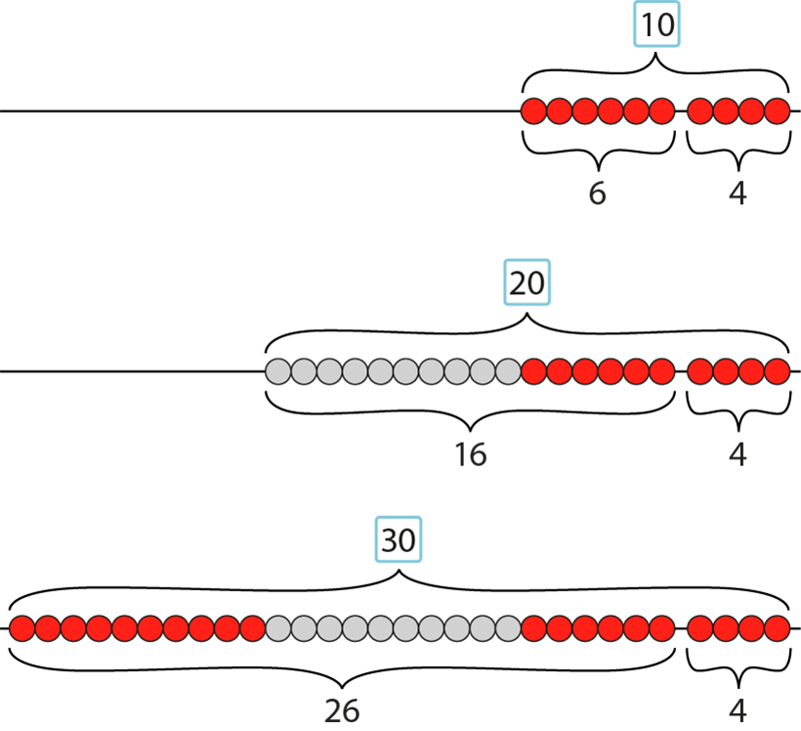
1.13 Calculation: two-digit +/− single-digit – step 3:1

Slide 41
1.13 Calculation: two-digit +/− single-digit – step 3:2
+3
+3
+3
+3
+3
+3
+3
+3
+3
17
20
27
30
37
40
47
50
57
60
67
70
77
80
87
90
97
100

Slide 42
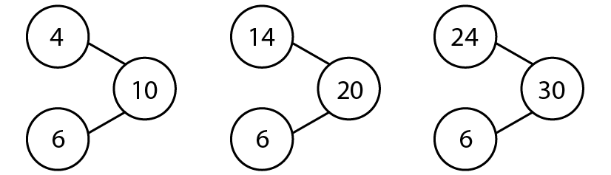
1.13 Calculation: two-digit +/− single-digit – step 3:3

Slide 43
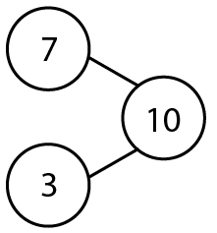
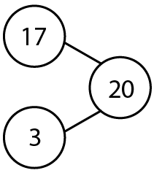
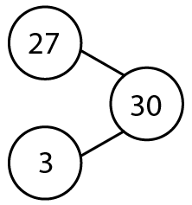
1.13 Calculation: two-digit +/− single-digit – step 3:4

Slide 44



1.13 Calculation: two-digit +/− single-digit – step 3:4
3
2
2
1
10
7
0
– 3
=
7

Slide 45
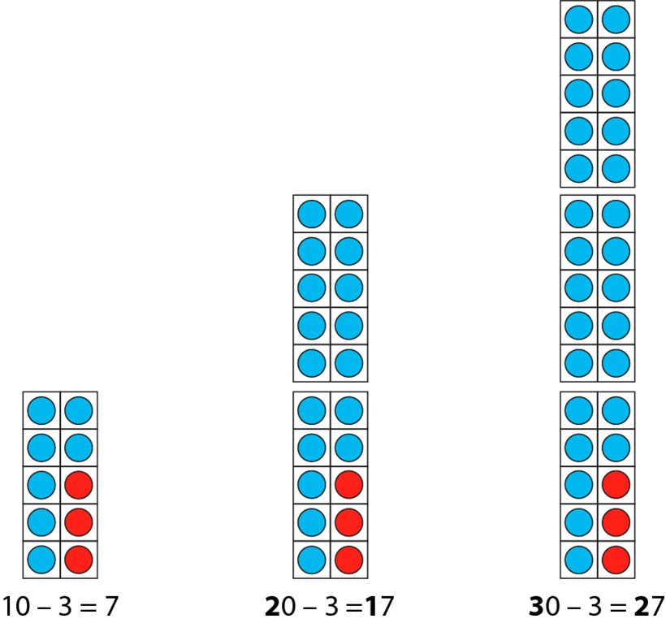
1.13 Calculation: two-digit +/− single-digit – step 3:4

Slide 46
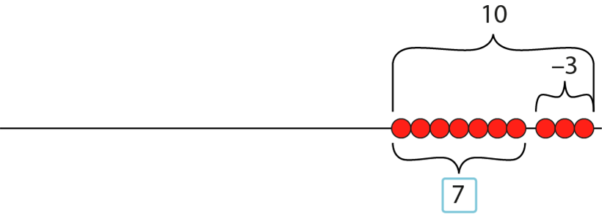
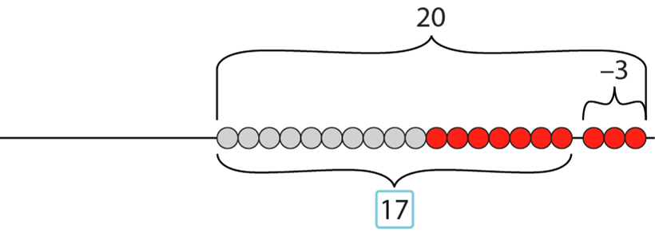
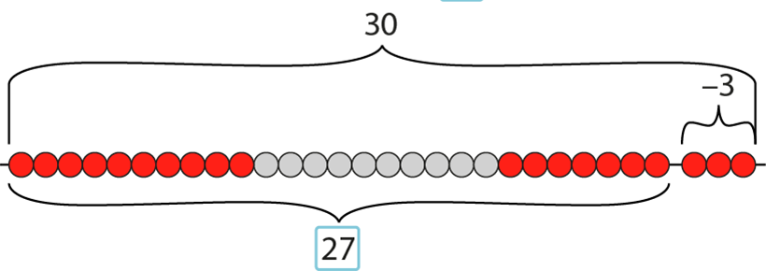
1.13 Calculation: two-digit +/− single-digit – step 3:4

Slide 47
1.13 Calculation: two-digit +/− single-digit – step 3:5
– 3
– 3
– 3
– 3
– 3
– 3
– 3
– 3
–3
17
20
27
30
37
40
47
50
57
60
67
70
77
80
87
90
97
100

Slide 48
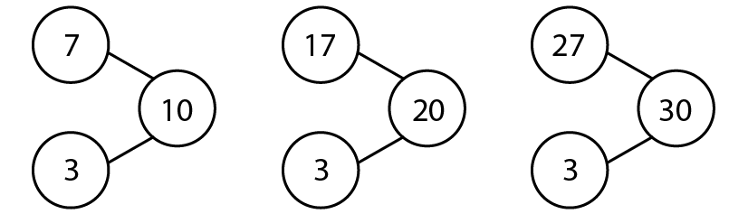
1.13 Calculation: two-digit +/− single-digit – step 3:6

Slide 49

1.13 Calculation: two-digit +/− single-digit – step 4:1
8 + 3 =
11
2
1

Slide 50

1.13 Calculation: two-digit +/− single-digit – step 4:1
3 + 8 =
11
7
1

Slide 51


1.13 Calculation: two-digit +/− single-digit – step 4:1
8
+ 3
=
11
2
1
+2
+1
8
10
11
+3

Slide 52


1.13 Calculation: two-digit +/− single-digit – step 4:1
3
+ 8
=
11
7
1
+7
+1
3
10
11
+8

Slide 53
1.13 Calculation: two-digit +/− single-digit – step 4:1
11
– 3
=
8
1
2
–2
–1
8
10
11
–3

Slide 54
1.13 Calculation: two-digit +/− single-digit – step 4:1
11
– 8
=
3
1
7
–7
–1
3
10
11
–8

Slide 55

1.13 Calculation: two-digit +/− single-digit – step 4:2
8
+ 3
=
11
2
1
8 + 3 = 8 + 2 +1
= 10 + 1
= 11

Slide 56

1.13 Calculation: two-digit +/− single-digit – step 4:2
18
+ 3
=
21
2
1
18 + 3 = 18 + 2 + 1
= 20 + 1
= 21

Slide 57
1.13 Calculation: two-digit +/− single-digit – step 4:2
28
+ 3
=
31
2
1
28 + 3 = 28 + 2 + 1
= 30 + 1
= 31

Slide 58



1.13 Calculation: two-digit +/− single-digit – step 4:3
+2
+1
+3
+2
+1
+3
+2
+1
+3
+2
+1
+3

Slide 59
1.13 Calculation: two-digit +/− single-digit – step 4:3
+2
+1
+3
+2
+1
+3
+2
+1
+3
+2
+1
+3

Slide 60
1.13 Calculation: two-digit +/− single-digit – step 4:3
+2
+1
+3
+2
+1
+3
+2
+1
+3

Slide 61
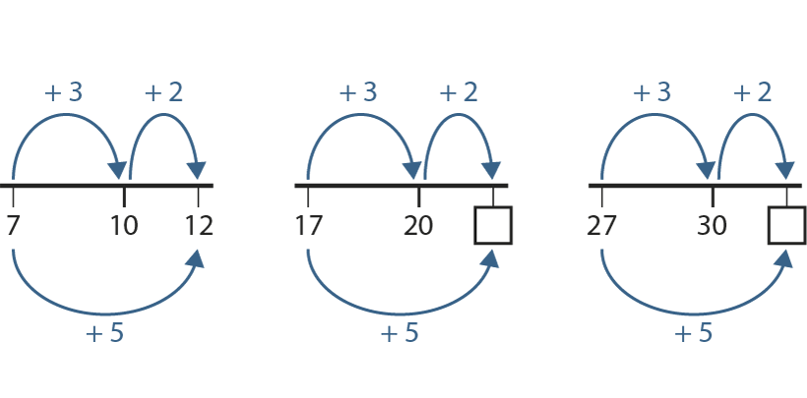
1.13 Calculation: two-digit +/− single-digit – step 4:4
22
32

Slide 62
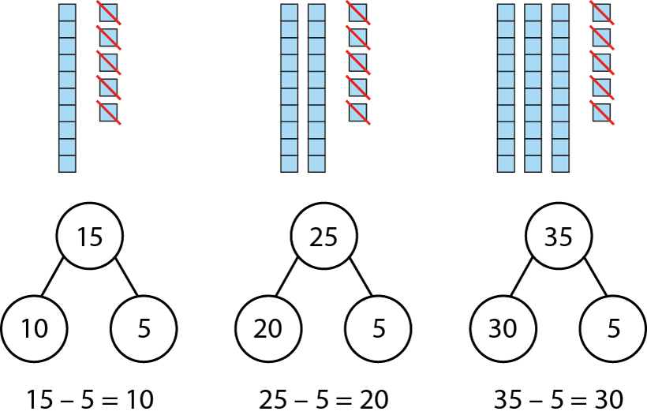
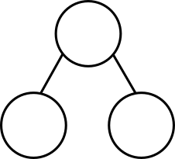
1.13 Calculation: two-digit +/− single-digit – step 4:5
1
2
3
5
0
1
2
3
5
1
2
3
5
– 5
=
1
2
3
0

Slide 63
1.13 Calculation: two-digit +/− single-digit – step 4:6
11
– 3
=
8
1
2
11 – 3 = 11 – 1 – 2
= 10 – 2
= 8

Slide 64
1.13 Calculation: two-digit +/− single-digit – step 4:6
21
– 3
=
18
1
2
21 – 3 = 21 – 1 – 2
= 20 – 2
= 18

Slide 65
1.13 Calculation: two-digit +/− single-digit – step 4:6
31
– 3
=
28
1
2
31 – 3 = 31 – 1 – 2
= 30 – 2
= 28

Slide 66
1.13 Calculation: two-digit +/− single-digit – step 4:7
–2
–1
–3
–2
–1
–3
–2
–1
–3
–2
–1
–3

Slide 67
1.13 Calculation: two-digit +/− single-digit – step 4:7
–2
–1
–3
–2
–1
–3
–2
–1
–3
–2
–1
–3

Slide 68
1.13 Calculation: two-digit +/− single-digit – step 4:7
–2
–1
–3
–2
–1
–3
–2
–1
–3

Slide 69
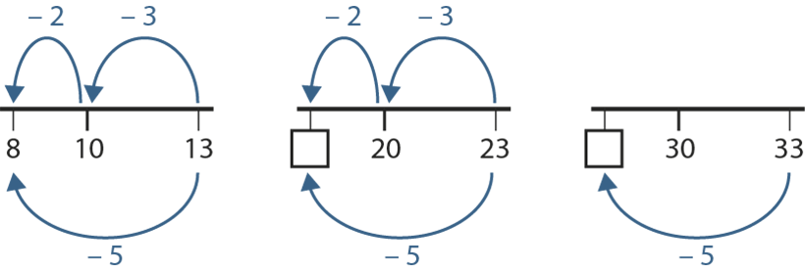
1.13 Calculation: two-digit +/− single-digit – step 4:8
18
28

Slide 70
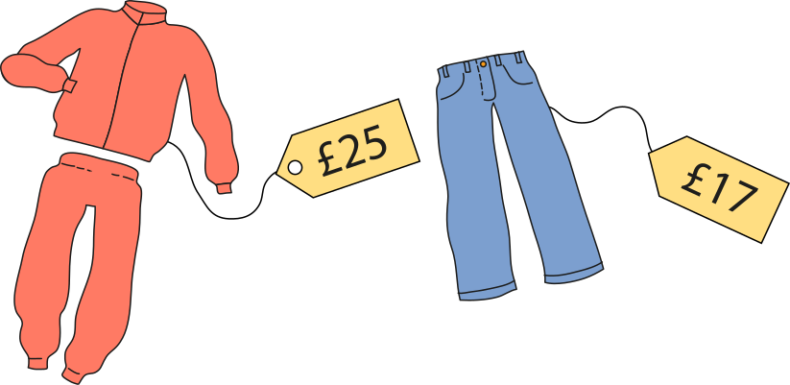

1.13 Calculation: two-digit +/− single-digit – step 4:9

