Slide 1
2.15 Division: partitioning leading to short division
Representations | Year 4
Multiplication and Division

Slide 2
How to use this presentation
You can find the teacher guide 2.15 Division: partitioning leading to short division by following the link below.

Slide 3
2.15 Short division Step 1:1
8 sticks shared equally between 4 children.
How many sticks each?
4
4
4
4
8 ÷ 4 =
2
Notes:
One four is one each. That’s four.
Two fours is two each. That’s eight.
Eight divided between four is equal to two each.
So, each child gets two sticks.

Slide 4
2.15 Short division Step 1:2
84 sticks shared equally between 4 children. How many sticks each?
84 ÷ 4 =
8 tens ÷ 4 = 2 tens
Notes:
Four tens are one ten each. That’s forty.
Eight tens are two tens each. That’s eighty.
Eight tens divided between four is equal to two tens each.

Slide 5
2.15 Short division Step 1:2
84 sticks shared equally between 4 children. How many sticks each?
84 ÷ 4 =
8 tens ÷ 4 = 2 tens
4 ones ÷ 4 = 1 one
Notes:
Four ones is one each. That’s four.
Four ones divided by four is equal to one one each.

Slide 6
2.15 Short division Step 1:2
84 sticks shared equally between 4 children. How many sticks each?
84 ÷ 4 =
21
8 tens ÷ 4 = 2 tens
4 ones ÷ 4 = 1 one
84 ÷ 4 = 21
Notes:
Eight tens and four ones divided between four is equal to two tens and one one.
Each child gets twenty-one sticks.

Slide 7
2.15 Short division Step 1:3
72 sticks shared equally between 3 children. How many sticks each?
72 ÷ 3 =
7 tens ÷ 3 = 2 tens r 1 ten
Notes:
Three tens are one ten each. That’s thirty.
Six tens are two tens each. That’s sixty.
There is one ten left over.
Seven tens divided between three is equal to two tens each, with a
remainder of one ten.

Slide 8
2.15 Short division Step 1:3
72 sticks shared equally between 3 children. How many sticks each?
72 ÷ 3 =
7 tens ÷ 3 = 2 tens r 1 ten
12 ones ÷ 3 = 4 ones
Notes:
One ten is equal to ten ones.
So, one ten and two ones is equal to twelve ones.
Three ones are one each. That’s three.
Six ones are two each. That’s six.
Nine ones are three each. That’s nine.
Twelve ones are four each. That’s twelve.
Twelve ones divided between three is equal to four ones each.

Slide 9
2.15 Short division Step 1:3
72 sticks shared equally between 3 children. How many sticks each?
72 ÷ 3 =
24
7 tens ÷ 3 = 2 tens r 1 ten
12 ones ÷ 3 = 4 ones
Notes:
Each child gets twenty-four sticks.

Slide 10
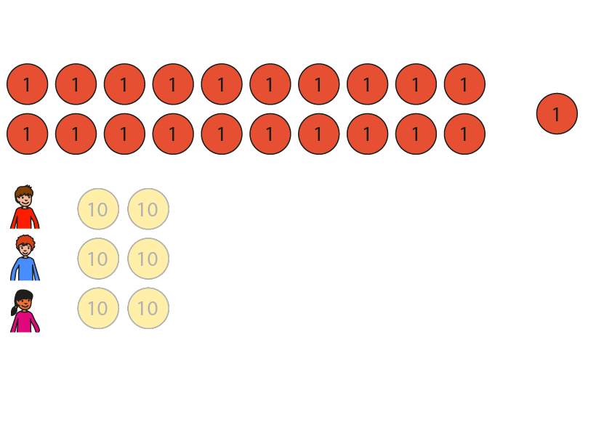
2.15 Short division Step 1:4
81 marbles shared equally between 3 children. How many marbles each?
81 ÷ 3 =
8 tens ÷ 3 = 2 tens r 2 tens
Notes:
Three tens are one ten each. That’s thirty.
Six tens are two tens each. That’s sixty.
There are two tens left over.
Eight tens divided between three is equal to two tens each, with a
remainder of two tens.

Slide 11
2.15 Short division Step 1:4
81 marbles shared equally between 3 children. How many marbles each?
81 ÷ 3 =
8 tens ÷ 3 = 2 tens r 2 tens
21 ones ÷ 3 = 7 ones
Notes:
Two tens and one one is equal to twenty-one ones.
Three ones are one each. That’s three.
Six ones are two each. That’s six…
Twenty-one ones are seven each. That’s twenty-one.
Twenty-one ones divided between three is equal to seven ones each.

Slide 12
2.15 Short division Step 1:4
81 marbles shared equally between 3 children. How many marbles each?
81 ÷ 3 =
27
8 tens ÷ 3 = 2 tens r 2 tens
21 ones ÷ 3 = 7 ones
Notes:
Each child gets twenty-seven marbles.

Slide 13
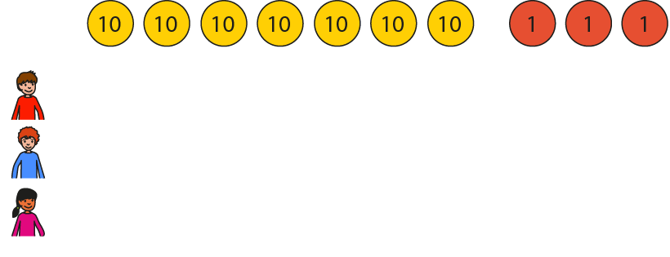
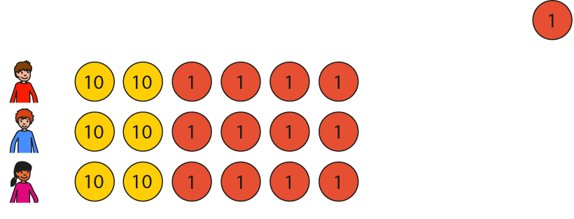
2.15 Short division Step 1:5
73 marbles shared equally between 3 children. How many marbles each?
73 ÷ 3 =
7 tens ÷ 3 = 2 tens r 1 ten
Notes:
Seven tens divided between three is equal to two tens each, with a
remainder of one ten.

Slide 14
2.15 Short division Step 1:5
73 marbles shared equally between 3 children. How many marbles each?
73 ÷ 3 =
7 tens ÷ 3 = 2 tens r 1 ten
13 ones ÷ 3 = 4 ones r 1 one
Notes:
One ten and three ones is equal to thirteen ones.
Thirteen ones divided between three is equal to four ones each, with a
remainder of one one.

Slide 15
2.15 Short division Step 1:5
73 marbles shared equally between 3 children. How many marbles each?
73 ÷ 3 =
24 r 1
7 tens ÷ 3 = 2 tens r 1 ten
13 ones ÷ 3 = 4 ones r 1 one
Notes:
Each child gets twenty-four marbles; there is one marble left over.

Slide 16
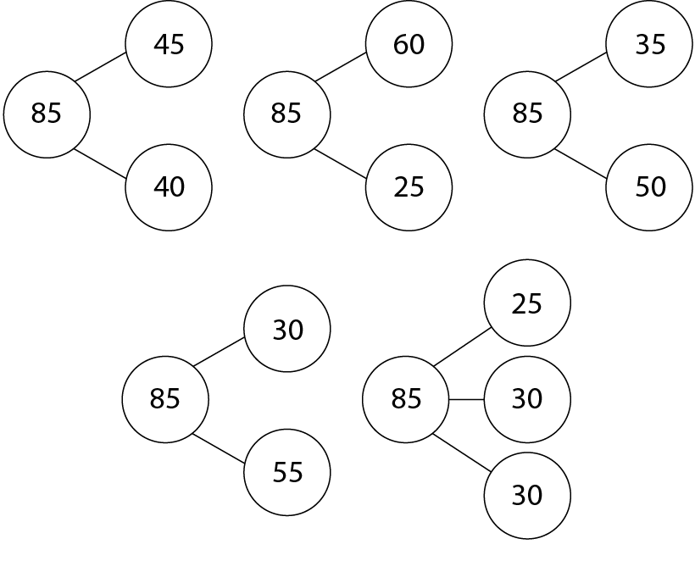
2.15 Short division Step 1:7
Notes:
Decide which way of partitioning the dividend is helpful for the calculation “85 ÷ 6”. Explain why.

Slide 17
2.15 Short division Step 2:1
84 sticks shared equally between 4 children. How many sticks each?
84 ÷ 4 =
Step 1 – write the divisor and dividend:
10s
1s
84 divided by 4.

Slide 18
2.15 Short division Step 2:1
84 sticks shared equally between 4 children. How many sticks each?
84 ÷ 4 =
Step 1 – write the divisor and dividend:
Step 2 – share the 10s:
10s
1s
8 tens ÷ 4 = 2 tens
8 tens divided by 4 is equal to 2 tens.
84 divided by 4.

Slide 19
2.15 Short division Step 2:1
84 sticks shared equally between 4 children. How many sticks each?
84 ÷ 4 =
Step 2 – share the 10s:
Step 3 – share the 1s:
10s
1s
8 tens ÷ 4 = 2 tens
4 ones ÷ 4 = 1 one
4 ones divided by 4 is equal to 1 one.
8 tens divided by 4 is equal to 2 tens.

Slide 20
2.15 Short division Step 2:1
84 sticks shared equally between 4 children. How many sticks each?
84 ÷ 4 =
Step 3 – share the 1s:
Summary
10s
1s
8 tens ÷ 4 = 2 tens
4 ones ÷ 4 = 1 one
4 ones divided by 4 is equal to 1 one.
Each child gets 21 sticks.

Slide 21
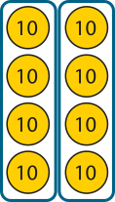
2.15 Short division Step 2:1
84 sticks shared equally between 4 children. How many sticks each?
84 ÷ 4 =
21
Summary
10s
1s
2
2
1
1
4
8
8
4
4
8 tens ÷ 4 = 2 tens
4 ones ÷ 4 = 1 one
Each child gets 21 sticks.
Notes:
Eight tens and four ones divided by four is equal to two tens and one one.
Each child gets twenty-one sticks.

Slide 22
2.15 Short division Step 2:2
84 | ÷ | 4 | = | 21
dividend | ÷ | divisor | = | quotient

Slide 23
2.15 Short division Step 2:5
72 sticks shared equally between 3 children. How many sticks each?
72 ÷ 3 =
Step 1 – write the divisor and the dividend:
3
Notes:
Seventy-two divided by three.

Slide 24
2.15 Short division Step 2:5
72 sticks shared equally between 3 children. How many sticks each?
72 ÷ 3 =
Step 1 – write the divisor and the dividend:
Step 2 – share the 10s:
2
3
7 tens ÷ 3 = 2 tens r 1 ten
Notes:
Write ‘2’ in the tens column…

Slide 25
2.15 Short division Step 2:5
72 sticks shared equally between 3 children. How many sticks each?
72 ÷ 3 =
Step 2 – share the 10s:
Step 3 – exchange:
2
3
7 tens ÷ 3 = 2 tens r 1 ten
Notes:
… and write ‘1’ to the left of the ones digit of the dividend to make twelve ones.

Slide 26
2.15 Short division Step 2:5
72 sticks shared equally between 3 children. How many sticks each?
72 ÷ 3 =
24
Step 4 – share the 1s:
Step 3 – exchange:
2
4
3
7 tens ÷ 3 = 2 tens r 1 ten
12 ones ÷ 3 = 4 ones
Notes:
Write ‘4’ in the ones column.

Slide 27
2.15 Short division Step 2:7
73 sticks shared equally between 3 children. How many sticks each?
73 ÷ 3 =
Step 1 – write the divisor and the dividend:
3
Notes:
Seventy-three divided by three.

Slide 28
2.15 Short division Step 2:7
73 sticks shared equally between 3 children. How many sticks each?
73 ÷ 3 =
Step 1 – write the divisor and the dividend:
Step 2 – share the 10s:
2
3
7 tens ÷ 3 = 2 tens r 1 ten
Notes:
Write ‘2’ in the tens column…

Slide 29
2.15 Short division Step 2:7
73 sticks shared equally between 3 children. How many sticks each?
73 ÷ 3 =
Step 2 – share the 10s:
Step 3 – exchange:
2
3
7 tens ÷ 3 = 2 tens r 1 ten
Notes:
… and write ‘1’ to the left of the ones digit of the dividend to
make thirteen ones.

Slide 30
2.15 Short division Step 2:7
73 sticks shared equally between 3 children. How many sticks each?
73 ÷ 3 =
24 r 1
Step 4 – share the 1s:
Step 3 – exchange:
2
4
r 1
3
7 tens ÷ 3 = 2 tens r 1 ten
13 ones ÷ 3 = 4 ones r 1 one
Notes:
Write ‘4 r1’ in the ones column.

Slide 31
2.15 Short division Step 3:1
848 pencils shared equally between 4 year groups. How many pencils each?
848 ÷ 4 =
Step 1 – presenting the problem:

Slide 32
2.15 Short division Step 3:1
848 pencils shared equally between 4 year groups. How many pencils each?
848 ÷ 4 =
Step 1 – presenting the problem:
Step 2 – sharing the 100s:
8 hundreds ÷ 4 = 2 hundreds
Notes:
Eight hundreds divided between four is equal to two hundreds each.

Slide 33
2.15 Short division Step 3:1
848 pencils shared equally between 4 year groups. How many pencils each?
848 ÷ 4 =
Step 2 – sharing the 100s:
Step 3 – sharing the 10s:
8 hundreds ÷ 4 = 2 hundreds
4 tens ÷ 4 = 1 ten
Notes:
Four tens divided between four is equal to one ten each.

Slide 34
2.15 Short division Step 3:1
848 pencils shared equally between 4 year groups. How many pencils each?
848 ÷ 4 =
Step 4 – sharing the 1s:
Step 3 – sharing the 10s:
8 hundreds ÷ 4 = 2 hundreds
4 tens ÷ 4 = 1 ten
8 ones ÷ 4 = 2 ones
Notes:
Eight ones divided between four is equal to two ones each.

Slide 35
2.15 Short division Step 3:1
848 pencils shared equally between 4 year groups. How many pencils each?
848 ÷ 4 =
212
Step 4 – sharing the 1s:
Step 5 – adding:
8 hundreds ÷ 4 = 2 hundreds
4 tens ÷ 4 = 1 ten
8 ones ÷ 4 = 2 ones
Notes:
Each year group gets two hundred and twelve pencils.

Slide 36
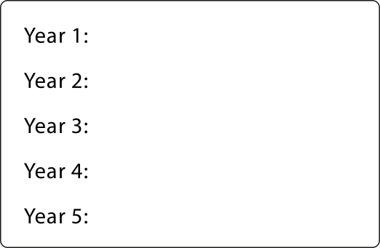
2.15 Short division Step 3:2
705 pencils shared equally between 5 year groups. How many pencils each?
705 ÷ 5 =
Step 1 – presenting the problem:

Slide 37
2.15 Short division Step 3:2
705 pencils shared equally between 5 year groups. How many pencils each?
705 ÷ 5 =
Step 1 – presenting the problem:
Step 2 – sharing the 100s:
7 hundreds ÷ 5 = 1 hundred r 2 hundreds
Notes:
Seven hundreds divided between five is equal to one hundred each,
with a remainder of two hundreds.

Slide 38
2.15 Short division Step 3:2
705 pencils shared equally between 5 year groups. How many pencils each?
705 ÷ 5 =
Step 3 – exchanging the remaining hundreds for tens:
Step 2 – sharing the 100s:
7 hundreds ÷ 5 = 1 hundred r 2 hundreds
2 hundreds = 20 tens
Notes:
Two hundreds is equal to twenty tens.

Slide 39
2.15 Short division Step 3:2
705 pencils shared equally between 5 year groups. How many pencils each?
705 ÷ 5 =
Step 3 – exchanging the remaining hundreds for tens:
Step 4 – sharing the 10s:
7 hundreds ÷ 5 = 1 hundred r 2 hundreds
2 hundreds = 20 tens
20 tens ÷ 5 = 4 tens
Notes:
Twenty tens divided between five is equal to four tens each.

Slide 40
2.15 Short division Step 3:2
705 pencils shared equally between 5 year groups. How many pencils each?
705 ÷ 5 =
Step 4 – sharing the 10s:
Step 5 – sharing the 1s:
7 hundreds ÷ 5 = 1 hundred r 2 hundreds
2 hundreds = 20 tens
20 tens ÷ 5 = 4 tens
5 ones ÷ 5 = 1 one
Notes:
Five ones divided between five is equal to one one each.

Slide 41
2.15 Short division Step 3:2
705 pencils shared equally between 5 year groups. How many pencils each?
705 ÷ 5 =
141
Step 6 – adding:
Step 5 – sharing the 1s:
7 hundreds ÷ 5 = 1 hundred r 2 hundreds
2 hundreds = 20 tens
20 tens ÷ 5 = 4 tens
5 ones ÷ 5 = 1 one
Notes:
Each year group gets one hundred and forty-one pencils.

Slide 42
2.15 Short division Step 4:1
848 pencils shared equally between 4 year groups. How many pencils each?
848 ÷ 4 =
Step 1 – writing the divisor and the dividend:
4
Notes:
Eight-hundred and forty-eight divided by four.

Slide 43
2.15 Short division Step 4:1
848 pencils shared equally between 4 year groups. How many pencils each?
848 ÷ 4 =
Step 1 – writing the divisor and the dividend:
Step 2 – sharing the 100s:
2
4
8 hundreds ÷ 4 = 2 hundreds
Notes:
Write ‘2’ in the hundreds column.

Slide 44
2.15 Short division Step 4:1
848 pencils shared equally between 4 year groups. How many pencils each?
848 ÷ 4 =
Step 2 – sharing the 100s:
Step 3 – sharing the 10s:
2
1
4
8 hundreds ÷ 4 = 2 hundreds
4 tens ÷ 4 = 1 ten
Notes:
Write ‘1’ in the tens column.

Slide 45
2.15 Short division Step 4:1
848 pencils shared equally between 4 year groups. How many pencils each?
848 ÷ 4 =
212
Step 3 – sharing the 10s:
Step 4 – sharing the 1s:
2
1
2
4
8 hundreds ÷ 4 = 2 hundreds
4 tens ÷ 4 = 1 ten
8 ones ÷ 4 = 2 ones
Notes:
Write ‘2’ in the ones column.

Slide 46
2.15 Short division Step 4:3
705 books shared equally between 5 year groups. How many books each?
705 ÷ 5 =
Step 1 – writing the divisor and dividend:
5
Notes:
Seven hundred and five divided by five.

Slide 47
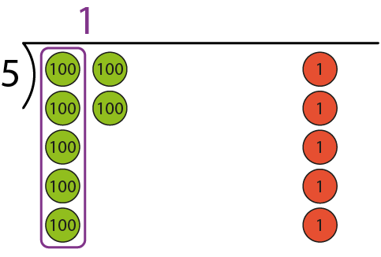
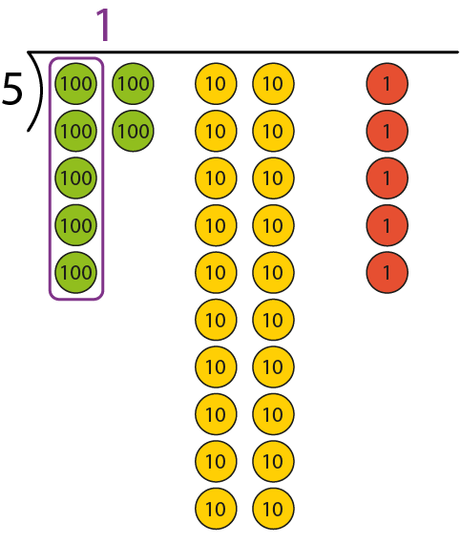
2.15 Short division Step 4:3
705 books shared equally between 5 year groups. How many books each?
705 ÷ 5 =
Step 1 – writing the divisor and dividend:
Step 2 – sharing the 100s:
1
5
5
7 hundreds ÷ 5 = 1 hundred r 2 hundreds
Notes:
Write ‘1’ in the hundreds column…

Slide 48
2.15 Short division Step 4:3
705 books shared equally between 5 year groups. How many books each?
705 ÷ 5 =
Step 2 – sharing the 100s:
Step 3 – exchanging:
1
5
7 hundreds ÷ 5 = 1 hundred r 2 hundreds
2 hundred = 20 tens
Notes:
… and write ‘2’ to the left of the tens digit of the dividend to make twenty tens.

Slide 49
2.15 Short division Step 4:3
705 books shared equally between 5 year groups. How many books each?
705 ÷ 5 =
Step 3 – exchanging:
Step 4 – sharing the 10s:
1
4
5
7 hundreds ÷ 5 = 1 hundred r 2 hundreds
2 hundred = 20 tens
20 tens ÷ 5 = 4 tens
Notes:
Write ‘4’ in the tens column.

Slide 50
2.15 Short division Step 4:3
705 books shared equally between 5 year groups. How many books each?
705 ÷ 5 =
141
Step 5 – sharing the 1s:
Step 4 – sharing the 10s:
1
4
1
5
7 hundreds ÷ 5 = 1 hundred r 2 hundreds
2 hundred = 20 tens
20 tens ÷ 5 = 4 tens
5 ones ÷ 5 = 1 one
Notes:
Write ‘1’ in the ones column.

Slide 51
2.15 Short division Step 4:5
612 ÷ 4 =
Step 1 – writing the divisor and the dividend:
4
Notes:
Six hundred and twelve divided by four.

Slide 52
2.15 Short division Step 4:5
612 ÷ 4 =
Step 1 – writing the divisor and the dividend:
Step 2 – sharing the 100s:
1
4
6 hundreds ÷ 4 = 1 hundred r 2 hundreds
Notes:
Write ‘1’ in the hundreds column…

Slide 53
2.15 Short division Step 4:5
612 ÷ 4 =
Step 2 – sharing the 100s:
Step 3 – exchanging:
1
4
6 hundreds ÷ 4 = 1 hundred r 2 hundreds
2 hundreds = 20 tens
Notes:
… and write ‘2’ to the left of the tens digit of the dividend to make twenty-one tens.

Slide 54
2.15 Short division Step 4:5
612 ÷ 4 =
Step 4 – sharing the 10s:
Step 3 – exchanging:
1
5
4
6 hundreds ÷ 4 = 1 hundred r 2 hundreds
2 hundreds = 20 tens
21 tens ÷ 4 = 5 tens r 1 ten
Notes:
Write ‘5’ in the tens column…

Slide 55
2.15 Short division Step 4:5
612 ÷ 4 =
Step 4 – sharing the 10s:
Step 5 – exchanging:
1
5
4
6 hundreds ÷ 4 = 1 hundred r 2 hundreds
2 hundreds = 20 tens
21 tens ÷ 4 = 5 tens r 1 ten
1 ten = 10 ones
Notes:
… and write ‘1’ to the left of the ones digit of the dividend to make twelve ones.

Slide 56
2.15 Short division Step 4:5
612 ÷ 4 =
153
Step 6 – sharing the 1s:
Step 5 – exchanging:
1
5
3
4
6 hundreds ÷ 4 = 1 hundred r 2 hundreds
2 hundreds = 20 tens
21 tens ÷ 4 = 5 tens r 1 ten
1 ten = 10 ones
12 ones ÷ 4 = 3 ones
Notes:
Write ‘3’ in the ones column.

Slide 57
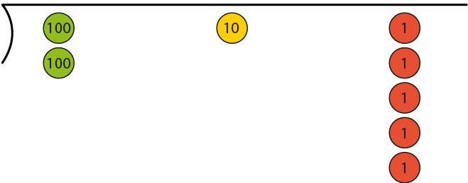
2.15 Short division Step 4:7
215 ÷ 5 =
Step 1 – writing the dividend and divisor:
5
Notes:
Two hundred and fifteen divided by five.

Slide 58
2.15 Short division Step 4:7
215 ÷ 5 =
Step 1 – writing the dividend and divisor:
Step 2 – sharing the 100s:
0
5
2 hundreds ÷ 5 = 0 hundreds r 2 hundreds
Notes:
Write ‘0’ in the hundreds column…

Slide 59
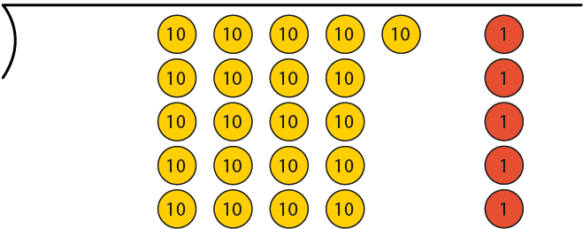
2.15 Short division Step 4:7
215 ÷ 5 =
Step 2 – sharing the 100s:
Step 3 – exchanging:
0
5
2 hundreds ÷ 5 = 0 hundreds r 2 hundreds
2 hundreds = 20 tens
Notes:
… and write ‘2’ to the left of the tens digit of the dividend to make twenty-one tens.

Slide 60
2.15 Short division Step 4:7
215 ÷ 5 =
Step 4 – sharing the 10s:
Step 3 – exchanging:
0
4
5
2 hundreds ÷ 5 = 0 hundreds r 2 hundreds
2 hundreds = 20 tens
21 tens ÷ 5 = 4 tens r 1 ten
Notes:
Write ‘4’ in the tens column…

Slide 61
2.15 Short division Step 4:7
215 ÷ 5 =
Step 4 – sharing the 10s:
Step 5 – exchanging:
0
4
5
2 hundreds ÷ 5 = 0 hundreds r 2 hundreds
2 hundreds = 20 tens
21 tens ÷ 5 = 4 tens r 1 ten
1 ten = 10 ones
Notes:
… and write ‘1’ to the left of the ones digit of the dividend to make fifteen ones.

Slide 62
2.15 Short division Step 4:7
215 ÷ 5 =
43
Step 6 – sharing the 1s:
Step 5 – exchanging:
0
4
3
5
2 hundreds ÷ 5 = 0 hundreds r 2 hundreds
2 hundreds = 20 tens
21 tens ÷ 5 = 4 tens r 1 ten
1 ten = 10 ones
15 ones ÷ 5 = 3 ones
Notes:
Write ‘3’ in the ones column.

Slide 63
2.15 Short division Step 4:8
6
800 ÷ 5
648 ÷ 6
8
5
6
426 ÷ 6
712 ÷ 4
4
7
6
4
8 > 5
6 = 6
4 < 6
7 > 4
3-digit quotient
3-digit quotient
2-digit quotient
3-digit quotient

