Slide 1
Multiplicative Reasoning Key Stage 3 Video 2.2 Calculating related quantities

Slide 2
2.2 Calculating related quantities
0 m
15
72
0 ft
50
?
How does the representation of the double number line support pupils’ ability to reason multiplicatively?

Slide 3
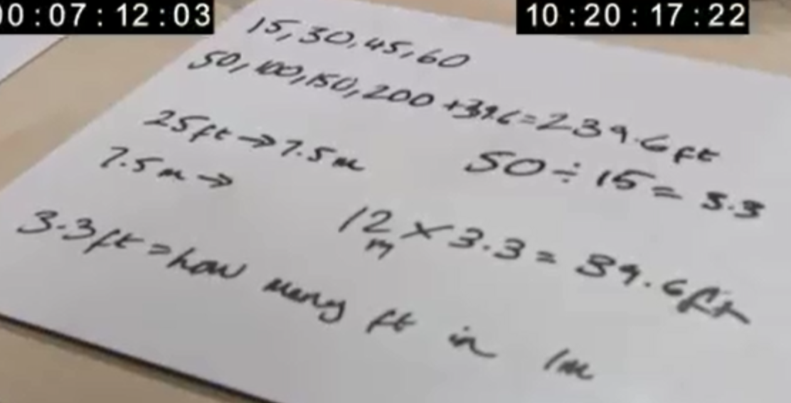
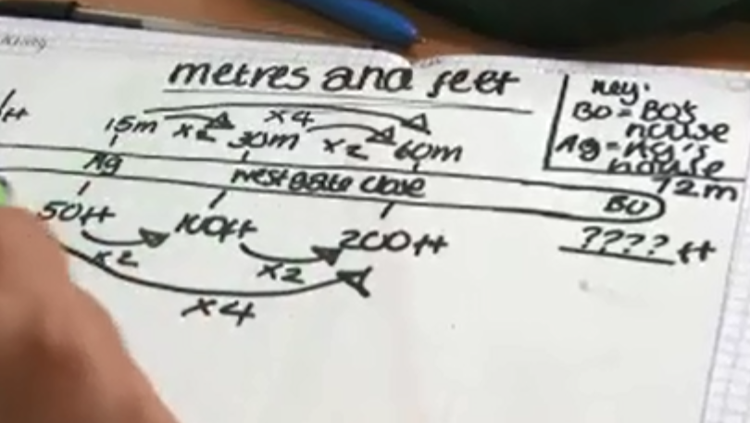
Compare and contrast these two pupils’ strategies

Slide 4



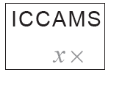
The “Westgate Close” activities used in these videos were developed by the ICCAMS (Increasing Competence and Confidence in Algebra and Multiplicative Structures) project.
The lesson aimed to introduce the double number line as a model of multiplication and to enable teachers to use formative assessment in mathematics lessons.
The full lesson materials, and further information, are available at http://iccams-maths.org/page-3/

Slide 5
ICCAMS was led by Professor Jeremy Hodgen at King’s College London. We are grateful to the teachers and schools who helped develop the lessons and to the Economic and Social Research Council (ESRC) for funding the research.
ICCAMS is part of TISME, the Targeted Initiative on Science and Mathematics Education: http://tisme-scienceandmaths.org/]

