Slide 1
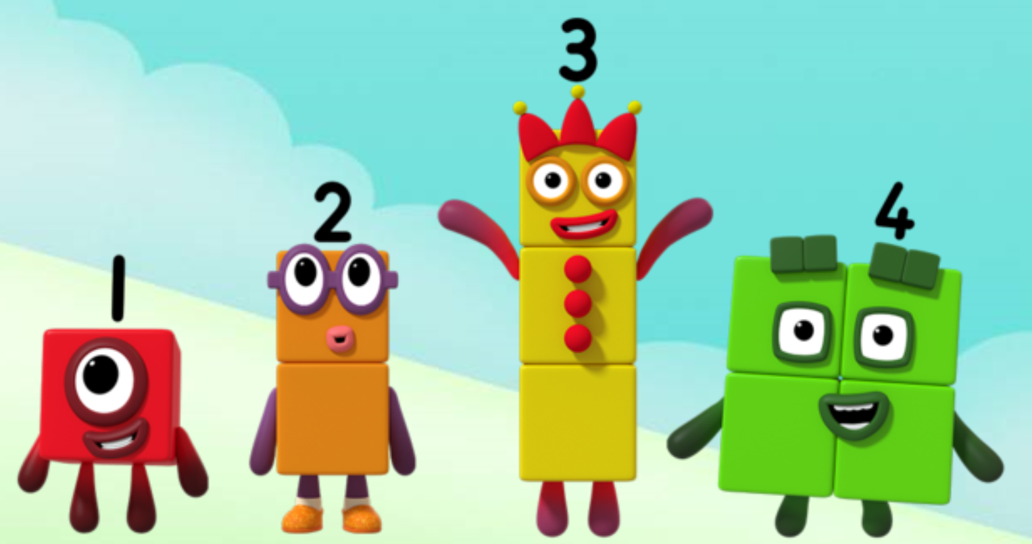
Series 1 Episode 11
Stampolines

Slide 2
Maths in the Episode
To watch this episode go to BBC iPlayer – Numberblocks. Look for Series 1: Stampolines
Recognising numbers 1 to 5
In this episode children can practise recognising the Numberblocks One to Five by the shapes they make, without needing to count each of their blocks.
Seeing numbers in different arrangements
The Numberblocks can make different shapes by changing the arrangement of their blocks.
Five can make more shapes because she has more blocks.
One can make any number when she remembers that all the other Numberblocks are made up of lots of single blocks.

Slide 3
Talk and discuss together
Watch the episode together.
Ask your child what they noticed and be interested in anything they have to say.
Use the following pictures and activities to explore and talk about the maths involved.

Slide 4
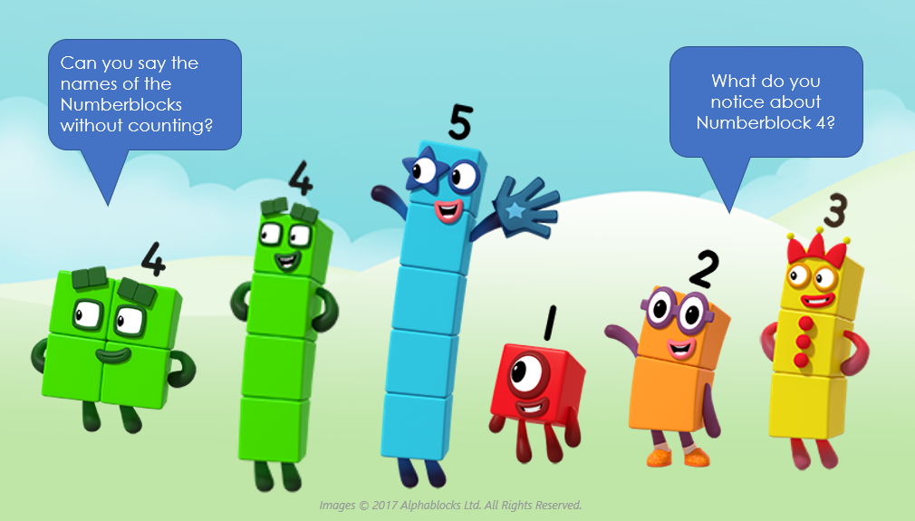

Slide 5
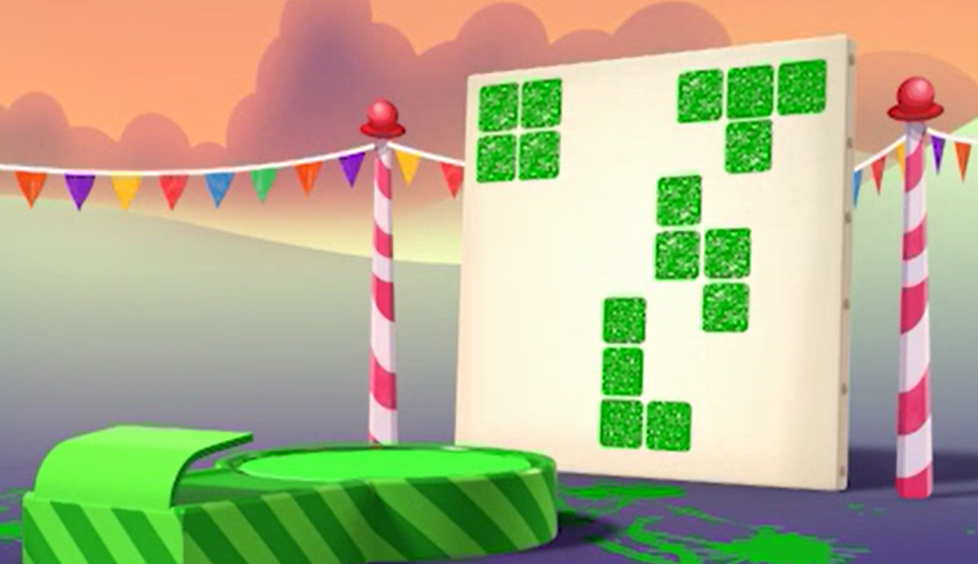
Who made these shapes?
Images © 2017 Alphablocks Ltd. All Rights Reserved.

Slide 6
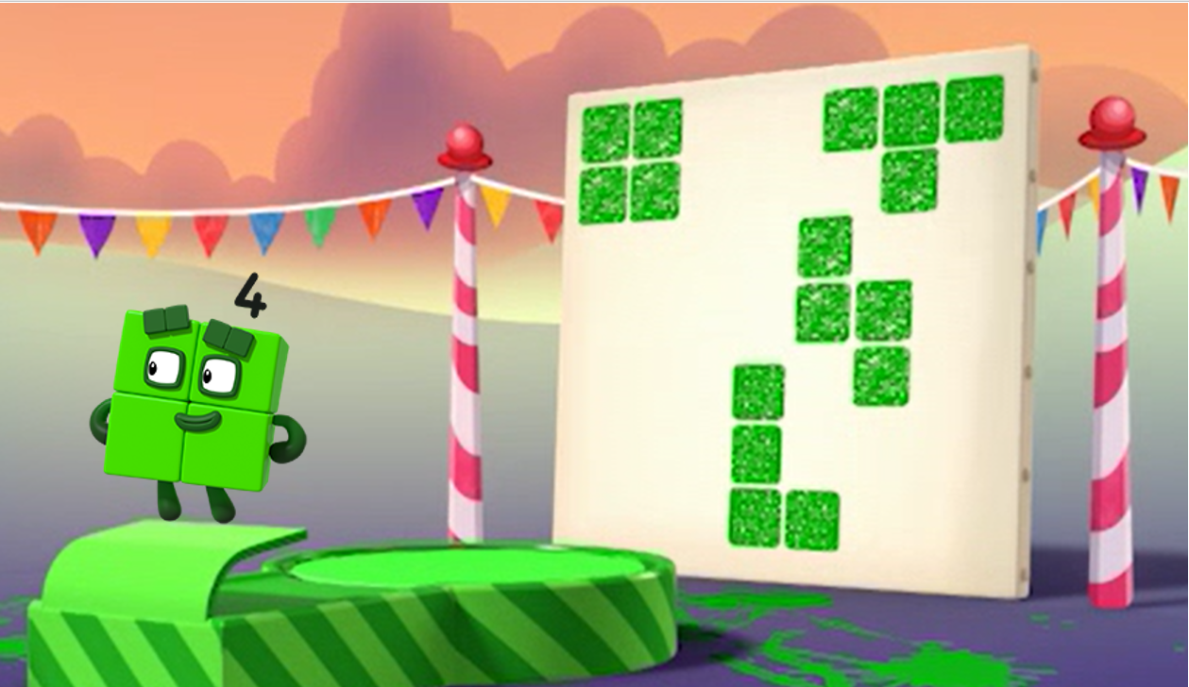
It was me, Four!
Images © 2017 Alphablocks Ltd. All Rights Reserved.

Slide 7
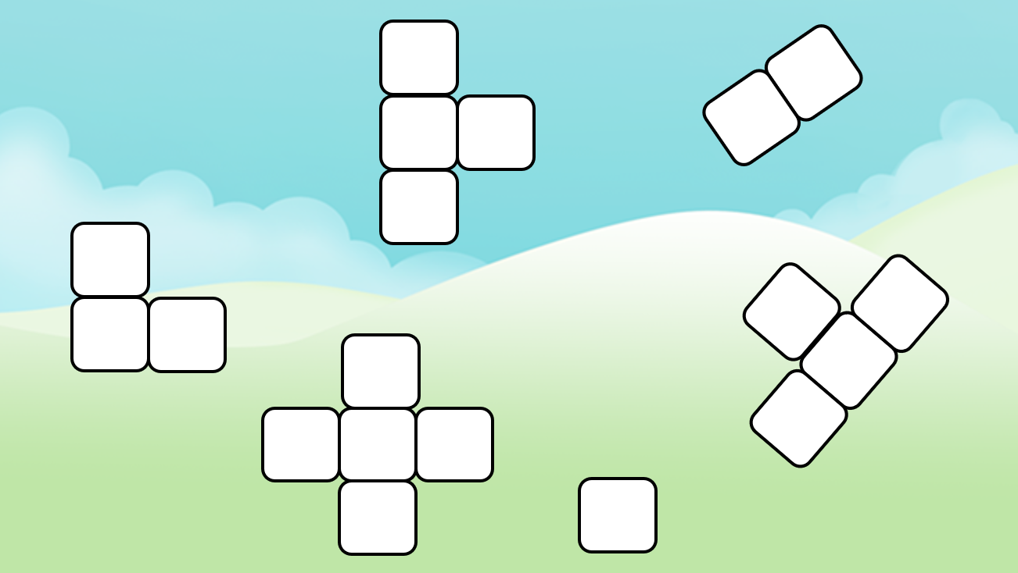
Who made these shapes?

Slide 8
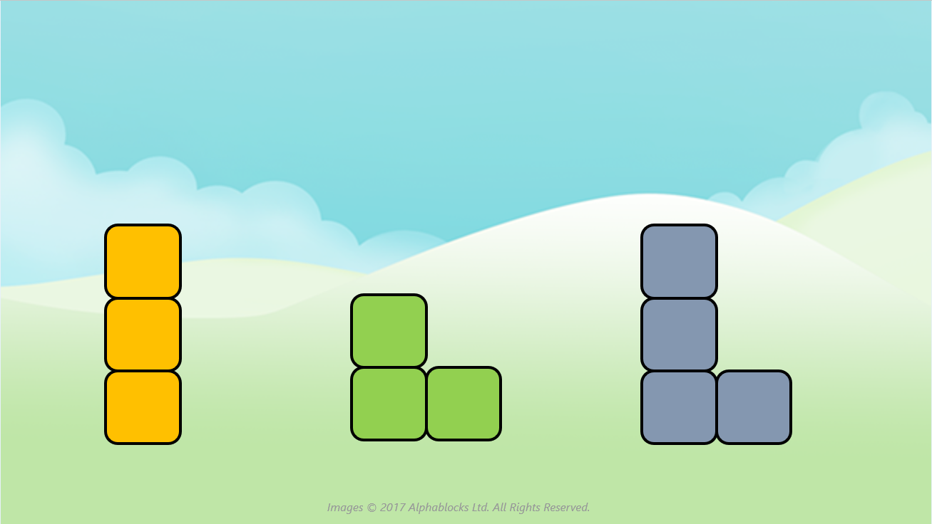
Which shape could be the odd on out? Can you think of more than one answer?

Slide 9
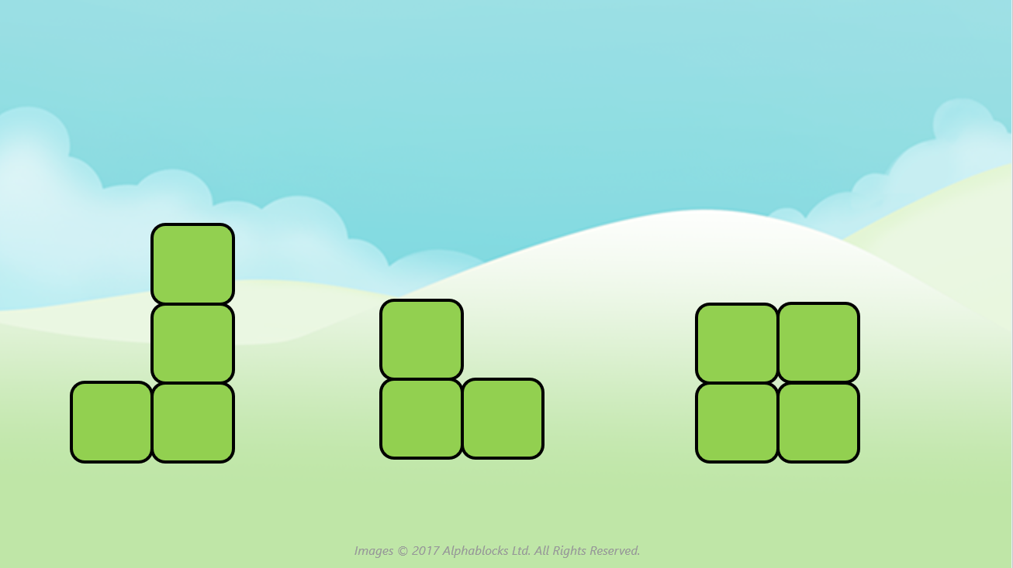
Which shape could be the odd on out? Can you think of more than one answer?

Slide 10
Around the home
Cut out some squares from a cereal box. Use some of the squares to make different arrangements for each Numberblock, keeping the sides together.
Draw some of the Numberblocks in their different shapes.
Make arrangements of small numbers using other objects, e.g. cups, plates.
Make a path across the floor with four or five cushions. Can you make it straight? Can you make it turn corners?

Slide 11
General tips that can make a difference in maths
Provide lots of opportunities to say how many things you can see (up to 5) without counting.
Whenever you talk about a small set of objects, say the number. For example, please pick up those 3 teddies or look at those 2 dogs.
Count up (starting from one) when walking upstairs and count back when walking downstairs.
Count lots of different objects, big and small, and ask ‘How many are there?’ Your child should be able to tell you without going back and re-counting. If they can’t, then tell them: ‘There are 6 altogether’.
Play with fingers, firstly practise counting fingers.
Ask your child to put their fingers down and then say or hold up a number such as 3. Can they do it without counting? Can they do it using different fingers? Can they do it using fingers from two hands?
Play board games with your child which involve moving along numbered tracks, such as ‘Snakes and Ladders’. Check that your child counts along the track correctly, moving one square for each number counted.
Regular use of these simple ideas, whenever the opportunity arises, will improve your child’s maths.

Slide 12
General tips that can make a difference in maths
Notice when there are two amounts and one is more than the other, or they are the same. For example, I have 2 eyes and 2 ears, or I have more chips than peas.
Talk about and describe shapes you can see outside or around your home. For example, count corners, talk about straight/curved edges, flat/curved surfaces. If you have building blocks then talk about and describe the things that are built.
In the bath or at the sink, play with containers, pouring water, counting how many small pots are needed to fill the big container.
Encourage your child to draw a picture of their number work and explain their mark-making to you, for example, how many leaves they find on a walk. This doesn’t necessarily mean writing the numerals (1, 2, 3, 4… etc.).
Sing counting songs and rhymes. You can find some on the internet, but children love it if you join in with them!
Make a deliberate maths mistake from time to time and ask your child to explain why you are wrong. For example, say that 4 is bigger than 5.
Regular use of these simple ideas, whenever the opportunity arises, will improve your child’s maths.

