Slide 1
Expressing additive relationships between variables
KS3 Mastery PD Materials: Exemplified Key Ideas
Materials for use in the classroom or to support professional development discussions
(From 1.4 Simplifying and manipulating expressions, equations and formulae)
Summer 2021

Slide 2
About this resource
These slides are designed to complement the 1.4 Simplifying and manipulating expressions, equations and formulae Core Concept document and its associated Theme Overview document 1 The Structure of the number system, both found in the Secondary Mastery Professional Development pages.
These slides re-present the key examples from the Core Concept document so that the examples can be used either directly in the classroom or with a group of teachers. There are prompt questions alongside the examples, and further clarification in the notes.
These slides do not fully replicate the Core Concept document, so should be used alongside it. Reference to specific page numbers, and to other useful NCETM resources, can be found in the notes for each slide.
This slide deck is not designed to be a complete PD session, rather it is a selection of resources that you can adapt and use as needed when planning a session with a group of teachers.

Slide 3


About this resource
The slides are structured as follows:
  The big picture:
    Where does this fit in?
    What do students need to understand?
    Why is this key idea important?
  Prior learning
  Misconceptions
  Exemplified key ideas
  Reflection questions
  Appendices:
    Key vocabulary
    Representations and structure
    Previous and Future learning
    Useful links
The exemplified key idea slides have the following symbols to indicate how they have been designed to be used:
Into the classroom
The examples are presented on these slides so that they could be used in PD, but also directly in the classroom. The notes feature suggested questions and things teachers might consider when using with students.
PD discussion prompts
These slides look at the examples in more detail, with question prompts to promote discussion among maths teachers. The notes feature reference to further information and guidance within the Core Concepts document.

Slide 4
Where does this fit in?
The NCETM has identified a set of six ‘mathematical themes’ within Key Stage 3 mathematics that bring together a group of ‘core concepts’.
The first of these themes is The structure of the number system, which covers the following interconnected core concepts:
    1.1 Place value, estimation and rounding
    1.2 Properties of number
    1.3 Ordering and comparing
    1.4 Simplifying and manipulating expressions, equations and formulae
Notes:
Linked on this slide is the Theme Overview document of The structure of the number system. This document includes why it is important, the key underpinning knowledge and links to prior and future learning. There is also guidance about how the five big ideas of Teaching for Mastery relate specifically to this theme.

Slide 5
Where does this fit in?
Within this core concept, 1.4 Simplifying and manipulating expressions, equations and formulae, there are three statements of knowledge, skills and understanding.
These, in turn, are broken down into seventeen key ideas. The highlighted key idea is exemplified in this slide deck.
Notes:
For key ideas marked with an asterisk, we exemplified the common difficulties and misconceptions that students might have and included elements of what teaching for mastery may look like. We have provided examples of possible student tasks and teaching approaches.
Within these slides are ‘classroom-ready’ versions of the examples for the key idea that has been highlighted. There are also slides that may be useful for discussion in a professional development session.

Slide 6
What do students need to understand?
1.4.5.1 Understand that an additive relationship between variables can be written in a number of different ways
Every addition can be rewritten as a subtraction and every subtraction as an addition.
  What prior knowledge might your students already have?
  What language might they use to describe this key idea?
  What questions might you want to ask to assess their prior learning?

Slide 7
Why is this key idea important?
The fundamental understanding in this set of key ideas is that a letter can be used to represent a generalised number and that algebraic notation is used to generalise number properties, structures and relationships.
At Key Stages 1 and 2, students had experience of expressing number relationships in different ways. So, for example, if students know 3 + 4 = 7, they should also know the ‘three facts for free’: 4 + 3 = 7, 7 − 4 = 3 and 7 − 3 = 4.
Within this key idea, students need to be aware that this additive structure can be expressed generally (i.e. a = b + c gives rise to a = c + b, a – b = c and a – c = b).
Students should also understand that this additive structure can be applied to more complex equations. For example, (x² + a) + (x³ − px + m) = (4 − p) can be rewritten as: (x² + a) = (4 − p) − (x³ − px + m), which, because the left-hand side is also an additive expression, can be written as: a = (4 − p) − (x³ – px + m) − x² to make a the subject.
This gives rise to work on rearranging formulae: students should appreciate that, when expressing the relationship between one variable (the subject of the formula) and the rest of the expression, it is possible to evaluate any of the variables, given values for all the others. Students should appreciate that the process of changing the subject of a formula is essentially the same process as solving an equation in one unknown.
Notes:
A more detailed overview of the core concept of Simplifying and manipulating expressions, equations and formulae can be found on page 2 of the 1.4 Core Concept document.
The background to each key idea is also explored in more detail on the following pages:
1.4.1 Understand and use the conventions and vocabulary of algebra, including forming and interpreting algebraic expressions and equations – page 5
1.4.2 Simplify algebraic expressions by collecting like terms to maintain equivalence – pages 5 and 6
1.4.3 Manipulate algebraic expressions using the distributive law to maintain equivalence – pages 6 and 7
1.4.4 Find products of binomials – pages 7 and 8
1.4.5 Rearrange formulae to change the subject – pages 8 and 9

Slide 8
Prior learning
Upper Key Stage 2 Learning Outcome
Use their knowledge of the order of operations to carry out calculations involving the four operations
Use simple formulae
Express missing number problems algebraically
Find pairs of numbers that satisfy an equation with two unknowns
Enumerate possibilities of combinations of two variables
Be introduced to the use of symbols and letters to represent variables and unknowns in mathematical situations that they already understand (non-statutory guidance)
  What prior knowledge might your students already have?
  What language might they use to describe this key idea?
  What questions might you want to ask to assess their prior learning?
Notes:
You may find it useful to speak to your partner schools to see how the above has been covered and the language used.
You can find further details regarding prior learning in the following segments of the NCETM primary mastery professional development materials (linked on final slide):
Year 5: 1.28 Common structures and the part–part–whole relationship
Year 6: 1.31 Problems with two unknowns
Within the 1 The structure of the number system Theme Overview document, you can also find a broader description of students’ potential previous learning (page 4), alongside further information about key underpinning knowledge (page 2).

Slide 9
Checking prior learning
The following slides contain questions for checking prior learning.
  What representations might students use to support their understanding of these questions?
  What variation might you put in place for these questions to fully assess students’ understanding of the concept?
  How might changing the language of each question change the difficulty?
  Why are these such crucial pre-requisites for this key idea?

Slide 10
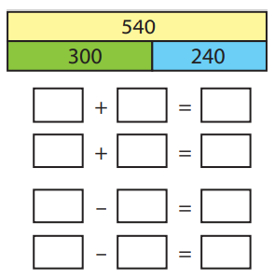
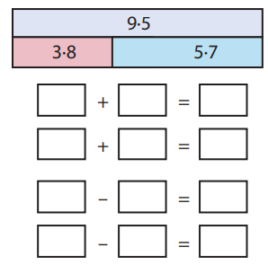
Checking prior learning
Write the four number facts that this bar model shows.
Write the four number facts that this bar model shows.
Notes:
References to the questions (links on final slide):
a) NCETM primary assessment materials: Year 3, page 14
b) NCETM primary assessment materials: Year 5, page 12

Slide 11
Common difficulties and misconceptions
What aspects of this key idea might pupils find challenging?
What misconceptions might pupils have?
When teaching this topic, you may find students encounter difficulties with…
Thinking expressions are not ‘finished’ and another step is needed for the ‘answer’
More information, and some suggestions for overcoming these challenges, can be found on the following slides.

Slide 12
Common difficulties and misconceptions (1)
A key misconception for some students is thinking that expressions such as 2x + 3, x² – 7 and x² + 2x + 4 are not ‘finished’ and another step is required to ‘complete’ them and get ‘an answer’. Consequently, some students will want to combine 2x + 3 to make 5 or 5x, or some will try to combine x² + 2x by treating the x² and x terms as somehow the same.
Students need to understand that algebraic expressions like the ones above cannot be simplified but can be thought of as one term when appropriate. For example, 2x + 3 can be thought of as the sum of 2x and 3, and x² + 2x + 4 can be thought of as the sum of x² and (2x + 4).
Notes:
More detail can be found on page 28 of the 1.4 Core Concept document.

Slide 13
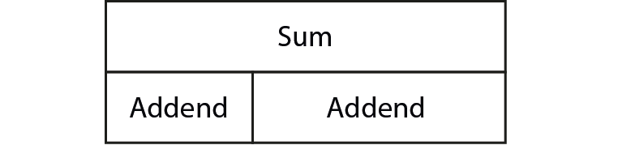
Every addition can be rewritten as a subtraction and every subtraction as an addition
Example 1
Identify two addends and their sum in the following equations and show them on a bar model (as below).
126 + 437 = 563
2x + 17 = y
r = p + q
x² + 6x = 4p² + 9
3m − 2n + r = V
Notes:
Suggested questioning:
What is the sum? What is the addend?
Is the sum always the value on the right hand side of the equals sign? Why not?
How many different bar models can you draw each time? Is there more than one possible answer for any of the equations?
Things for you to think about:
An important awareness in this key idea is that equations of the form A = B + C are examples of additive relationships even though the expressions A, B and C themselves are not. Once students develop this awareness, they are able to transform such equations in a number of different ways, depending on what is required. For example, students could transform v² = u² + 2as into v² − u² = 2as (to begin to isolate a or s) or v² − 2as = u² (to begin to isolate u).
In Example 1, the numbers in part a) have been chosen so that students cannot easily calculate the subtraction and check that this gives one of the addends. The emphasis on students’ thinking (and in any ensuing discussion) needs to be on the structure of the number sentence (i.e. A + B = C ↔ A = C − B and B = C – A).
Part c) has the single term on the left, not on the right as in parts a) and b), and students should be familiar with such variability and not be thrown by such changes.
Parts d) and e) introduce extra terms (2 on both sides in part d) and then 3 on one side in part e)). Again, students need to appreciate that this does not change the overall additive structure. It will be important for discussions to enable students to find more than one way of seeing the additive structure and, therefore, rearranging it.
In part e), students may see the addends as (3m − 2n) and r. It will be useful to ask the question, ‘Is there any other way to write this?’ in order to show the additive relationship as the alternative: (3m + r) − 2n = V. This is also showing the additive relationship A – B = C.
Such flexibility of thinking will support students in working on Example 3 below.

Slide 14
Every addition can be rewritten as a subtraction and every subtraction as an addition
Example 1
Identify two addends and their sum in the following equations and show them on a bar model (as below).
  How familiar are your students with the bar model representation?
  Why might it be useful to explore this representation in the context of these questions?
  What different answers might students produce for parts d) and e)? How do you plan to respond?
126 + 437 = 563
2x + 17 = y
r = p + q
x² + 6x = 4p² + 9
3m − 2n + r = V
Notes:
Due to space constraints, the image on this PD discussion slide is very small. PD Leads might like to use or print the ‘in the classroom’ version of this slide for teachers to access during discussions.
More detail about the sequencing of this example can be found on pages 28 and 29 of the 1.4 Core Concept document.

Slide 15
Every addition can be rewritten as a subtraction and every subtraction as an addition
Example 2
Re-express the equations in Example 1 as subtractions.
126 + 437 = 563
2x + 17 = y
r = p + q
x² + 6x = 4p² + 9
3m − 2n + r = V
Notes:
Suggested questioning:
How many different subtractions can you write each time?
How would you represent these in a bar model?
Things for you to think about:
Examining the answers to Examples 1 and 2 in a bar model formation allows students to see the additive relationship and to manipulate it to reveal the inverse relationship. Parts a) and c) could be represented as shown on page 29 of the 1.4 Core Concept document (also shown on slide 16).

Slide 16
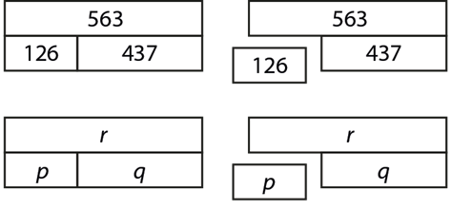
Every addition can be rewritten as a subtraction and every subtraction as an addition
Example 2
  What misconceptions might students have around the additive relationship and its inverse? How might a task like this help address these misconceptions?
  You could use a bar model formation, like those below, to examine these answers. What are the advantages of this? Are there any potential disadvantages?
Re-express the equations in Example 1 as subtractions.
126 + 437 = 563
2x + 17 = y
r = p + q
x² + 6x = 4p² + 9
3m − 2n + r = V
Notes:
Due to space constraints, the image on this PD discussion slide is very small. PD Leads might like to use or print the ‘in the classroom’ version of this slide for teachers to access during discussions.
The bar models here could be used to examine parts a) and c). The right-hand diagram in each case reveals the inverse additive relationship: 563 – 126 = 437 or 563 – 437 = 126 and r − p = q or r − q = p.
More detail about this example can be found on page 29 of the 1.4 Core Concept document.

Slide 17
Every addition can be rewritten as a subtraction and every subtraction as an addition
Example 3
Identify the additive relationship in the following expressions and rewrite them in as many different ways as you can.
V = u + at
p = 2q + 2l
cos²ϴ = 1 – sin²ϴ
s = ut + ½at²
x + 3y − 2p³ = 5x²y
Notes:
Suggested questioning:
What is the additive relationship each time?
How many different ways can you rewrite these relationships?
Can you represent these in a bar model?
What other formulae do you know? Could you write and rewrite these?
Things for you to think about:
In Example 3, there is a mixture of equations and formulae of the form A + B = C and X − Y = Z. It is important that students see both types as an additive relationship, each of which can be written in three different ways. You could ask students to make up some of their own expressions and set them as a challenge for their partner. Alternatively, ask students what formulae they have used in other subjects (as well as in mathematics) and ask them to write these in different ways.

Slide 18
Every addition can be rewritten as a subtraction and every subtraction as an addition
Example 3
  Which of these will your students find most challenging to rewrite? How might you explain or model these examples?
  How might students’ increased confidence with additive structures benefit other aspects of the curriculum? When might you want to refer back to this work?
Identify the additive relationship in the following expressions and rewrite them in as many different ways as you can.
V = u + at
p = 2q + 2l
cos²ϴ = 1 – sin²ϴ
s = ut + ½at²
x + 3y − 2p³ = 5x²y
Notes:
Due to space constraints, the image on this PD discussion slide is very small. PD Leads might like to use or print the ‘in the classroom’ version of this slide for teachers to access during discussions.
More detail about the sequencing of this example can be found on page 29 of the 1.4 Core Concept document.

Slide 19
Reflection questions
What other mathematical concepts will be supported by students’ stronger understanding of this key idea?
What mathematical language will you continue to use to support pupils to make connections with other areas?
Which representations might you continue to use to further develop students’ understanding?

Slide 21
Appendices
You may choose to use the following slides when planning or delivering a PD session. They cover:
  Key vocabulary
  Representations and structure
  Previous learning
  Future learning
  Library of links

Slide 22
Key vocabulary (1)
Term | Definition
binomial | An algebraic expression of the sum or difference of two terms.
equation | A mathematical statement showing that two expressions are equal. The expressions are linked with the symbol = Examples: 7 – 2 = 4 + 1 4x = 3 x² − 2x + 1 = 0
expression | A mathematical form expressed symbolically. Examples: 7 + 3 a² + b²
factorise | To express a number or a polynomial as the product of its factors. Example 1: Factorising 12: 12 = 1 × 12 = 2 × 6 = 3 × 4 The factors of 12 are 1, 2, 3, 4, 6 and 12. 12 may be expressed as a product of its prime factors: 12 = 2 × 2 × 3 Example 2: Factorising x² − 4x − 21: x² − 4x – 21 = (x + 3)(x − 7) The factors of x² − 4x – 21 are (x + 3) and (x − 7).

Slide 23
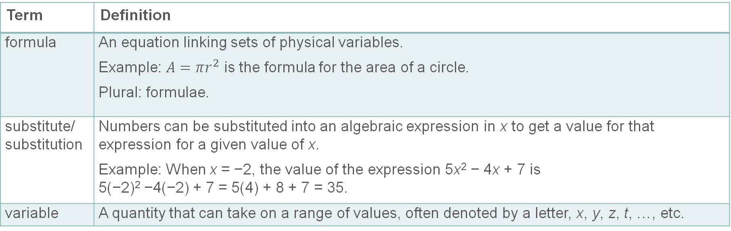
Key vocabulary (2)
Term | Definition
formula | An equation linking sets of physical variables. Example: $A=πr^{2}$ is the formula for the area of a circle. Plural: formulae.
substitute/ substitution | Numbers can be substituted into an algebraic expression in x to get a value for that expression for a given value of x. Example: When x = −2, the value of the expression 5x² − 4x + 7 is 5(−2)² −4(−2) + 7 = 5(4) + 8 + 7 = 35.
variable | A quantity that can take on a range of values, often denoted by a letter, x, y, z, t, …, etc.

Slide 24
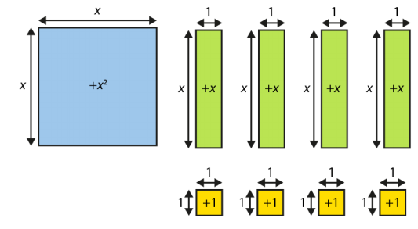
Representations and structure
There are a number of different representations that you may wish to use to support students’ understanding of this key idea. These might include:
Bar models
  Bar models can be very useful to support students in representing (literally, re-presenting) problems to reveal additive and multiplicative structures, including those involving unknown values.
Algebra tiles
  Although not offering a generalised image of a variable (x is represented by an actual length and will necessarily be seen as a particular length relative to the ‘1’), algebra tiles can provide a useful representation for expressions and give meaning to certain symbolic manipulations.
Notes:
More information about the representations and structure involved in this key idea can be found:
On page 8 of the The Structure of the number system Theme Overview document
Within the NCETM’s Using Mathematical Representations at KS3 documents
Links to all of these can be found on the final slide.

Slide 25
Previous learning
From Upper Key Stage 2, students will bring experience of:
reading, writing, ordering and comparing numbers up to 10 000 000 and determining the value of each digit
rounding any whole number to a required degree of accuracy
using negative numbers in context
identifying the value of each digit in numbers given to three decimal places and multiplying and dividing numbers by 10, 100 and 1 000, giving answers up to three decimal places
using, reading, writing and converting between standard units, converting measurements of length, mass, volume and time from a smaller unit of measure to a larger unit and vice versa, using decimal notation up to three decimal places
using symbols and letters to represent variables and unknowns in mathematical situations that they already understand, such as:
  missing numbers, lengths, coordinates and angles
  formulae in mathematics and science
Notes:
Theme 1 The structure of the number system

Slide 26
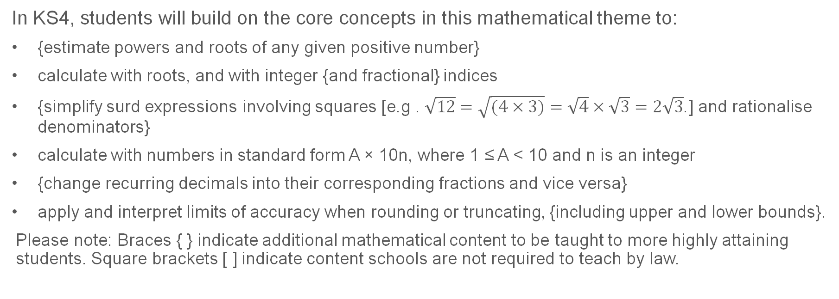
Future learning
In KS4, students will build on the core concepts in this mathematical theme to:
{estimate powers and roots of any given positive number}
calculate with roots, and with integer {and fractional} indices
{simplify surd expressions involving squares [e.g . $\sqrt{12}=\sqrt{(4×3)}=\sqrt{4}×\sqrt{3}=2\sqrt{3}$.] and rationalise denominators}
calculate with numbers in standard form A × 10n, where 1 ≤ A < 10 and n is an integer
{change recurring decimals into their corresponding fractions and vice versa}
apply and interpret limits of accuracy when rounding or truncating, {including upper and lower bounds}.
Please note: Braces { } indicate additional mathematical content to be taught to more highly attaining students. Square brackets [ ] indicate content schools are not required to teach by law.
Notes:
Theme 1 The structure of the number system

Slide 27
Library of Links
The following resources from the NCETM website have been referred to within this slide deck:
  NCETM Secondary Mastery Professional Development
    1 The Structure of the number system Theme Overview Document
    1.4 Simplifying and manipulating expressions, equations and formulae Core Concept Document
  Using mathematical representations at KS3 | NCETM
  NCETM primary mastery professional development materials
  NCETM primary assessment materials

