Slide 1
Understanding sequences
KS3 Mastery PD Materials: Exemplified Key Ideas
Materials for use in the classroom or to support professional development discussions
(from 4.1 Sequences)
Summer 2021

Slide 2
About this resource
These slides are designed to complement the 4.1 Sequences Core Concept document and its associated Theme Overview document 4 Sequences and Graphs, both found in the Secondary Mastery Professional Development pages.
These slides re-present the key examples from the Core Concept document so that the examples can be used either directly in the classroom or with a group of teachers. There are prompt questions alongside the examples, and further clarification in the notes.
These slides do not fully replicate the Core Concept document, so should be used alongside it. Reference to specific page numbers, and to other useful NCETM resources, can be found in the notes for each slide.
This slide deck is not designed to be a complete PD session, rather it is a selection of resources that you can adapt and use as needed when planning a session with a group of teachers.

Slide 3


About this resource
The slides are structured as follows:
The big picture:
Where does this fit in?
What do students need to understand?
Why is this key idea important?
Prior learning
Misconceptions
Exemplified key ideas
Reflection questions
Appendices:
Key vocabulary
Representations and structure
Previous and Future learning
Useful links
The exemplified key idea slides have the following symbols to indicate how they have been designed to be used:
Into the classroom
The examples are presented on these slides so that they could be used in PD, but also directly in the classroom. The notes feature suggested questions and things teachers might consider when using with students.
PD discussion prompts
These slides look at the examples in more detail, with question prompts to promote discussion among maths teachers. The notes feature reference to further information and guidance within the Core Concepts document.

Slide 4
Where does this fit in?
The NCETM has identified a set of six ‘mathematical themes’ within Key Stage 3 mathematics that bring together a group of ‘core concepts’.
The fourth of these themes is Sequences and graphs, which covers the following interconnected core concepts:
4.1 Sequences
4.1 Graphical representations
Notes:
Linked on this slide is the Theme Overview document of Sequences and graphs. This document includes why it is important, the key underpinning knowledge and links to prior and future learning. There is also guidance about how the five big ideas of Teaching for Mastery relate specifically to this theme.

Slide 5
Where does this fit in?
Within this core concept, 4.1 Sequences, there are three statements of knowledge, skills and understanding.
These, in turn, are broken down into ten key ideas. The highlighted key idea is exemplified in this slide deck.
Notes:
For key ideas marked with an asterisk, we exemplified the common difficulties and misconceptions that students might have and included elements of what teaching for mastery may look like. We have provided examples of possible student tasks and teaching approaches.
Within these slides are ‘classroom-ready’ versions of the examples for the key idea that has been highlighted. There are also slides that may be useful for discussion in a professional development session.

Slide 6
What do students need to understand?
4.1.1.1 Appreciate that a sequence is a succession of terms formed according to a rule
Understand the characteristics of sequences.
Understand that some numeric sequences can be described by a non-mathematical rule.
What prior knowledge might your students already have?
What language might they use to describe this key idea?
What questions might you want to ask to assess their prior learning?

Slide 7
Why is this key idea important? (1)
A fundamental feature of algebra and algebraic thinking is the recognition and expression of generality. When studying sequences, students are asked to discern what is the same about a collection of different terms, what links them together and what makes them examples of the same thing.
As such, it is a context that provides an accessible and powerful introduction to using algebraic symbolism which builds on intuitive ideas of generality, many of which have been laid down at primary school. While introduced in Year 6, algebra is developed further at Key Stage 3 and is a key element of conceptual development essential for success at Key Stage 4.
When working with sequences, a powerful and important distinction that students will make is figuring out what is needed to generate the next term in the sequence and describing any term in the sequence in relation to its position in that sequence. Such a generalisation requires seeing and expressing a common structure behind each term of a sequence and is an important precursor to proof.
Notes:
A more detailed overview of the core concept of Sequences can be found on page 2 of the 4.1 Core Concept document.
The background to each key idea is also explored in more detail on the following pages:
4.1.1 Understand the features of a sequence – page 7
4.1.2 Recognise and describe arithmetic sequences – page 7
4.1.3 Recognise and describe other types of sequences (non-arithmetic) – page 7

Slide 8
Why is this key idea important? (2)
While students will have encountered sequences in various forms throughout Key Stages 1 and 2, the extent to which students have previously explored them in depth may vary. Therefore, students should consolidate, secure and deepen their understanding of linear sequences and how to find and use term-to-term rules to generate the next term. Then, they can progress on to describing any term in the sequence directly in relation to its position in the sequence.
This key idea extends students’ knowledge of sequences through exploration of the mathematical structure, not just by spotting the patterns that the structure creates.
This learning has connections to other areas of algebra, particularly solving equations (when checking if a number is a term in a sequence) and straight line graphs. Work on sequences in Key Stage 3 provides the foundation for exploring quadratic sequences and simple geometric progressions in Key Stage 4.
Students should be familiar with finding and using difference patterns in linear sequences to generate the terms of a sequence. This and other related key ideas provide an opportunity to secure and deepen understanding by applying this prior learning to other linear and non-linear sequences, including those containing negative and fractional terms.
Notes:
A more detailed overview of the core concept of Sequences can be found on page 2 of the 4.1 Core Concept document.
The background to each key idea is also explored in more detail on the following pages:
4.1.1 Understand the features of a sequence – page 7
4.1.2 Recognise and describe arithmetic sequences – page 7
4.1.3 Recognise and describe other types of sequences (non-arithmetic) – page 7

Slide 9
Prior learning
What prior knowledge might your students already have?
What language might they use to describe this key idea?
What questions might you want to ask to assess their prior learning?
Upper Key Stage 2 Learning Outcome
Generate and describe linear number sequences
Use simple formulae
Describe positions on the full coordinate grid (all four quadrants)
Notes:
You may find it useful to speak to your partner schools to see how the above has been covered and the language used.
You can find further details regarding prior learning in the following segments of the NCETM primary mastery professional development materials:
Year 5: 2.21 Factors, multiples, prime numbers and composite numbers
Year 6: 1.31 Problems with two unknowns
Year 6: 2.27 Scale factors, ratio and proportional reasoning
Within the 4 Sequences and Graphs Theme Overview document, you can also find a broader description of students’ potential previous learning (page 4), alongside further information about key underpinning knowledge (page 2).

Slide 10
Prior learning
What representations might your students already be familiar with?
What language might they use?
How does this fit in with your curriculum progression?
Key Stage 3 Learning Outcome
1.2.1 Understand multiples
1.2.2 Understand integer exponents and roots
1.4.1 Understand and use the conventions and vocabulary of algebra, including forming and interpreting algebraic expressions and equations
Please note: Numerical codes refer to statements of knowledge, skills and understanding in the NCETM breakdown of Key Stage 3 mathematics.

Slide 11
Checking prior learning
The following slides contain questions for checking prior learning.
What representations might students use to support their understanding of these questions?
What variation might you put in place for these questions to fully assess students’ understanding of the concept?
How might changing the language of each question change the difficulty?
Why are these such crucial pre-requisites for this key idea?

Slide 12
Checking prior learning (1)
a)
The numbers in this sequence increase by the same amount each time.
Write the missing numbers.
1
1
5
8
2
1
4
b)
The numbers in this sequence increase by the same amount each time.
Write the missing numbers.
42
49
63
Notes:
References to the questions (links on final slide):
2017 Key Stage 2 Mathematics Paper 3: reasoning, Question 21
2018 Key Stage 2 Mathematics Paper 3: reasoning, Question 1

Slide 13
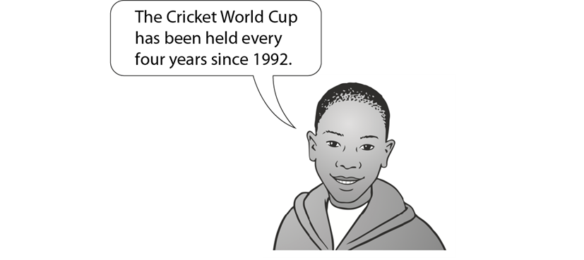
Checking prior learning (2)
c)
The list below shows the years in which the Cricket World Cup was held since 1992:
1992, 1996, 1999, 2003, 2007, 2011, 2015
Adam says,
Adam is not correct.
Explain how you know.
Notes:
References to the questions (links on final slide):
c) 2018 Key Stage 2 Mathematics Paper 2: reasoning, Question 9

Slide 14
Common difficulties and misconceptions
What aspects of this key idea might students find challenging?
What misconceptions might students have?
When teaching this topic, you may find students encounter difficulties with…
Expressing the rule of the sequence
Only noticing additively increasing sequences
More information, and some suggestions for overcoming these challenges, can be found on the following slides.
Notes:
More detail can be found on page 8 of the 4.1 Core Concept document.

Slide 15
Common difficulties and misconceptions (1)
Students may have an intuitive sense that the terms in a sequence progress logically according to a rule, but may find it difficult to express clearly what that rule is.
Students should, through discussion and sharing ideas, be able to clearly articulate a rule and should be encouraged to use mathematical language to describe sequences wherever possible.
For example, when describing the sequence 3, 5, 7, 9, 11, … students may often say, ‘It goes up in 2s’. Through discussion, this response can be refined so that students are more explicit regarding the starting number and the amount added each time. For example, ‘The sequence begins with three, and two is added each time’ or ‘The 1st term is three, the 2nd term is three plus two, the 3rd term is three, plus two, plus two, etc.’.
The focus in this core concept is being aware that there is a consistent mathematical rule that generates terms, without necessarily describing that rule precisely. However, discussion of different sequences and how they progress, using increasingly sophisticated mathematical language, is an important precursor to finding term-to-term and position-to-term rules later.
Notes:
More detail can be found on page 8 of the 4.1 Core Concept document.

Slide 16
Common difficulties and misconceptions (2)
It is not uncommon for students to notice only additively increasing sequences (i.e. arithmetic sequences where the common difference is positive), so students should experience a varied collection of types of sequence. For example:
23, 19, 15, 11, 7, 3, … (decreasing arithmetic sequences)
3, 6, 12, 24, 48, 96, … (geometric sequences, where there is a constant multiple or ratio between successive terms)
1, 4, 5, 9, 14, 23, … (Fibonacci-like sequences, where terms are generated by adding the two preceding terms)
Also, sequences of squares (or cubes or multiples of a given number or odd numbers) are useful in that, while students may wish to describe them using differences, there is the opportunity to notice that, for example, ‘the third number in the sequence is the third square (or cube or multiple of seven or odd number)’.
Students should also experience sequences where there are multiple ways in which the sequence could be extended. For example, the terms in the sequence 1, 2, 4, … could be generated by:
doubling each term to get the next (1, 2, 4, 8, 16, 32, …)
adding one, then two, then three, etc. (1, 2, 4, 7, 11, …)
Notes:
More detail can be found on page 8 of the 4.1 Core Concept document.

Slide 17
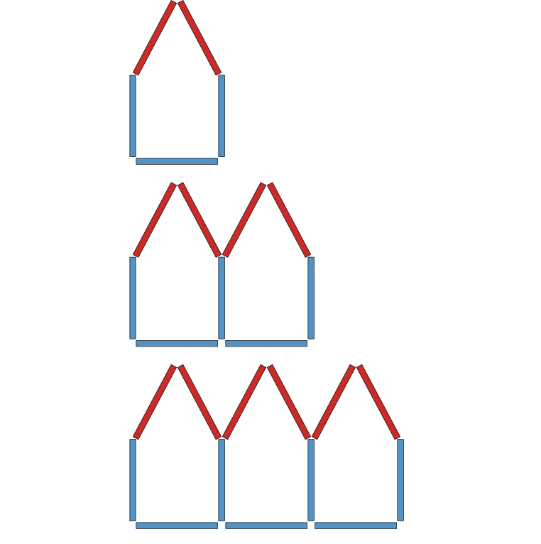
Understand the characteristics of sequences
Example 1
Here is a sequence of shapes.
What is staying the same?
What is changing?
How many red sticks will the 4th shape of this sequence require?
How many blue sticks will the 5th shape of this sequence require?
What can you say about the 18th shape in this sequence?
How many blue sticks are in the shape that has 16 red sticks?
Notes:
Suggested questioning:
What is the same? What is different?
How many red/blue sticks am I adding each time?
Why do I not add three blue sticks each time? What would that look like?
What would the __th term in the sequence look like? Could you draw it? Could you describe it in words?
How did you work out what the 18th shape looks like? Do you have to draw all of the patterns in the sequence that come before it?
Things for you to think about:
Presenting sequences of ‘growing shapes’, such as those in Example 1, is helpful in supporting students to spot patterns and rules. Students may be more readily able to see (particularly if pictures are colour-coded, as in Example 1) both how the number of sticks is increasing and how each picture/term has the same structure.

Slide 18
Understand the characteristics of sequences
Example 1
Here is a sequence of shapes.
Watch video 7 in the Mathematical Prompts for Deeper Thinking videos | NCETM
Reflect upon these questions:
How does the teacher give the students time to explore and fully reject their own incorrect answers?
How does the teacher build upon students' responses in her questioning?
What is staying the same?
What is changing?
How many red sticks will the 4th shape of this sequence require?
How many blue sticks will the 5th shape of this sequence require?
What can you say about the 18th shape in this sequence?
How many blue sticks are in the shape that has 16 red sticks?
Notes:
Due to space constraints, the image on this PD discussion slide is very small. PD Leads might like to use or print the ‘in the classroom’ version of this slide for teachers to access during discussions.
More detail about the sequencing of this example can be found on page 9 of the 4.1 Core Concept document.
A downloadable PowerPoint, giving more insight into the video and some links to research, can be found on the Mathematical Prompts for Deeper Thinking videos page.

Slide 19
Understand the characteristics of sequences
Example 2
Afsal thinks that the following statements about sequences are true:
Sequences always increase.
A sequence can have either positive or negative terms, but it cannot have both.
An arithmetic sequence always has a common difference that is an integer.
All sequences have terms that increase by the same amount each time.
For each statement, find an example of a sequence which shows that Afsal is not right.
Notes:
Suggested questioning:
Why might Afsal think this? Why is he wrong?
How could you describe your sequence?
Things for you to think about:
Asking students to generate examples of their own that fit certain criteria is an effective way of encouraging deeper thinking. An important use of variation is to encourage students to be aware of the full range of examples of a certain mathematical object (in this case, sequences) – both standard and non-standard examples. Students often develop misconceptions as a result of being exposed to a limited range of examples. Example 2 is designed to get students to think about such possible misconceptions and refine in their own minds what makes a list of numbers form a sequence.

Slide 20
Understand the characteristics of sequences
Example 2
Afsal thinks that the following statements about sequences are true:
Sequences always increase.
A sequence can have either positive or negative terms, but it cannot have both.
An arithmetic sequence always has a common difference that is an integer.
All sequences have terms that increase by the same amount each time.
For each statement, find an example of a sequence which shows that Afsal is not right.
Why might it be useful/revealing to get students to develop their own sequences?
How might this activity support students to refine in their own minds what makes a list of numbers form a sequence?
Notes:
Due to space constraints, the image on this PD discussion slide is very small. PD Leads might like to use or print the ‘in the classroom’ version of this slide for teachers to access during discussions.
More detail about the sequencing of this example can be found on page 10 of the 4.1 Core Concept document.

Slide 21
Understand the characteristics of sequences
Example 3
Consider the sequence: 5, 7, 9, 11, …
Charlie says that the 6th term is going to be twice the 3rd term.
Is he right?
Notes:
Suggested questioning:
Why might Charlie think this?
What is twice the 3rd term? What is the 6th term if you continue the sequence?
When might Charlie be correct?
Things for you to think about:
The idea that you can multiply a term to find terms further on in a sequence is a very common misconception (students asked for the 100th term will often find the 10th term and multiply it by ten). Do your students harbour this misconception? Why do you think this might be so? How might you address it?
By representing the terms in the sequence as points on a graph, students may be better able to reason why, for example, simply doubling the 3rd term does not obtain the 6th term. See page 11 of the 4.1 Core Concept document for more information on how you might model this, including the special case for when Charlie’s method does work (i.e. when the points passes through (0,0)).

Slide 22
Understand the characteristics of sequences
Example 3
What misconception might this example be trying to expose? How might you address it?
How will you run an activity like this in your classroom? What routines might you need to put in place to maximise the benefit from the mathematical discussions?
Consider the sequence: 5, 7, 9, 11, …
Charlie says that the 6th term is going to be twice the 3rd term.
Is he right?
Notes:
Due to space constraints, the image on this PD discussion slide is very small. PD Leads might like to use or print the ‘in the classroom’ version of this slide for teachers to access during discussions.
More detail about this example can be found on pages 10 and 11 of the 4.1 Core Concept document. The next slide also offers a suggestion for a representation that models why Charlie is wrong.

Slide 23
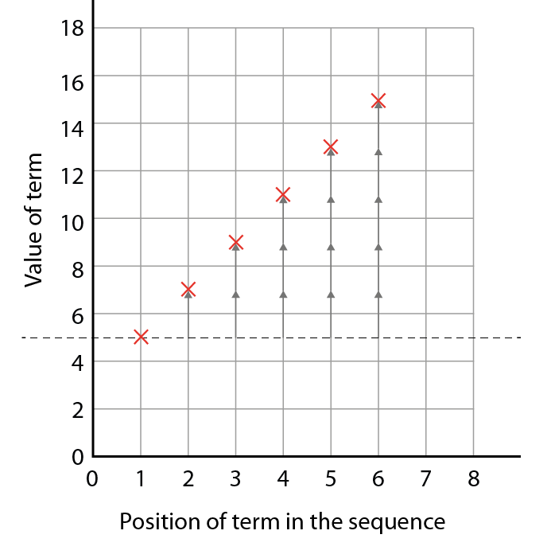
Understand the characteristics of sequences
Example 3a
Consider the sequence: 5, 7, 9, 11, …
Charlie says that the 6th term is going to be twice the 3rd term.
Is he right?
How might this representation support students to see that simply doubling the 3rd term does not obtain the 6th term?
Notes:
By representing the terms in the sequence as points on a graph, students may be better able to reason why, for example, simply doubling the 3rd term does not obtain the 6th term. See page 11 of the 4.1 Core Concept document for more information on how you might model this, including the special case for when Charlie’s method does work (i.e. when the points passes through (0,0)).

Slide 24
Understand the characteristics of sequences.
Example 4
Here is a sequence of numbers.
5, 10, 15, 20, 25, 30, …
Will the number 67 be in the sequence?
Explain your answer.
What position would 55 be in the sequence?
Give a reason for your answer.
Give some more examples of numbers that are (and are not) in this sequence and explain why.
Notes:
Suggested questioning:
What is the rule for this sequence? Can you describe this using the most precise mathematical language possible?
Which multiple of 5 is term __?
Things for you to think about:
Students will often look to see how the sequence is progressing from term to term. Example 4 has been designed to encourage students to think about what structure is common to each term in the sequence. Being able to say that ‘All of the numbers are multiples of five’ (and not just that ‘They go up in fives’) is an important step as it prepares the ground for the important question ‘Which multiple of five is each term?’, which will support students later in being able to identify any term in the sequence.

Slide 25
Understand the characteristics of sequences
Example 4
Here is a sequence of numbers.
5, 10, 15, 20, 25, 30, …
Will the number 67 be in the sequence?
Explain your answer.
What position would 55 be in the sequence?
Give a reason for your answer.
Give some more examples of numbers that are (and are not) in this sequence and explain why.
What language would you want students to use here?
What would be acceptable/unacceptable?
Why might a lack of precision in language cause problems later on?
Notes:
Due to space constraints, the image on this PD discussion slide is very small. PD Leads might like to use or print the ‘in the classroom’ version of this slide for teachers to access during discussions.
More detail about this example can be found on page 11 of the 4.1 Core Concept document.

Slide 26
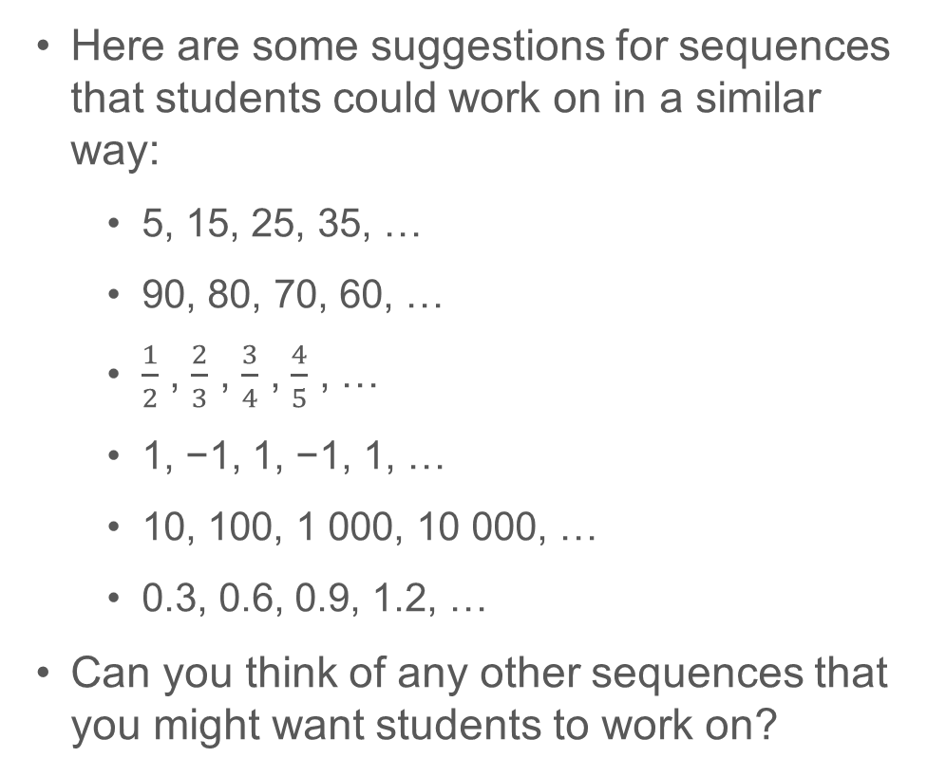
Understand the characteristics of sequences
Example 4a
Here are some suggestions for sequences that students could work on in a similar way:
5, 15, 25, 35, …
90, 80, 70, 60, …
$\frac{1}{2}$ , $\frac{2}{3}$ , $\frac{3}{4}$ , $\frac{4}{5}$ , …
1, −1, 1, −1, 1, …
10, 100, 1 000, 10 000, …
0.3, 0.6, 0.9, 1.2, …
Can you think of any other sequences that you might want students to work on?
Here is a sequence of numbers.
5, 10, 15, 20, 25, 30, …
Will the number 67 be in the sequence?
Explain your answer.
What position would 55 be in the sequence?
Give a reason for your answer.
Give some more examples of numbers that are (and are not) in this sequence and explain why.
Notes:
Due to space constraints, the image on this PD discussion slide is very small. PD Leads might like to use or print the ‘in the classroom’ version of this slide for teachers to access during discussions.
More detail about this example can be found on page 11 of the 4.1 Core Concept document.

Slide 27
Understand that some numeric sequences can be described by a non-mathematical rule
Example 5
A sequence is generated by the rule ‘The value of a term in this sequence is given by the number of letters in the position number’.
The first five terms are 3, 3, 5, 4, 4, …
What are the next three terms?
Notes:
Suggested questioning:
Can you make your own sequences?
How would you describe your rule?
Does your sequence have an infinite number of terms? Why or why not?
Things for you to think about:
This is an opportunity to be really creative, and encourage your students to do the same. Students could be invited to devise their own sequences, similar to Example 5, that cannot be described with a mathematical rule; for example, the number of days in consecutive months: 31, 28, 31, 30, …

Slide 28
Understand that some numeric sequences can be described by a non-mathematical rule
Example 5
What is the benefit of exposing students to sequences that can be described using non-mathematical rules?
What might you do next with your students?
A sequence is generated by the rule ‘The value of a term in this sequence is given by the number of letters in the position number’.
The first five terms are 3, 3, 5, 4, 4, …
What are the next three terms?
Notes:
Due to space constraints, the image on this PD discussion slide is very small. PD Leads might like to use or print the ‘in the classroom’ version of this slide for teachers to access during discussions.
More detail about the sequencing of this example can be found on page 11 of the 4.1 Core Concept document.

Slide 29
Reflection questions
What other mathematical concepts will be supported by students’ stronger understanding of this key idea?
What mathematical language will you continue to use to support pupils to make connections with other areas?
Which representations might you continue to use to further develop students’ understanding?

Slide 31
Appendices
You may choose to use the following slides when planning or delivering a PD session. They cover:
Key vocabulary
Representations and structure
Previous learning
Future learning
Library of links

Slide 32
Key vocabulary (1)
Term | Definition
arithmetic sequence | A sequence of numbers in which successive terms are generated by adding or subtracting a constant amount to/from the preceding term. Example 1: 3, 11, 19, 27, 35, …, where 8 is added. Example 2: 4, −1, −6, −11, …, where 5 is subtracted (or −5 has been added). The sequence can be generated by giving one term (usually the first term) and the constant that is added (or subtracted) to give the subsequent terms. Also called an ‘arithmetic progression’.
cube number | A number that can be expressed as the product of three equal integers. Example: 27 = 3 × 3 × 3. Consequently, 27 is a cube number. It is the cube of 3 or 3-cubed. This is written compactly as 27 = 3³, using index (or power) notation.
geometric sequence | A series of terms in which each term is a constant multiple of the previous term (known as the common ratio) is called a geometric sequence, sometimes also called a ‘geometric progression’. Example 1: 1, 5, 25, 125, 625, …, where the constant multiplier is 5. Example 2: 1, −3, 9, −27, 81, …, where the constant multiplier is −3. A geometric sequence may have a finite number of terms or it may go on forever, in which case it is an infinite geometric sequence. In an infinite geometric sequence with a common ratio strictly between zero and one, all the terms add to a finite sum.

Slide 33
Key vocabulary (2)
Term | Definition
nth term of a sequence | This is the name for the term that is in the nth position starting the count of terms from the first term. The nth term is sometimes represented by the symbol u_{n}.
prime number | A whole number greater than one that has exactly two factors: itself and one. Examples: 2 (factors 2, 1), 3 (factors 3, 1). 51 is not prime (factors 51, 17, 3, 1).
sequence | A succession of terms formed according to a rule. There is a definite relation between one term and the next and between each term and its position in the sequence. Example: 1, 4, 9, 16, 25, …
square number | A number that can be expressed as the product of two equal numbers. Example: 36 = 6 × 6 and so 36 is a square number or ‘6 squared’. A square number can be represented by dots in a square array.
term | A term is either a single number or variable, or the product of several numbers or variables. Terms are separated by a + or − sign in an overall expression. Example: In 3 + 4x + 5yzw; 3, 4x and 5yzw are three separate terms.

Slide 34
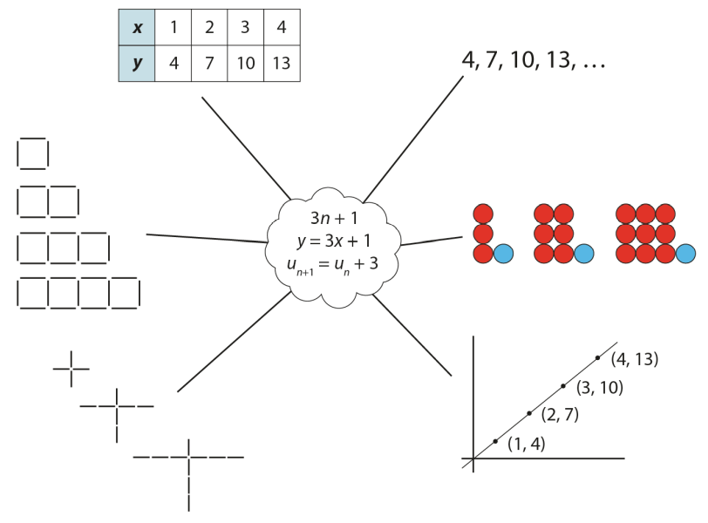
Representations and structure
There are a number of different representations that you may wish to use to support students’ understanding of this key idea. These might include:
Tables of values, graphs, sequences and structured pictorial arrangements
It is important for students to see multiple representations of the same structure, as in the diagram, and to connect them.
Prompts such as ‘Where is the 3 in this representation?’ and ‘Where is the 1?’ can support students in making these connections and understanding that each representation has the same underpinning structure.
Notes:
More information about the representations and structure involved in this key idea can be found:
On page 5 of the 4 Sequences and Graphs Theme Overview document.
Links can be found on the final slide.

Slide 35
Previous Learning
From Upper Key Stage 2, students will bring experience of:
using simple formulae
generating and describing linear number sequences
describing positions on the full coordinate grid (all four quadrants).
Notes:
Theme 4 Sequences and graphs

Slide 36
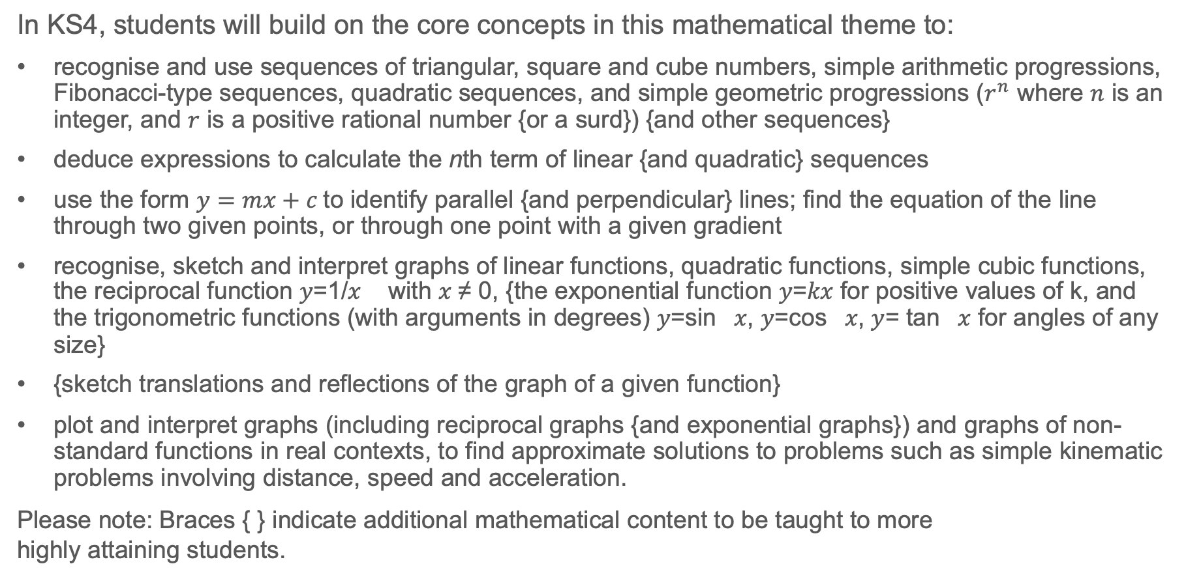
Future learning
In KS4, students will build on the core concepts in this mathematical theme to:
recognise and use sequences of triangular, square and cube numbers, simple arithmetic progressions, Fibonacci-type sequences, quadratic sequences, and simple geometric progressions ($r^{n}$ where $n$ is an integer, and $r$ is a positive rational number {or a surd}) {and other sequences}
deduce expressions to calculate the nth term of linear {and quadratic} sequences
use the form $y=mx+c$to identify parallel {and perpendicular} lines; find the equation of the line through two given points, or through one point with a given gradient
recognise, sketch and interpret graphs of linear functions, quadratic functions, simple cubic functions, the reciprocal function 𝑦=1/𝑥 with 𝑥 ≠ 0, {the exponential function 𝑦=𝑘𝑥 for positive values of k, and the trigonometric functions (with arguments in degrees) 𝑦=sin⁡𝑥, 𝑦=cos⁡𝑥, 𝑦= tan⁡𝑥 for angles of any size}
{sketch translations and reflections of the graph of a given function}
plot and interpret graphs (including reciprocal graphs {and exponential graphs}) and graphs of non-standard functions in real contexts, to find approximate solutions to problems such as simple kinematic problems involving distance, speed and acceleration.
Please note: Braces { } indicate additional mathematical content to be taught to more
highly attaining students.
Notes:
Theme 4 Sequences and graphs

Slide 37
Library of links
The following resources from the NCETM website have been referred to within this slide deck:
NCETM Secondary Mastery Professional Development
4 Sequences and Graphs Theme Overview Document
4.1 Sequences Core Concept Document
1.4 Simplifying and manipulating expressions, equations and formulae Core Concept Document
Mathematical Prompts for Deeper Thinking videos | NCETM
NCETM primary mastery professional development materials
There are also references to:
Standards & Testing Agency’s past mathematics papers

