Slide 1
The mathematical structure of multiplying fractions
KS3 Mastery PD Materials: Exemplified Key Ideas
Materials for use in the classroom or to support professional development discussions
(From 2.1 Arithmetic procedures)
Summer 2021

Slide 2
About this resource
These slides are designed to complement the 2.1 Arithmetic procedures Core Concept document and its associated Theme Overview document 2 Operating on number, both found in the Secondary Mastery Professional Development pages.
These slides re-present the key examples from the Core Concept document so that the examples can be used either directly in the classroom or with a group of teachers. There are prompt questions alongside the examples, and further clarification in the notes.
These slides do not fully replicate the Core Concept document, so should be used alongside it. Reference to specific page numbers, and to other useful NCETM resources, can be found in the notes for each slide.
This slide deck is not designed to be a complete PD session, rather it is a selection of resources that you can adapt and use as needed when planning a session with a group of teachers.

Slide 3


About this resource
The slides are structured as follows:
  The big picture:
    Where does this fit in?
    What do students need to understand?
    Why is this key idea important?
  Prior learning
  Misconceptions
  Exemplified key ideas
  Reflection questions
  Appendices:
    Key vocabulary
    Representations and structure
    Future learning
    Useful links
The exemplified key idea slides have the following symbols to indicate how they have been designed to be used:
Into the classroom
The examples are presented on these slides so that they could be used in PD, but also directly in the classroom. The notes feature suggested questions and things teachers might consider when using with students.
PD discussion prompts
These slides look at the examples in more detail, with question prompts to promote discussion among maths teachers. The notes feature reference to further information and guidance within the Core Concepts document.

Slide 4
Where does this fit in?
The NCETM has identified a set of six ‘mathematical themes’ within Key Stage 3 mathematics that bring together a group of ‘core concepts’.
The second of these themes is Operating on number, which covers the following interconnected core concepts:
2.1 Arithmetic procedures
2.2 Solving linear equations
Notes:
Linked on this slide is the Theme Overview document of Operating on number. This document includes why it is important, the key underpinning knowledge and links to prior and future learning. There is also guidance about how the five big ideas of Teaching for Mastery relate specifically to this theme.

Slide 5
Where does this fit in?
Within this core concept, 2.1 Arithmetic Procedures, there are five statements of knowledge, skills and understanding.
These, in turn, are broken down into twenty one key ideas. The highlighted key idea is exemplified in this slide deck.
Notes:
For key ideas marked with an asterisk, we exemplified the common difficulties and misconceptions that students might have and included elements of what teaching for mastery may look like. We have provided examples of possible student tasks and teaching approaches.
Within these slides are ‘classroom-ready’ versions of the examples for the key idea that has been highlighted. There are also slides that may be useful for discussion in a professional development session

Slide 6
What do students need to understand?
2.1.4.1 Understand the mathematical structures that underpin the multiplication of fractions
Think of multiplication as scaling/reduction when both numbers are fractions and that either fraction can be thought of as the scale factor.
Understand how an area model can represent the multiplication of fractions.
  What prior knowledge might your students already have?
  What language might they use to describe this key idea?
  What questions might you want to ask to assess their prior learning?

Slide 7
Why is this key idea important?
The ability to calculate is a fundamental skill in mathematics and this, of course, includes the requirement that students know and use standard methods of calculation.
However, students who know these methods solely as a set of memorised steps, without any understanding of why they work and the laws of arithmetic on which they are based, may quickly forget them.
There is a danger that students see the mathematics curriculum as a set of separate topics, each with its own set of rules and techniques. This unconnected view of the curriculum can result in an entirely instrumental and procedural approach to mathematics, with no sense of conceptual coherence.
It is, therefore, important that students see fractions or rational numbers as a part of a unified number system and that the operations on such numbers are related and connected to previously taught and learnt concepts for integers.
Notes:
A more detailed overview of the core concept of arithmetic procedures can be found on page 2 of the 2.1 Core Concept document.
The background to each key idea is also explored in more detail on the following pages:
2.1.1 Understand and use the structures that underpin addition and subtraction strategies – page 10
2.1.2 Understand and use the structures that underpin multiplication and division strategies – pages 10 and 11
2.1.3 Know, understand and use fluently a range of calculation strategies for addition and subtraction of fractions – page 11
2.1.4 Know, understand and use fluently a range of calculation strategies for multiplication and division of fractions – pages 11 and 12
2.1.5 Use the laws and conventions of arithmetic to calculate efficiently – pages 12 and 13

Slide 8
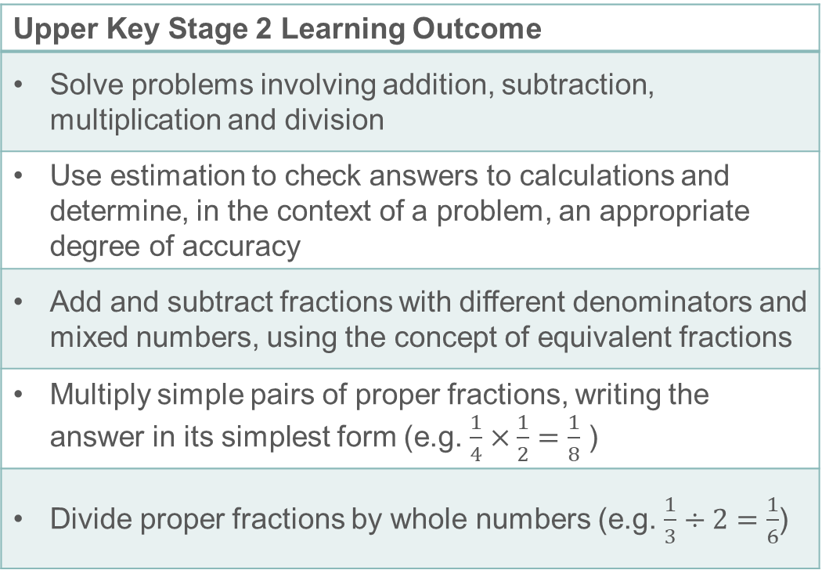
Prior learning
Upper Key Stage 2 Learning Outcome
Solve problems involving addition, subtraction, multiplication and division
Use estimation to check answers to calculations and determine, in the context of a problem, an appropriate degree of accuracy
Add and subtract fractions with different denominators and mixed numbers, using the concept of equivalent fractions
Multiply simple pairs of proper fractions, writing the answer in its simplest form (e.g. $\frac{1}{4}×\frac{1}{2}=\frac{1}{8}$ )
Divide proper fractions by whole numbers (e.g. $\frac{1}{3}÷2=\frac{1}{6}$)
  What prior knowledge might your students already have?
  What language might they use to describe this key idea?
  What questions might you want to ask to assess their prior learning?
Notes:
You may find it useful to speak to your partner schools to see how the above has been covered and the language used.
The prior learning is covered in a number of the segments from Spines 1, 2 and 3 of the NCETM primary mastery professional development materials (linked on final slide).
Within the Operating on Number Theme Overview document, you can also find a broader description of students’ potential previous learning (page 6), alongside further information about key underpinning knowledge (page 2).

Slide 9
Checking prior learning
The following slides contain questions for checking prior learning.
  What representations might students use to support their understanding of these questions?
  What variation might you put in place for these questions to fully assess students’ understanding of the concept?
  How might changing the language of each question change the difficulty?
  Why are these such crucial pre-requisites for this key idea?

Slide 10
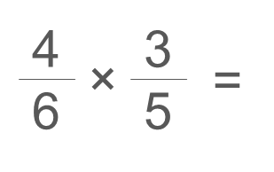
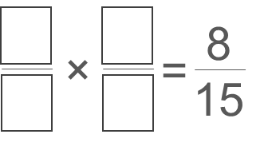
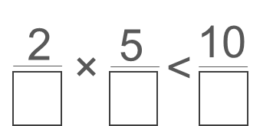
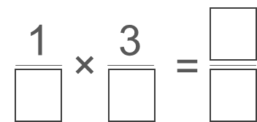
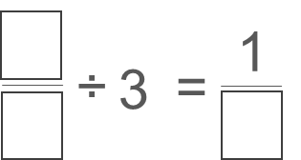
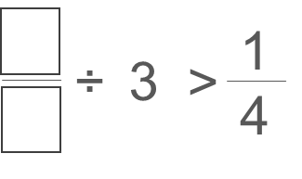
Checking prior learning
a)
b)
The length of a day on Earth is 24 hours.
The length of a day on Mercury is 58 times the length of a day on Earth.
What is the length of a day on Mercury, in hours?
Show your method.
2
3
c)
In each number sentence, replace the boxes with different whole numbers less than 20 so that the number sentence is true.
Notes:
References to the questions (links on final slide):
a) 2017 Key Stage 2 Mathematics Paper 1: arithmetic, Question 15
b) 2018 Key Stage 2 Mathematics Paper 2: reasoning, Question 23
c) NCETM primary assessment materials: Year 6, page 22

Slide 11
Common difficulties and misconceptions (1)
What aspects of this key idea might students find challenging?
What misconceptions might students have?
When teaching this topic, you may find students encounter difficulties with…
The idea that the product of two numbers can be smaller than either of those two numbers
Multiplication as scaling, rather than repeated addition
More information, and some suggestions for overcoming these challenges, can be found on the following slides
Notes:
More detail can be found on page 33 of the 2.1 Core Concept document.

Slide 12
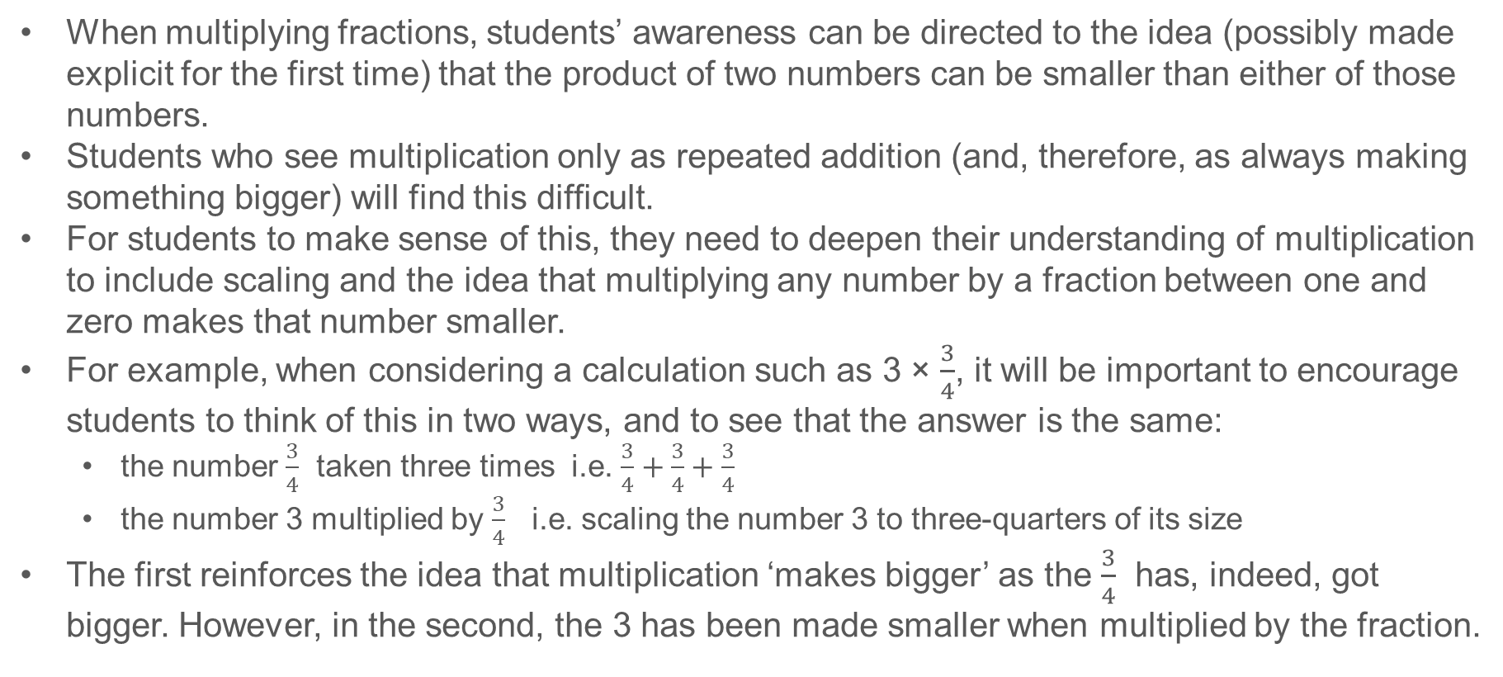
Common difficulties and misconceptions (2)
When multiplying fractions, students’ awareness can be directed to the idea (possibly made explicit for the first time) that the product of two numbers can be smaller than either of those numbers.
Students who see multiplication only as repeated addition (and, therefore, as always making something bigger) will find this difficult.
For students to make sense of this, they need to deepen their understanding of multiplication to include scaling and the idea that multiplying any number by a fraction between one and zero makes that number smaller.
For example, when considering a calculation such as 3 × $\frac{3}{4}$, it will be important to encourage students to think of this in two ways, and to see that the answer is the same:
  the number $\frac{3}{4}$ taken three times i.e. $\frac{3}{4}+\frac{3}{4}+\frac{3}{4}$
  the number 3 multiplied by $\frac{3}{4}$ i.e. scaling the number 3 to three-quarters of its size
The first reinforces the idea that multiplication ‘makes bigger’ as the $\frac{3}{4}$ has, indeed, got bigger. However, in the second, the 3 has been made smaller when multiplied by the fraction.
Notes:
More detail can be found on page 33 of the 2.1 Core Concept document.

Slide 13

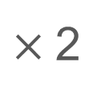

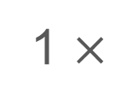
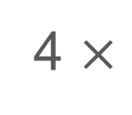

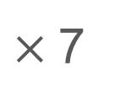


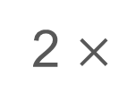
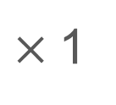
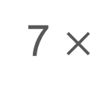


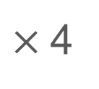

Think of multiplication as scaling/reduction when both numbers are fractions and that either fraction can be thought of as the scale factor
Example 1
1
3
1
3
1
3
1
3
a)
1 $×$
$$=$$
$×$1
$$=$$
b)
2 $×$
$$=$$
$×$2
$$=$$
1
3
1
3
1
3
1
3
c)
4 $×$
$$=$$
$×$4
$$=$$
d)
7 $×$
$$=$$
$×$7
$$=$$
Notes:
Suggested questioning:
What does each statement mean?
Why do they give the same answer?
What diagrams might you draw to help you represent these calculations?
How do you picture these calculations? Do you picture both calculations in a pair in the same way?
Things for you to think about:
In Example 1, the fraction remains the same while the integer changes. Each part also has two versions of the same calculation. It is important to draw students’ attention to the different ways we can think of multiplying – for example, if the integer is the multiplier students might think about ‘groups of’. However, if the fraction is the multiplier, students are forced to re-think multiplication as scaling.

Slide 14
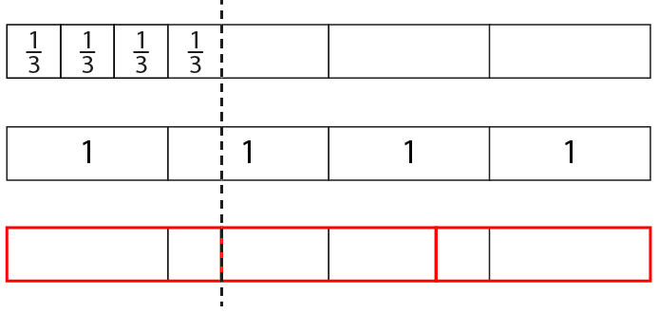

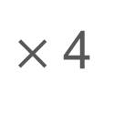

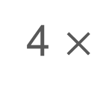
Think of multiplication as scaling/reduction when both numbers are fractions and that either fraction can be thought of as the scale factor
Example 1
1
3
1
3
c)
4 $×$
$$=$$
$×$4
$$=$$
How does this bar model show both calculations?
Notes:
Suggested questioning:
What does each statement mean?
Why do they give the same answer?
Where is the 1/3 in each bar model? Where is the 4?
Things for you to think about:
The first bar model shows 1/3 replicated four times (i.e. four groups of 1/3). The third bar model shows how four (depicted in the second bar model) has been multiplied by one third (i.e. reduced to one third of the original amount). Students could also be encouraged to use number lines to show this equivalence:

Slide 15
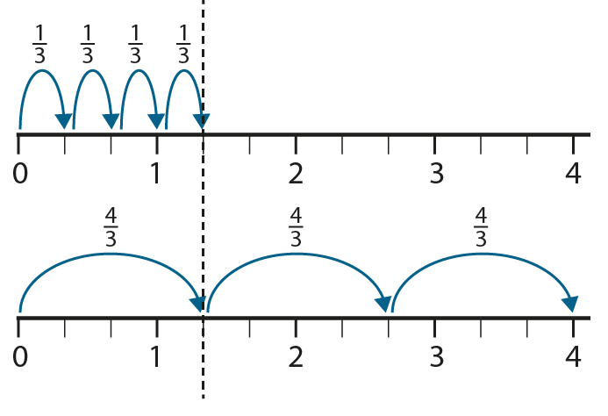




Think of multiplication as scaling/reduction when both numbers are fractions and that either fraction can be thought of as the scale factor
Example 1
1
3
1
3
c)
4 $×$
$$=$$
$×$4
$$=$$
How does this number line show both calculations?
Notes:
Suggested questioning:
What does each statement mean?
Why do they give the same answer?
Where is the 1/3 in each number line? Where is the 4?
Things for you to think about:
Students could also be encouraged to use number lines to show the equivalence of these calculations. How might you explain this representation to students?

Slide 16

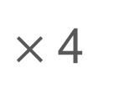

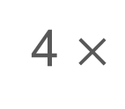
Think of multiplication as scaling/reduction when both numbers are fractions and that either fraction can be thought of as the scale factor
Example 1
1
3
1
3
c)
4 $×$
$$=$$
$×$4
$$=$$
What is the same? What is different?
Notes:
Suggested questioning:
What does each statement mean?
Why do they give the same answer?
Where is the 1/3 in each bar model? Where is the 4?
Things for you to think about:
This slide presents both representations together to support comparisons between them. What questions might you ask students to ensure they have understood these representations?

Slide 17
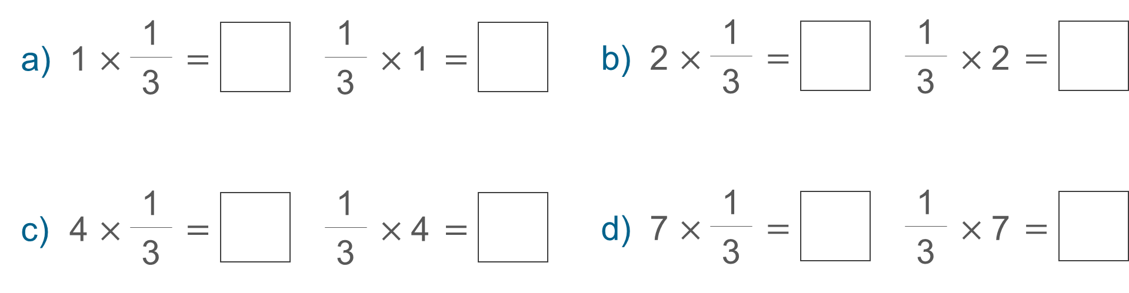
Think of multiplication as scaling/reduction when both numbers are fractions and that either fraction can be thought of as the scale factor
Example 1
  What representations might you use to support students to see these multiplications as scaling?
  What questions might you ask?
Notes:
More detail about the intention behind this example can be found on pages 33 and 34 of the 2.1 Core Concept document.

Slide 18
Think of multiplication as scaling/reduction when both numbers are fractions and that either fraction can be thought of as the scale factor
Example 1
  How might these representations support students to see multiplication as scaling?
  How do these representations model the equivalence of these calculations?
  What questions might you ask to support them to understand?
Notes:
Due to space constraints, the image on this PD discussion slide is very small. PD Leads might like to use or print the ‘in the classroom’ version of this slide for teachers to access during discussions.
This example can be found on pages 33 and 34 of the 2.1 Core Concept document.

Slide 19
Think of multiplication as scaling/reduction when both numbers are fractions and that either fraction can be thought of as the scale factor
Example 2
Which has the larger value:
1
2
1
3
1
3
1
2
1
4
1
3
1
3
1
4
of
or
of
?
of
or
of
?
Can you make up an example of your own and show how the two answers compare?
Notes:
Suggested questioning:
Which do you think will be bigger? Why?
How can you model these calculations to SHOW me which is bigger?
Things for you to think about:
Example 2 has been posed in this way (i.e. not including ‘or are they the same?’) because it is anticipated that students may be surprised by the fact that the values are the same. Try this with your students and see how they react. Is the possible surprise element important?

Slide 20

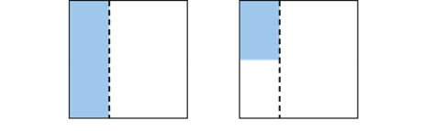

Think of multiplication as scaling/reduction when both numbers are fractions and that either fraction can be thought of as the scale factor
Example 2
Which has the larger value:
1
2
1
3
1
3
1
2
of
or
of
?
What is the same and different about these diagrams?
Notes:
Suggested questioning:
Where is the ½ in each diagram? Where is the 1/3?
How do you know that these calculations have the same value?
Things for you to think about:
Students should see how the above diagrams represent the multiplications and begin to make sense of the rule ‘multiply the denominators’. They should appreciate that the commutative law (with which they will be familiar for integers) also applies to fractions. What questions might you ask to help students do this after having worked through these examples together?

Slide 21
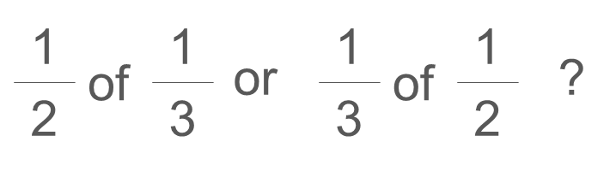
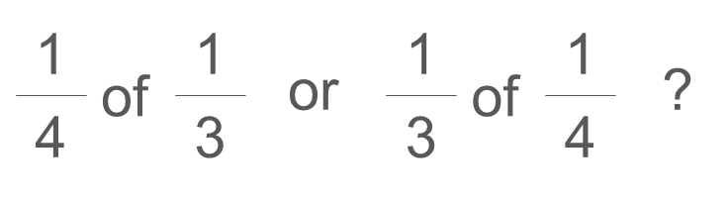
Think of multiplication as scaling/reduction when both numbers are fractions and that either fraction can be thought of as the scale factor
Example 2
  What representations might you use to support students to visualise these calculations?
  Is the possible ‘surprise’ element (of the calculations being the same) important?
  What questions might you ask to support students to make links to the commutative law?
Which has the larger value:
Can you make up an example of your own and show how the two answers compare?
Notes:
More detail about the representations you might use with this example can be found on pages 34 and 35 of the 2.1 Core Concept document.

Slide 22
Think of multiplication as scaling/reduction when both numbers are fractions and that either fraction can be thought of as the scale factor
Example 2 (cont’d)
  Think about some students that you teach. How might they approach this task? What misconceptions might you expect to uncover?
  Now watch the video of this task here: Mathematical Prompts for Deeper Thinking videos | NCETM
  How do the students’ responses compare to your expectations?
  What might their choice of representation tell you about their understanding of fractions?
Which has the larger value:
Can you make up an example of your own and show how the two answers compare?
Notes:
More detail about the representations you might use with this example can be found on pages 34 and 35 of the 2.1 Core Concept document.
A downloadable PowerPoint, giving more insight into the video and some links to research, can be found on the Mathematical Prompts for Deeper Thinking videos | NCETM page.

Slide 23
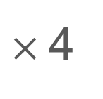


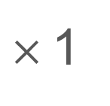
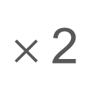
Think of multiplication as scaling/reduction when both numbers are fractions and that either fraction can be thought of as the scale factor
Example 3
Fill in the gaps with <, > or =.
1
2
1
2
1
2
1
2
1
2
a)
$×$4
d)
$$×$$
1
2
1
2
1
2
1
4
1
2
b)
$×$2
e)
$$×$$
1
2
1
2
c)
$×$1
Notes:
Suggested questioning:
What do you notice each time?
When is the product larger than ½? When is it the same? When is it smaller?
Does the multiplier always make the product bigger?
Can you write an example where the product is bigger/smaller/the same?
Things for you to think about:
This example offers a context in which to explore the misconception that ‘multiplication makes bigger’. By comparing the relative sizes of one of the factors and the resulting product in Example 3, students’ attention can be drawn to the point where the product becomes equal to and then less than ½, and so develop their understanding of when the multiplier makes the product smaller.

Slide 24
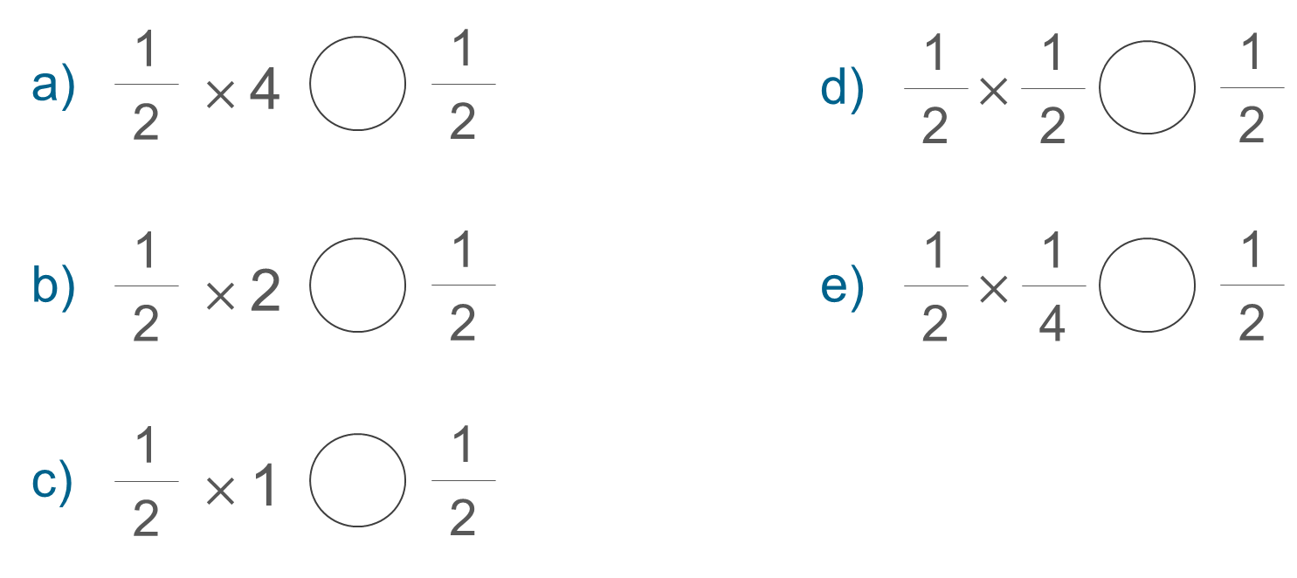
Think of multiplication as scaling/reduction when both numbers are fractions and that either fraction can be thought of as the scale factor
Example 3
Fill in the gaps with <, > or =.
  How does this sequence of questions explore the misconception that ‘multiplication makes bigger’?
  What questions might you ask alongside this example?
Notes:
More detail about the intention behind this example can be found on page 35 of the 2.1 Core Concept document.

Slide 25
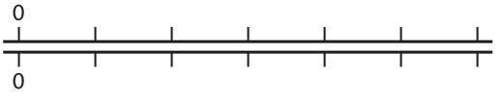
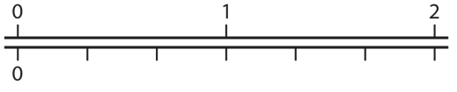
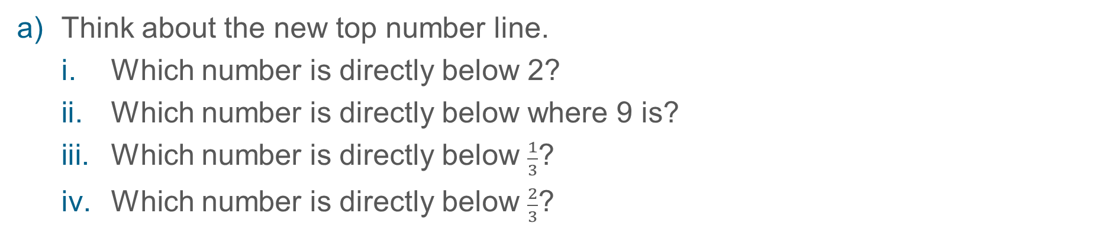
Think of multiplication as scaling/reduction when both numbers are fractions and that either fraction can be thought of as the scale factor
Example 4
Here are two identical number lines.
Now the top number line has been stretched out so that it is three times longer than before.
The bottom number line has not changed at all.
Think about the new top number line.
  Which number is directly below 2?
  Which number is directly below where 9 is?
  Which number is directly below $\frac{1}{3}$?
  Which number is directly below $\frac{2}{3}$?
Write a number sentence to describe each of your answers to part a).
Notes:
Suggested questioning:
What number is above/below __?
Can you label this line with some values that you know?
If you know __ is below __, what else do you know?
Complete the sentence: “Any value on the bottom line is __ times the value on the top line”
What is the ratio of the top line to the bottom line?
Things for you to think about:
The representation here is not intended as a tool to calculate an answer; rather it is to provide an image of multiplication as stretching or scaling. Aligning values on the top of the resulting double number line (DNL; also known as stacked number lines) with those on the bottom allows for multiplication by three (since it is ‘three times’ larger).

Slide 26
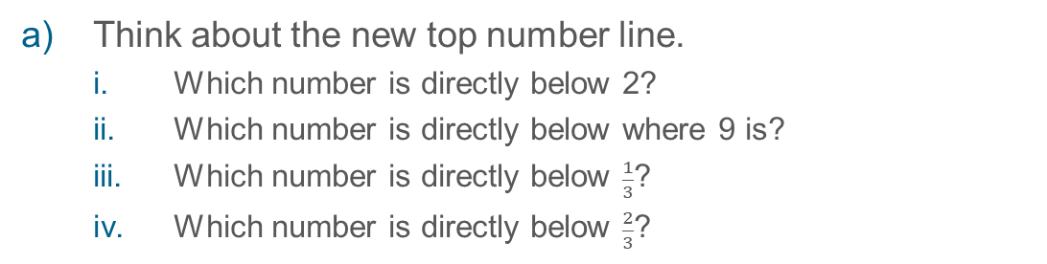
Think of multiplication as scaling/reduction when both numbers are fractions and that either fraction can be thought of as the scale factor
Example 4
Here are two identical number lines.
  How does the double (or stacked) number line support students to understand the concept of multiplication as scaling?
  How will you use your modelling and questioning to explore this representation with students?
Now the top number line has been stretched out so that it is three times longer than before.
The bottom number line has not changed at all.
Think about the new top number line.
  Which number is directly below 2?
  Which number is directly below where 9 is?
  Which number is directly below $\frac{1}{3}$?
  Which number is directly below $\frac{2}{3}$?
Write a number sentence to describe each of your answers to part a).
Notes:
Due to space constraints, the image on this PD discussion slide is very small. PD Leads might like to use or print the ‘in the classroom’ version of this slide for teachers to access during discussions.
More detail about this example, and using the DNL representation in the classroom, can be found on pages 36 and 37 of the 2.1 Core Concept document. Also there is a more detailed exploration of using the DNL in the Using Mathematical Representations in KS3 section of the NCETM website

Slide 27
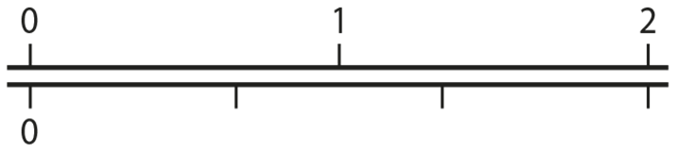
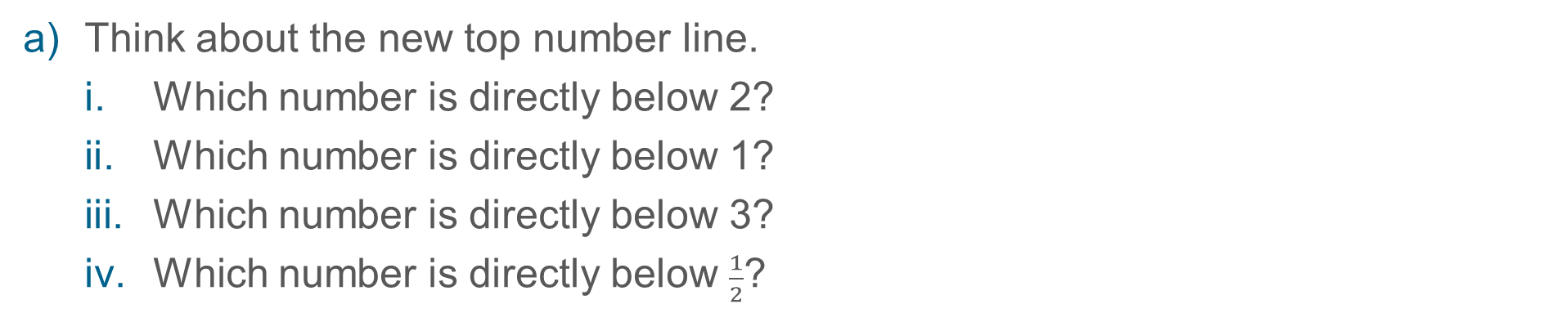
Think of multiplication as scaling/reduction when both numbers are fractions and that either fraction can be thought of as the scale factor
Example 4 (optional extension)
Here are two identical number lines.
Now the top number line has been stretched out so that it is three times longer than before.
The bottom line is also stretched out. It is two times longer than previously.
Think about the new top number line.
  Which number is directly below 2?
  Which number is directly below 1?
  Which number is directly below 3?
  Which number is directly below $\frac{1}{2}$?
Write a number sentence to describe each of your answers to part a).
Notes:
Suggested questioning:
What number is above/below __?
Can you label this line with some values that you know?
If you know __ is below __, what else do you know?
Complete the sentence: “Any value on the bottom line is __ times the value on the top line”
What is the ratio of the top line to the bottom line?
Things for you to think about:
This is a version of the PD task on slide 29 that you could use directly in the classroom. What support might students need to access it? How might exploring this task deepen their understanding of multiplication as scaling? How does the double number lines representation support this?

Slide 28
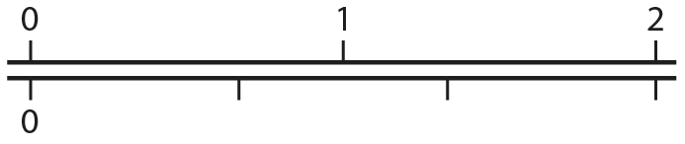

Think of multiplication as scaling/reduction when both numbers are fractions and that either fraction can be thought of as the scale factor
Example 4 (optional extension)
  You might like to consider the following situation yourself and with colleagues as a way of thinking more deeply about the double number line.
The bottom line is now also stretched out.
It is two times longer than previously.
Think about the new top number line.
  Which number is directly below 2?
  Which number is directly below 1?
  Which number is directly below 3?
  Which number is directly below $\frac{1}{2}$ ?
Write a number sentence to describe each of your answers to part a).
  Discuss and reflect on the ways that you tackled this task.
  How does this fit in with your understanding of multiplication, and particularly multiplication of fractions?
Notes:
Due to space constraints, the image on this PD discussion slide is very small. PD Leads might like to use or print the ‘in the classroom’ version of this slide for teachers to access during discussions.
More detail about this example, and using the double number line (DNL) representation in the classroom, can be found on pages 36 and 37 of the 2.1 Core Concept document. Also there is a more detailed exploration of using the DNL in the Using Mathematical Representations in KS3 section of the NCETM website.

Slide 29
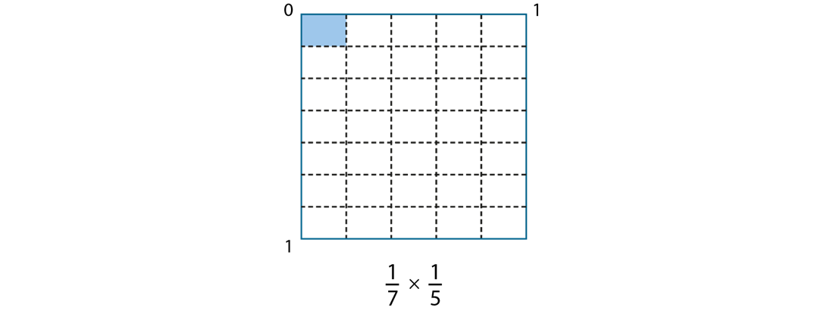
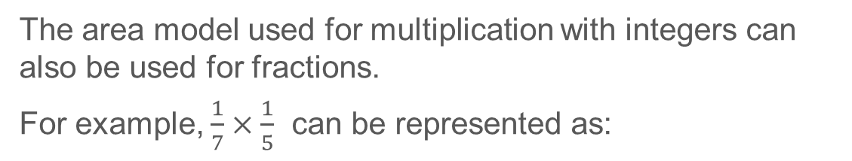
Understand how an area model can represent the multiplication of fractions
Using the area model for Examples 5 and 6
  Watch video 6 (from 11:00 onwards) from the ‘Insights from experienced teachers’ page on the NCETM website.
  How can you support students to generalise using this representation?
The area model used for multiplication with integers can also be used for fractions.
For example, $\frac{1}{7}×\frac{1}{5}$ can be represented as:

Slide 30
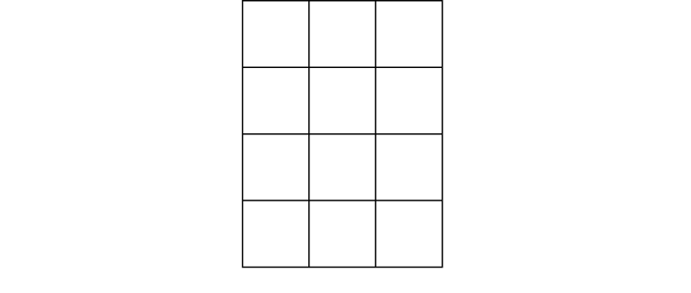
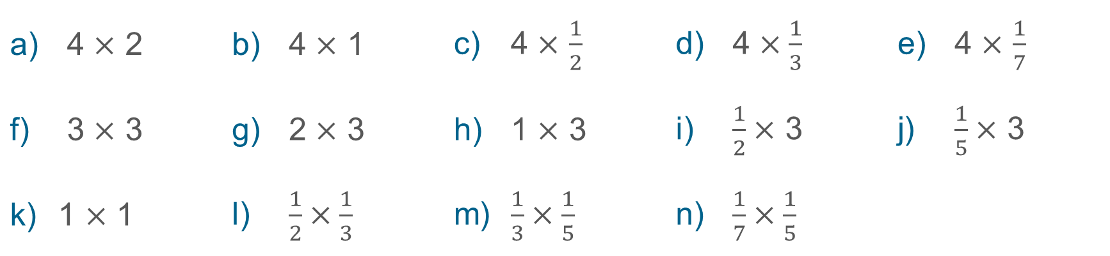
Understand how an area model can represent the multiplication of fractions
Example 5
This is a picture for 4 × 3:
Draw a similar picture for each of these and use it to state each product.
4 $×$ 2 | 4 $×$ 1 | 4 $×$ $\frac{1}{2}$ | 4 $×\frac{1}{3}$ | 4 $×$ $\frac{1}{7}$
3 $×$ 3 | 2 $×$ 3 | 1 $×$ 3 | $\frac{1}{2}×$ 3 | $\frac{1}{5}×$ 3
1 $×$ 1 | $\frac{1}{2}×\frac{1}{3}$ | $\frac{1}{3}×\frac{1}{5}$ | $\frac{1}{7}×\frac{1}{5}$
Notes:
Suggested questioning:
What is the same/different about the first five sets of calculations? How can you draw a picture for each one?
Which calculations ‘reduce’ the side of your rectangle? Why?
(For parts l, m and n) Why do you get sixths when you multiply halves and thirds? Why do you get fifteenths when you multiply thirds and fifths?
(After parts l, m and n) My product has a denominator of 24. What two fractions might I have multiplied together?
Things for you to think about:
In Example 5, the numbers have been chosen to draw attention to the idea of reducing one side of the rectangle (while keeping the other side constant), and so reducing the area (product), and to focus on the fraction as the multiplier.
It will be important to pause after a few of these (during the first set of five and then again during the second set of five) and ask students what is the same and what is different about successive calculations, and what they notice about the product

Slide 31
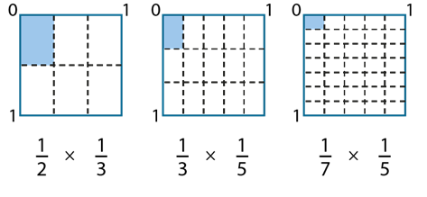

Understand how an area model can represent the multiplication of fractions
Example 5
Explain how each of these diagrams represent these multiplications
$\frac{1}{2}×\frac{1}{3}$ | $\frac{1}{3}×\frac{1}{5}$ | $\frac{1}{7}×\frac{1}{5}$
Notes:
Suggested questioning:
How does the unit square help us to show multiplication of two fractions?
What fraction of the unit square is shaded? What do you notice about this denominator?
Things for you to think about:
Once students have established that 1x1 (part k from the previous slide) can be represented as a unit square, you can introduce the idea of each side as a unit that can be further reduced, or as a number line from 0 to 1 where fractions can be placed. This important image and associated awareness will support students in seeing the multiplication of any two fractions as an area within the unit square.

Slide 32
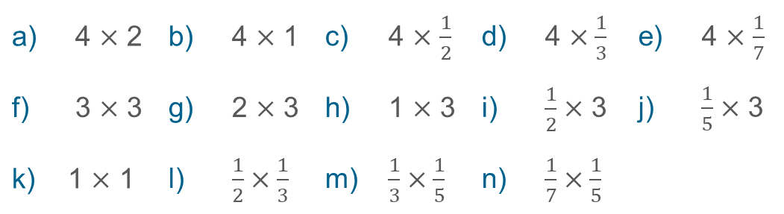
Understand how an area model can represent the multiplication of fractions
Example 5
This is a picture for 4 × 3:
  What is the effect of the number choice and sequencing in this example?
  What language will you use to support students’ understanding of the unit square to model multiplication of fractions?
Draw a similar picture for each of these and use it to state each product.
4 $×$ 2 | 4 $×$ 1 | 4 $×$ $\frac{1}{2}$ | 4 $×\frac{1}{3}$ | 4 $×$ $\frac{1}{7}$
3 $×$ 3 | 2 $×$ 3 | 1 $×$ 3 | $\frac{1}{2}×$ 3 | $\frac{1}{5}×$ 3
1 $×$ 1 | $\frac{1}{2}×\frac{1}{3}$ | $\frac{1}{3}×\frac{1}{5}$ | $\frac{1}{7}×\frac{1}{5}$
Notes:
Due to space constraints, the image on this PD discussion slide is very small. PD Leads might like to use or print the ‘in the classroom’ version of this slide for teachers to access during discussions.
More detail about the intention behind this example can be found on pages 37 and 38 of the 2.1 Core Concept document. You can also watch two teachers discussing this representation on the NCETM website; it is clip 6 in the ‘Insights from experienced teachers’ page. Links can be found on the final slide.

Slide 33
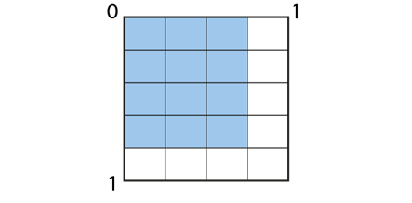

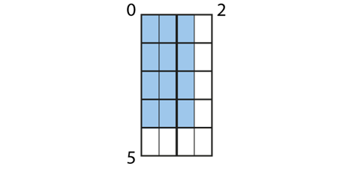
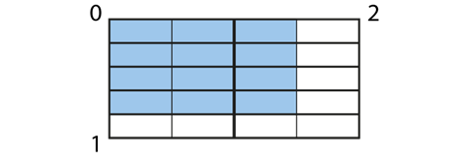
Understand how an area model can represent the multiplication of fractions
Example 6
What multiplication might these diagrams represent?
Write a number sentence for each.
Which of these diagrams show the answer to the multiplication clearly, and which do you need to think about more?
(i)
(ii)
(iii)
(iv)
Notes:
Suggested questioning:
What is each length of the blue rectangle each time? Why is it not just ‘3’ and ‘4’?
What is the same and what is different about these diagrams?
What is the same and what is different about the calculations they represent?
Where is the ‘3’ and ‘4’ in each calculation? Where is the 12?
Things for you to think about:
The representation is varied in Example 6 to deepen students’ understanding of the area model of multiplication and to connect multiplication of fractions and integers.

Slide 34
Understand how an area model can represent the multiplication of fractions
Example 6
(i)
(ii)
What is the same and different about these two examples?
Notes:
Suggested questioning:
What is the same and what is different about these diagrams?
What is the same and what is different about the calculations they represent?
Where is the ‘3’ and ‘4’ in each calculation? Where is the 12?
Things for you to think about:
In part (i), a unit square is used to model a multiplication. In part (ii), a different multiplication is being modelled, although the visual structure looks the same as part (i).
It will be helpful to ask ‘What is the same and what is different about diagrams (i) and (ii) and the calculations they represent?’ in order to draw students’ attention to the similarities in structure between 3 × 4 and ¾ x 4/5 .

Slide 35
Understand how an area model can represent the multiplication of fractions
Example 6
(iii)
(iv)
What is the same and different about these two examples?
Notes:
Suggested questioning:
What is the same and what is different about these diagrams?
What is the same and what is different about the calculations they represent?
Where is the ‘3’ and ‘4’ in each calculation? Where is the 12?
Things for you to think about:
In part (iii), students need to think more deeply about what the dimensions of the shaded area are – what the ‘3’ and the ‘4’ represent (the diagram is representing three halves multiplied by four ones). Similarly, in part (iv) students will need to give careful thought to what the ‘3 by 4’ shaded rectangle represents. Discussion of these diagrams and their respective calculations should lead to the awareness that while the numerator is 12 each time, the denominator is different

Slide 36
Understand how an area model can represent the multiplication of fractions
Example 6
What multiplication might these diagrams represent?
Write a number sentence for each.
Which of these diagrams show the answer to the multiplication clearly, and which do you need to think about more?
  What is the effect of varying the calculation but keeping the shaded area the same?
  What might students struggle with in interpreting these diagrams?
  What questions or language structures might you use to support them?
(i)
(ii)
(iii)
(iv)
Notes:
Due to space constraints, the image on this PD discussion slide is very small. PD Leads might like to use or print the ‘in the classroom’ version of this slide for teachers to access during discussions.
More detail about the variation behind this example can be found on pages 38 and 39 of the 2.1 Core Concept document.

Slide 37
Reflection questions
What other mathematical concepts will be supported by students’ stronger understanding of this key idea?
What mathematical language will you continue to use to support pupils to make connections with other areas?
Which representations might you continue to use to further develop students’ understanding?

Slide 39
Appendices
You may choose to use the following slides when planning or delivering a PD session. They cover:
  Key vocabulary
  Representations and structure
  Future learning
  Library of links

Slide 40
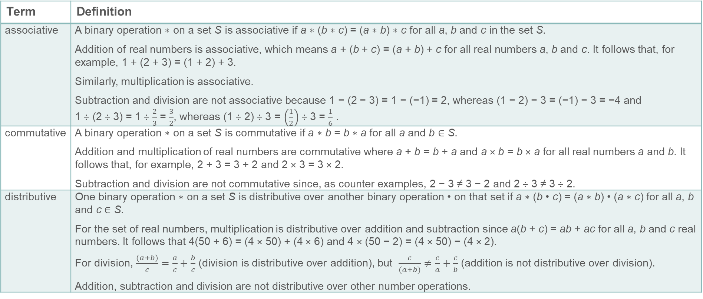
Key vocabulary (1)
Term | Definition
associative | A binary operation ∗ on a set S is associative if a ∗ (b ∗ c) = (a ∗ b) ∗ c for all a, b and c in the set S. Addition of real numbers is associative, which means a + (b + c) = (a + b) + c for all real numbers a, b and c. It follows that, for example, 1 + (2 + 3) = (1 + 2) + 3. Similarly, multiplication is associative. Subtraction and division are not associative because 1 − (2 − 3) = 1 − (−1) = 2, whereas (1 − 2) − 3 = (−1) − 3 = −4 and 1 ÷ (2 ÷ 3) = 1 ÷ $\frac{2}{3}$ = $\frac{3}{2}$, whereas (1 ÷ 2) ÷ 3 = $\left(\frac{1}{2}\right)$ ÷ 3 = $\frac{1}{6}$ .
commutative | A binary operation ∗ on a set S is commutative if a ∗ b = b ∗ a for all a and b ∈ S. Addition and multiplication of real numbers are commutative where a + b = b + a and a × b = b × a for all real numbers a and b. It follows that, for example, 2 + 3 = 3 + 2 and 2 × 3 = 3 × 2. Subtraction and division are not commutative since, as counter examples, 2 − 3 ≠ 3 − 2 and 2 ÷ 3 ≠ 3 ÷ 2.
distributive | One binary operation ∗ on a set S is distributive over another binary operation • on that set if a ∗ (b • c) = (a ∗ b) • (a ∗ c) for all a, b and c ∈ S. For the set of real numbers, multiplication is distributive over addition and subtraction since a(b + c) = ab + ac for all a, b and c real numbers. It follows that 4(50 + 6) = (4 × 50) + (4 × 6) and 4 × (50 − 2) = (4 × 50) − (4 × 2). For division, $\frac{(a+b)}{c}=\frac{a}{c}+\frac{b}{c}$ (division is distributive over addition), but $\frac{c}{(a+b)}≠\frac{c}{a}+\frac{c}{b}$ (addition is not distributive over division). Addition, subtraction and division are not distributive over other number operations.

Slide 41
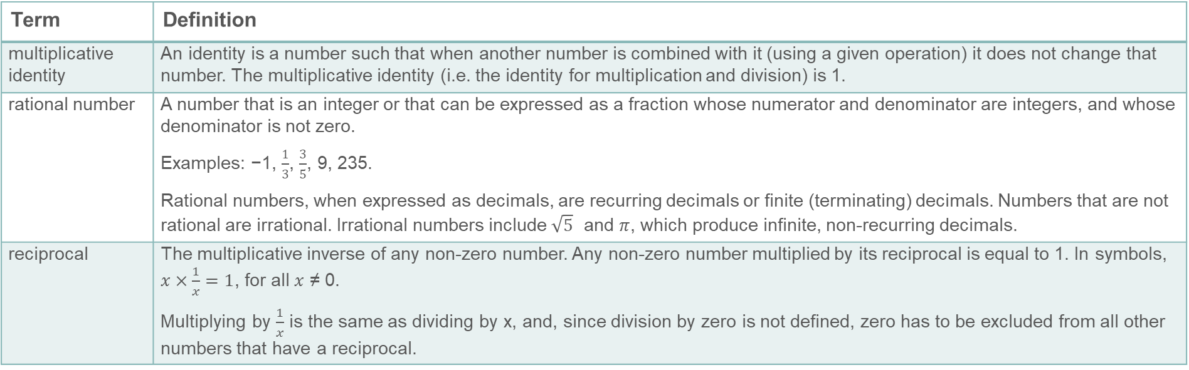
Key vocabulary (2)
Term | Definition
multiplicative identity | An identity is a number such that when another number is combined with it (using a given operation) it does not change that number. The multiplicative identity (i.e. the identity for multiplication and division) is 1.
rational number | A number that is an integer or that can be expressed as a fraction whose numerator and denominator are integers, and whose denominator is not zero. Examples: −1, $\frac{1}{3}$, $\frac{3}{5}$, 9, 235. Rational numbers, when expressed as decimals, are recurring decimals or finite (terminating) decimals. Numbers that are not rational are irrational. Irrational numbers include $\sqrt{5}$ and $π$, which produce infinite, non-recurring decimals.
reciprocal | The multiplicative inverse of any non-zero number. Any non-zero number multiplied by its reciprocal is equal to 1. In symbols, $x×\frac{1}{x}=1$, for all $x$ ≠ 0. Multiplying by $\frac{1}{x}$ is the same as dividing by x, and, since division by zero is not defined, zero has to be excluded from all other numbers that have a reciprocal.

Slide 42

Representations and structure
There are a number of different representations that you may wish to use to support students’ understanding of this key idea. These might include:
Arrays and area models
  The array is a useful image for revealing the commutative and distributive properties of multiplication. When the rectangle has continuous measures for the dimensions, it becomes a useful way of thinking about the product of any two numbers including decimals and fractions.
Bar models
  Bar models can be very useful to support students in representing (literally, re-presenting) problems to reveal additive and multiplicative structures, including those involving fractions.
Notes:
More information about the representations and structure involved in this key idea can be found:
On page 11 and 12 of the Theme Overview document.
In the ‘Using mathematical representations at KS3’ documents
Links to all of these can be found on the final slide.

Slide 43
Previous learning (1)
From Upper Key Stage 2, students will bring experience of:
multiplying multi-digit numbers up to four digits by a two-digit whole number using the formal written method of long multiplication
dividing numbers up to four digits by a two-digit whole number using the formal written method of long division, and interpreting remainders as whole number remainders, fractions, or by rounding, as appropriate for the context
dividing numbers up to four digits by a two-digit number using the formal written method of short division where appropriate, and interpreting remainders according to the context
performing mental calculations, including with mixed operations and large numbers
using their knowledge of the order of operations to carry out calculations involving the four operations
solving addition and subtraction multi-step problems in contexts, deciding which operations and methods to use and why
Notes:
Theme 2 Operating on number

Slide 44
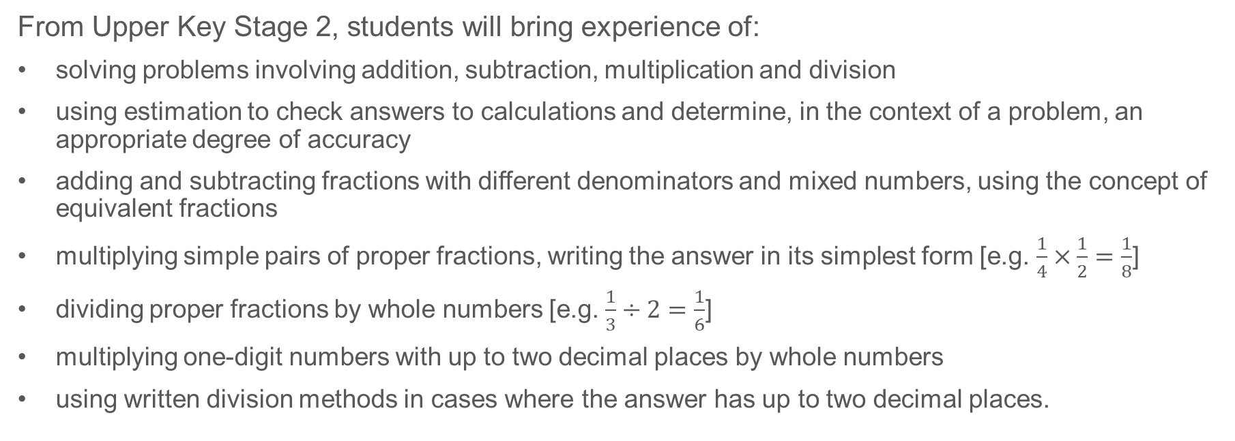
Previous learning (2)
From Upper Key Stage 2, students will bring experience of:
solving problems involving addition, subtraction, multiplication and division
using estimation to check answers to calculations and determine, in the context of a problem, an appropriate degree of accuracy
adding and subtracting fractions with different denominators and mixed numbers, using the concept of equivalent fractions
multiplying simple pairs of proper fractions, writing the answer in its simplest form [e.g. $\frac{1}{4}×\frac{1}{2}=\frac{1}{8}$]
dividing proper fractions by whole numbers [e.g. $\frac{1}{3}÷2=\frac{1}{6}$]
multiplying one-digit numbers with up to two decimal places by whole numbers
using written division methods in cases where the answer has up to two decimal places.
Notes:
Theme 2 Operating on number

Slide 45

Future learning
In KS4, students will build on the core concepts in this mathematical theme to:
calculate with roots and with integer {and fractional} indices
calculate exactly with fractions, {surds} and multiples of $π$; {simplify surd expressions involving squares [e.g. $\sqrt{12}=\sqrt{(4×3)}=\sqrt{4}×\sqrt{3}=2\sqrt{3}$ ] and rationalise denominators}
calculate with numbers in standard form A × 10^{n}, where 1 ≤ A < 10 and n is an integer
solve two simultaneous equations in two variables (linear/linear {or linear/quadratic}) algebraically; find approximate solutions using a graph
translate simple situations or procedures into algebraic expressions or formulae; derive an equation (or two simultaneous equations), solve the equation(s) and interpret the solution
solve linear inequalities in one {or two} variable{s}, {and quadratic inequalities in one variable}; represent the solution set on a number line, {using set notation and on a graph}.
Please note: Braces { } indicate additional mathematical content to be taught to more highly attaining students. Square brackets [ ] indicate content schools are not required to teach by law.
Notes:
Theme 2 Operating on number

Slide 46
Library of links
The following resources from the NCETM website have been referred to within this slide deck:
  NCETM Secondary Mastery Professional Development
    2 Operating on number Theme Overview Document
    2.1 Arithmetic procedures Core Concept Document
  Using mathematical representations at KS3 | NCETM
  Insights from experienced teachers | NCETM
  Mathematical Prompts for Deeper Thinking videos | NCETM
  NCETM primary mastery professional development materials
  NCETM primary assessment materials
There are also references to:
  Standards & Testing Agency’s past mathematics papers

