Slide 1
Year 5, Unit 4
Short Multiplication and Short Division

Slide 2
Year 5, Unit 4
These materials heavily reflect the prioritisation approach of the ready-to-progress criteria in the DfE Primary Mathematics Guidance 2020 and on the PPTs that exemplify them on the NCETM website. They also include other relevant National Curriculum content. Related sections of the NCETM Primary Mastery Professional Development Materials provide small-step teaching guidance.
Ready-to-progress criteria addressed by this unit
Teaching of this unit supports the following criteria from the ‘DfE Mathematics Guidance: key stages 1 & 2’ (the 335-page document available as a download)
5MD-3 Page 248
5MD-4 Page 252
Prior learning
If the following ready-to-progress criteria, contained in the same DfE guidance document as above, were secured in Year 4, children will be ready to start on this unit.
4MD-3 Page 178

Slide 3
Contents
The links below take you to the starting slide of each learning outcome.
1 | Pupils multiply a two-digit number by a single-digit number using partitioning and representations (no regroups)
2 | Pupils multiply a two-digit number by a single-digit number using partitioning and representations (one regroup)
3 | Pupils multiply a two-digit number by a single-digit number using partitioning and representations (two regroups)
4 | Pupils multiply a two-digit number by a single-digit number using partitioning
5 | Pupils multiply a two-digit number by a single-digit number using expanded multiplication (no regroups)
6 | Pupils multiply a two-digit number by a single-digit number using short multiplication (no regroups)
7 | Pupils multiply a two-digit number by a single-digit number using expanded multiplication (regrouping ones to tens)
Click the arrow button to return to this Contents slide.

Slide 4
Contents
The links below take you to the starting slide of each learning outcome.
8 | Pupils multiply a two-digit number by a single-digit number using short multiplication (regrouping ones to tens)
9 | Pupils multiply a two-digit number by a single-digit number using expanded multiplication (regrouping tens to hundreds)
10 | Pupils multiply a two-digit number by a single-digit number using short multiplication (regrouping tens to hundreds)
11 | Pupils multiply a two-digit number by a single-digit number using both expanded and short multiplication (two regroups)
12 | Pupils use estimation to support accurate calculation
13 | Pupils multiply a three-digit number by a single-digit number using partitioning and representations
Click the arrow button to return to this Contents slide.

Slide 5
Contents
The links below take you to the starting slide of each learning outcome.
14 | Pupils multiply a three-digit number by a single-digit number using partitioning
15 | Pupils multiply a three-digit number by a single-digit number using expanded and short multiplication (no regroups)
16 | Pupils multiply a three-digit number by a single-digit number using expanded and short multiplication (one regroup)
17 | Pupils multiply a three-digit number by a single-digit number using expanded and short multiplication (multiple regroups)
18 | Pupils use estimation to support accurate calculation
19 | Pupils divide a two-digit number by a single-digit number using partitioning and representations (no remainders, no exchanging)
Click the arrow button to return to this Contents slide.

Slide 6
Contents
The links below take you to the starting slide of each learning outcome.
20 | Pupils divide a two-digit number by a single-digit number using partitioning and representations (with exchanging)
21 | Pupils divide a two-digit number by a single-digit number using partitioning and representations (with exchanging and remainders)
22 | Pupils divide a two-digit number by a single-digit number using short division (no exchanging, no remainders)
23 | Pupils divide a two-digit number by a single-digit number using short division (with exchanging)
24 | Pupils divide a two-digit number by a single-digit number using short division (with exchanging and remainders)
25 | Pupils divide a three-digit number by a single-digit number using partitioning and representations (no exchanging, no remainders)
Click the arrow button to return to this Contents slide.

Slide 7
Contents
The links below take you to the starting slide of each learning outcome.
26 | Pupils divide a three-digit number by a single-digit number using partitioning and representations (one exchange, no remainders)
27 | Pupils divide a three-digit number by a single-digit number using partitioning and representations (with exchanging and remainders)
28 | Pupils divide a three-digit number by a single-digit number using short division
29 | Pupils divide a three-digit number by a single-digit number using short division (with exchanging and remainders)
30 | Pupils solve short division problems accurately when the hundreds digit is smaller than the divisor
31 | Pupils will use efficient strategies of division to solve problems
Click the arrow button to return to this Contents slide.

Slide 8
Year 5, Unit 4, Learning Outcome 1
Learning Outcome 1
Pupils multiply a two-digit number by a single-digit number using partitioning and representations (no regroups)
The following slides have been collated to support the teaching of this learning outcome.

Slide 9
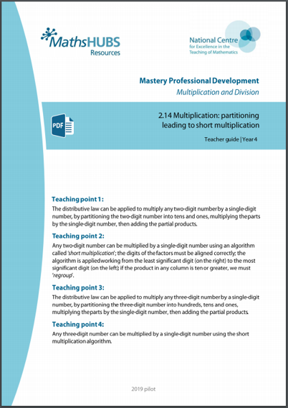
Year 5, Unit 4, Learning Outcome 1
Additional teacher guidance for this outcome should be read first and can be found in this segment of the NCETM Primary Mastery Professional Development Materials:
2.14 Multiplication: partitioning leading to short multiplication
The spine materials are divided into ‘teaching points’ and ‘steps in learning’.
Teaching point | Steps in learning | Pages
1 | 1:1-1:2 | 3-5

Slide 10
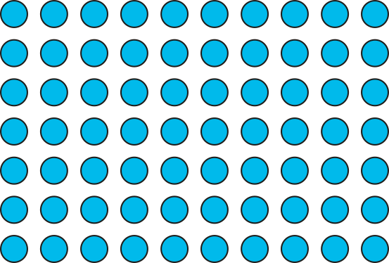
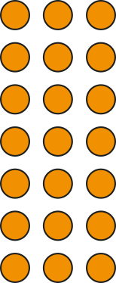
2.14 Short multiplication Step 1:1
7 × 13
= 91
10
3
7
70
21
7 × 13 = 7 × 10 + 7 × 3
= 70
+
21
= 91

Slide 11

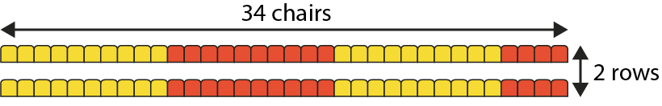
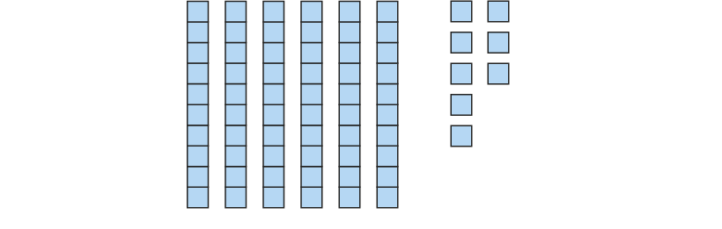
2.14 Short multiplication Step 1:2
2 rows, each with 34 chairs. How many chairs altogether?
34 = 30 + 4
34 × 2 = 30 × 2 + 4 × 2
= 60 + 8
= 68
Notes:
Thirty-four is equal to three tens and four ones.
Gather thirty-four and multiply by two.
Three-tens-and-four-ones multiplied by two.
Three-tens-and-four-ones multiplied by two is equal
to three tens multiplied by two and four ones multiplied by two.
3 tens × 2 = 6 tens
4 ones × 2 = 8 ones

Slide 12
Year 5, Unit 4, Learning Outcome 2
Learning Outcome 2
Pupils multiply a two-digit number by a single-digit number using partitioning and representations (one regroup)
The following slides have been collated to support the teaching of this learning outcome.

Slide 13
Year 5, Unit 4, Learning Outcome 2
Additional teacher guidance for this outcome should be read first and can be found in this segment of the NCETM Primary Mastery Professional Development Materials:
2.14 Multiplication: partitioning leading to short multiplication
The spine materials are divided into ‘teaching points’ and ‘steps in learning’.
Teaching point | Steps in learning | Pages
1 | 1:3-1:4 | 6-9

Slide 14

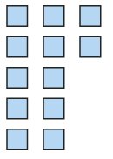



2.14 Short multiplication Step 1:3
3 rows, each with 24 chairs. How many chairs altogether?
24 × 3 = 20 × 3 + 4 × 3
= 60 + 12
= 70 + 2
= 72
Notes:
Two-tens-and-four-ones multiplied by three is equal to
two tens multiplied by three and four ones multiplied by three.
2 tens × 3 = 6 tens
4 ones × 3 = 12 ones
Regroup the ones into tens and ones.
Twelve ones is equal to one ten and two ones.
12 ones = 1 ten + 2 ones

Slide 15
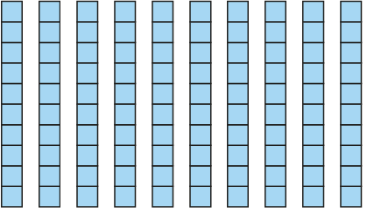
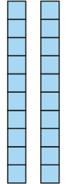
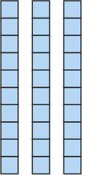


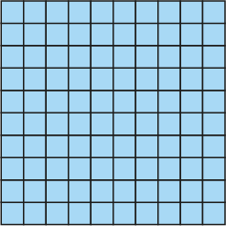
2.14 Short multiplication Step 1:4
4 rows, each with 32 chairs. How many chairs altogether?
32 × 4 = 30 × 4 + 2 × 4
= 120 + 8
= 128
Notes:
Three-tens-and-two-ones multiplied by four is equal to
three tens multiplied by four and two ones multiplied by four.
3 tens × 4 = 12 tens
2 ones × 4 = 8 ones
Regroup the tens into hundreds and tens.
Twelve tens is equal to one hundred and two tens.
12 tens = 1 hundred + 2 tens

Slide 16
Year 5, Unit 4, Learning Outcome 3
Learning Outcome 3
Pupils multiply a two-digit number by a single-digit number using partitioning and representations (two regroups)
The following slides have been collated to support the teaching of this learning outcome.

Slide 17
Year 5, Unit 4, Learning Outcome 3
Additional teacher guidance for this outcome should be read first and can be found in this segment of the NCETM Primary Mastery Professional Development Materials:
2.14 Multiplication: partitioning leading to short multiplication
The spine materials are divided into ‘teaching points’ and ‘steps in learning’.
Teaching point | Steps in learning | Pages
1 | 1:5 | 10-11

Slide 18
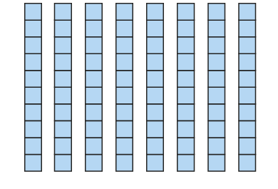
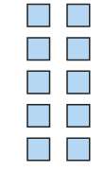





2.14 Short multiplication Step 1:5
4 rows, each with 26 chairs. How many chairs altogether?
26 × 4 = 20 × 4 + 6 × 4
= 80 + 24
= 100 + 4
= 104
Notes:
Two-tens-and-six-ones multiplied by four is equal to
two tens multiplied by four and six ones multiplied by four.
2 tens × 4 = 8 tens
6 ones × 4 = 24 ones
Twenty-four ones is equal to two tens and four ones
24 ones = 2 tens + 4 ones
Ten tens is equal to one hundred.
10 tens = 1 hundred

Slide 19
Year 5, Unit 4, Learning Outcome 4
Learning Outcome 4
Pupils multiply a two-digit number by a single-digit number using partitioning
The following slides have been collated to support the teaching of this learning outcome.

Slide 20
Year 5, Unit 4, Learning Outcome 4
Additional teacher guidance for this outcome should be read first and can be found in this segment of the NCETM Primary Mastery Professional Development Materials:
2.14 Multiplication: partitioning leading to short multiplication
The spine materials are divided into ‘teaching points’ and ‘steps in learning’.
Teaching point | Steps in learning | Pages
1 | 1:6-1:7 | 12-14

Slide 21
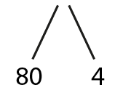
2.14 Short multiplication Step 1:6
1 pack of biscuits costs 84 p. How much do 6 packs cost?
84 × 6 =
504
80 × 6 = 480
4 × 6 = 24
480 + 24
= 504
6 packs cost 504p

Slide 22
Year 5, Unit 4, Learning Outcome 5
Learning Outcome 5
Pupils multiply a two-digit number by a single-digit number using expanded multiplication (no regroups)
The following slides have been collated to support the teaching of this learning outcome.

Slide 23
Year 5, Unit 4, Learning Outcome 5
Additional teacher guidance for this outcome should be read first and can be found in this segment of the NCETM Primary Mastery Professional Development Materials:
2.14 Multiplication: partitioning leading to short multiplication
The spine materials are divided into ‘teaching points’ and ‘steps in learning’.
Teaching point | Steps in learning | Pages
2 | 2:1-2:3 | 15-17

Slide 24
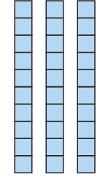

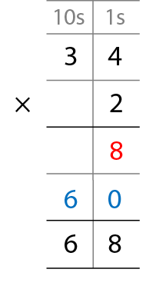
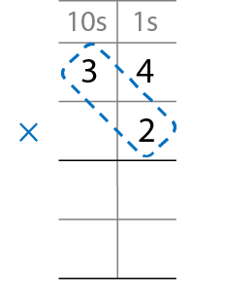
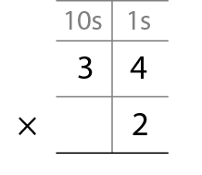
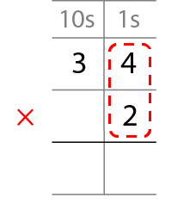
2.14 Short multiplication Step 2:1
2 rows, each with 34 chairs. How many chairs altogether?
8
2 × 4 ones = 8 ones
6
0
2 × 3 tens = 6 tens
Notes:
Step 1 – write the factors.
Step 2 – multiply the one-digit number by the ones.
Step 3 – multiply the one-digit number by the tens.
Step 4 – add the partial products.

Slide 25
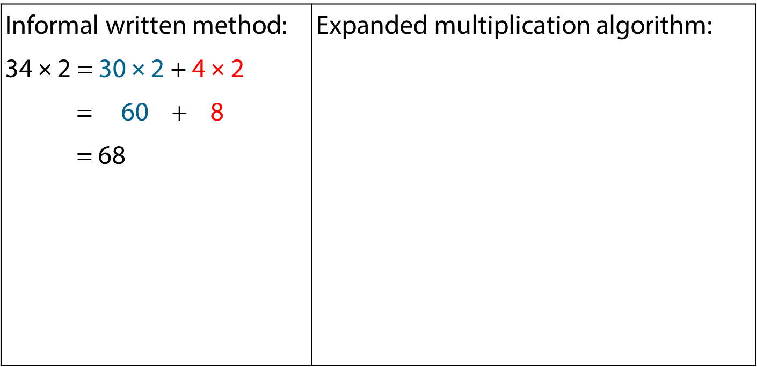
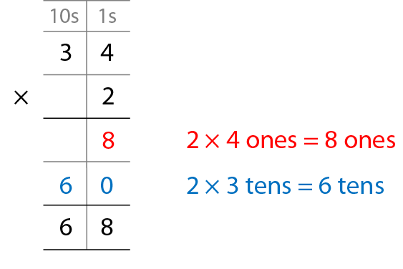
2.14 Short multiplication Step 2:2
Notes:
What’s the same?
What’s different?

Slide 26
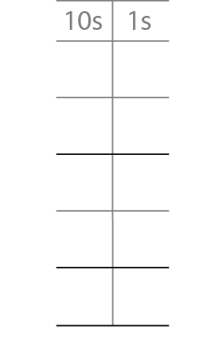
2.14 Short multiplication Step 2:3
3 × 32 =
96
3
2
×
3
6
3 × 2 ones = 6 ones
9
0
3 × 3 tens = 9 tens
9
6

Slide 27
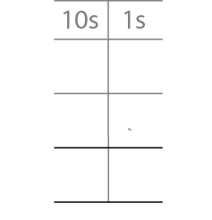
2.14 Short multiplication Step 2:3
3 × 32 =
96
3
2
×
3
9
6
3 × 2 ones = 6 ones
Write “6” in the ones column.
3 × 3 tens = 9 tens
Write “9” in the tens column.

Slide 28
Year 5, Unit 4, Learning Outcome 6
Learning Outcome 6
Pupils multiply a two-digit number by a single-digit number using short multiplication (no regroups)
The following slides have been collated to support the teaching of this learning outcome.

Slide 29
Year 5, Unit 4, Learning Outcome 6
Additional teacher guidance for this outcome should be read first and can be found in this segment of the NCETM Primary Mastery Professional Development Materials:
2.14 Multiplication: partitioning leading to short multiplication
The spine materials are divided into ‘teaching points’ and ‘steps in learning’.
Teaching point | Steps in learning | Pages
2 | 2:4-2:5 | 18

Slide 30
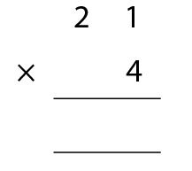
2.14 Short multiplication Step 2:4
21 × 4 =
84
8
4
Notes:
4 × 1 one = 4 ones
Write “4” in the ones column.
4 × 2 tens = 8 tens
Write “8” in the tens column.

Slide 31
Year 5, Unit 4, Learning Outcome 7
Learning Outcome 7
Pupils multiply a two-digit number by a single-digit number using expanded multiplication (regrouping ones to tens)
The following slides have been collated to support the teaching of this learning outcome.

Slide 32
Year 5, Unit 4, Learning Outcome 7
Additional teacher guidance for this outcome should be read first and can be found in this segment of the NCETM Primary Mastery Professional Development Materials:
2.14 Multiplication: partitioning leading to short multiplication
The spine materials are divided into ‘teaching points’ and ‘steps in learning’.
Teaching point | Steps in learning | Pages
2 | 2:6 | 19-20

Slide 33
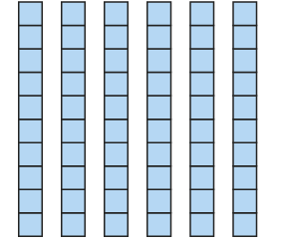

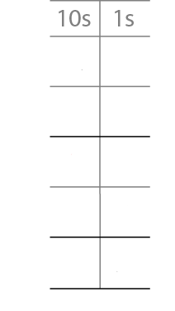


2.14 Short multiplication Step 2:6
3 rows, each with 24 chairs. How many chairs altogether?
2
4
×
3
3 × 4 ones = 12 ones
1
2
= 1 ten + 2 ones
6
0
3 × 2 tens = 6 tens
7
2

Slide 34
Year 5, Unit 4, Learning Outcome 8
Learning Outcome 8
Pupils multiply a two-digit number by a single-digit number using short multiplication (regrouping ones to tens)
The following slides have been collated to support the teaching of this learning outcome.

Slide 35
Year 5, Unit 4, Learning Outcome 8
Additional teacher guidance for this outcome should be read first and can be found in this segment of the NCETM Primary Mastery Professional Development Materials:
2.14 Multiplication: partitioning leading to short multiplication
The spine materials are divided into ‘teaching points’ and ‘steps in learning’.
Teaching point | Steps in learning | Pages
2 | 2:7-2:8 | 20-21

Slide 36
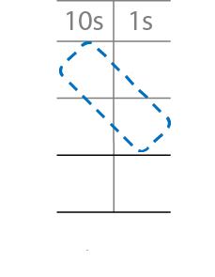
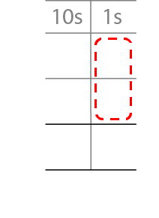
2.14 Short multiplication Step 2:7
2
4
×
3
3 × 4 ones = 12 ones
3 × 2 tens = 6 tens
7
2
6 tens + 1 ten = 7 tens
= 1 ten + 2 ones
1
Write “7” in the tens column.
Write “1” below the tens column and “2” in the ones column.
Notes:
Step 1 – write the factors.
Step 2 – multiply the one-digit number by the ones and regroup.
Step 3 – multiply the one-digit number by the tens and add
the tens from regrouping

Slide 37
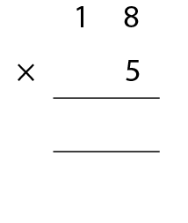
2.14 Short multiplication Step 2:7
18 × 5 =
90
9
0
4
Notes:
5 × 8 ones = 40 ones; 40 ones = 4 tens and 0 ones
Write “4” below the tens column and “0” in the ones column.
5 × 1 ten = 5 tens
5 × 1 ten + 4 tens = 9 tens
Write “9’” in the tens column

Slide 38
Year 5, Unit 4, Learning Outcome 9
Learning Outcome 9
Pupils multiply a two-digit number by a single-digit number using expanded multiplication (regrouping tens to hundreds)
The following slides have been collated to support the teaching of this learning outcome.

Slide 39
Year 5, Unit 4, Learning Outcome 9
Additional teacher guidance for this outcome should be read first and can be found in this segment of the NCETM Primary Mastery Professional Development Materials:
2.14 Multiplication: partitioning leading to short multiplication
The spine materials are divided into ‘teaching points’ and ‘steps in learning’.
Teaching point | Steps in learning | Pages
2 | 2:9 | 22-23

Slide 40
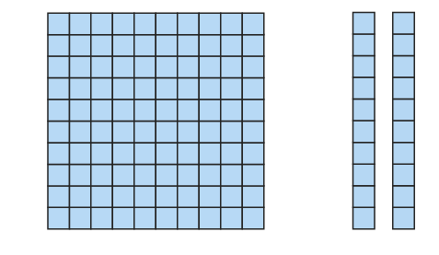
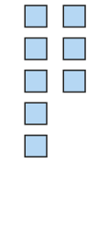
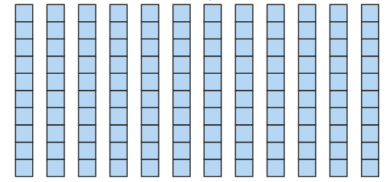
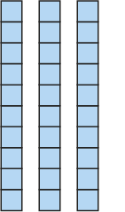

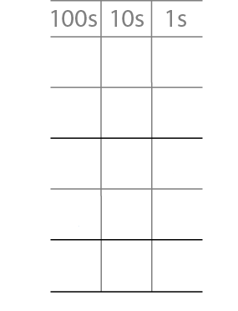
2.14 Short multiplication Step 2:9
4 rows, each with 32 chairs. How many chairs altogether?
3
2
×
4
8
4 × 2 ones = 8 ones
1
2
0
4 × 3 tens = 12 tens
1
2
8
= 1 hundred + 2 tens

Slide 41
Year 5, Unit 4, Learning Outcome 10
Learning Outcome 10
Pupils multiply a two-digit number by a single-digit number using short multiplication (regrouping tens to hundreds)
The following slides have been collated to support the teaching of this learning outcome.

Slide 42
Year 5, Unit 4, Learning Outcome 10
Additional teacher guidance for this outcome should be read first and can be found in this segment of the NCETM Primary Mastery Professional Development Materials:
2.14 Multiplication: partitioning leading to short multiplication
The spine materials are divided into ‘teaching points’ and ‘steps in learning’.
Teaching point | Steps in learning | Pages
2 | 2:10-2:11 | 23-24

Slide 43
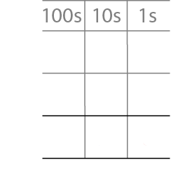
2.14 Short multiplication Step 2:10
32 × 4 =
128
3
2
×
4
4 × 3 tens = 12 tens
= 1 hundred + 2 tens
1
2
8
4 × 2 ones = 8 ones
Write “8” in the ones column.
Write “1” in the hundreds column and “2” in the tens column.

Slide 44
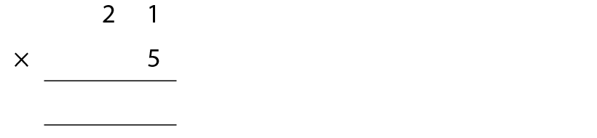
2.14 Short multiplication Step 2:10
21 × 5 =
105
1
0
5
Notes:
5 × 1 one = 5 ones
Write “5” in the ones column.
5 × 2 tens = 10 tens = 1 hundred and 0 tens
Write “1” in the hundreds column and “0” in the tens column.

Slide 45
Year 5, Unit 4, Learning Outcome 11
Learning Outcome 11
Pupils multiply a two-digit number by a single-digit number using both expanded and short multiplication (two regroups)
The following slides have been collated to support the teaching of this learning outcome.

Slide 46
Year 5, Unit 4, Learning Outcome 11
Additional teacher guidance for this outcome should be read first and can be found in this segment of the NCETM Primary Mastery Professional Development Materials:
2.14 Multiplication: partitioning leading to short multiplication
The spine materials are divided into ‘teaching points’ and ‘steps in learning’.
Teaching point | Steps in learning | Pages
2 | 2:12-2:13 | 24-26

Slide 47
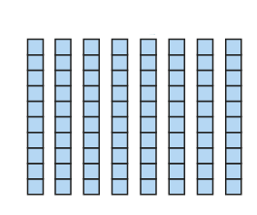



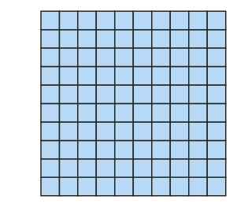

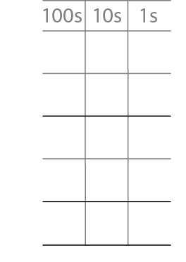

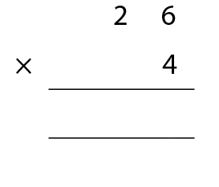
2.14 Short multiplication Step 2:13
4 rows, each with 26 chairs. How many chairs altogether?
2
6
×
4
2
4
1
0
4
8
0
2
1
0
4
Notes:
4 × 6 ones = 24 ones = 2 tens + 4 ones
4 × 2 tens = 8 tens
8 tens + 2 tens + 4 ones = 10 tens + 4 ones = one hundred + 4 ones

Slide 48
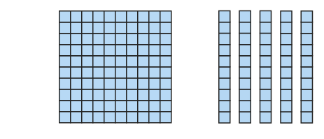

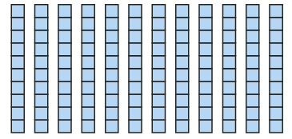
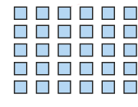


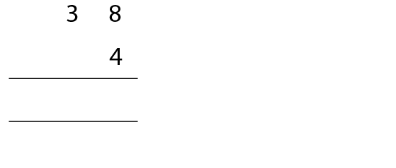

2.14 Short multiplication Step 2:13
4 rows of 38 carrot plants. How many carrot plants altogether?
3
8
×
4
×
3
2
1
5
2
1
2
0
3
1
5
2
Notes:
4 × 8 ones = 32 ones = 3 tens + 2 ones
4 × 3 tens = 12 tens = 1 hundred + 2 tens
1 hundred + 2 tens + 3 tens + 2 ones = 1 hundred + 5 tens + 2 ones

Slide 49
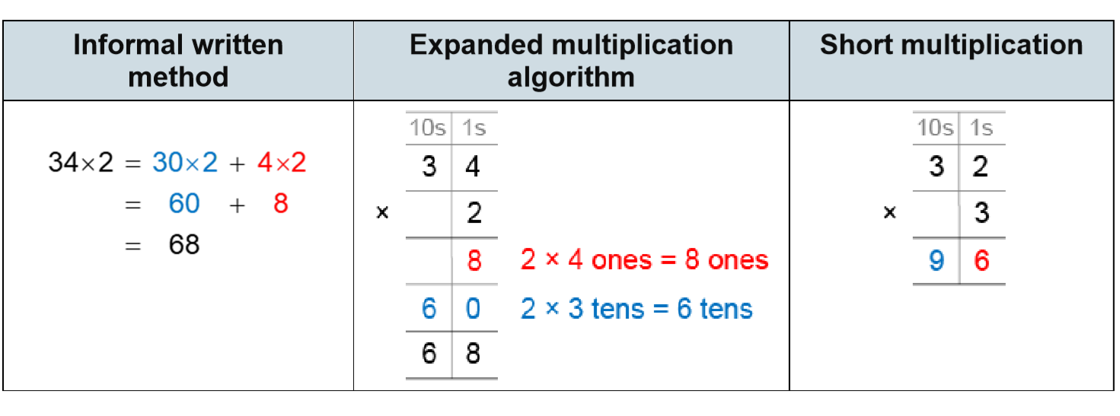
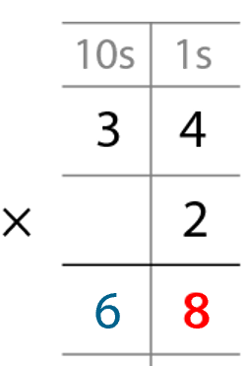
5MD-3 Multiply using a formal written method
The table shows three different ways to solve the same calculation. What’s the same? What’s different?
Use Dienes to model the calculation and explain what each digit within each method represents.

Slide 50
Year 5, Unit 4, Learning Outcome 12
Learning Outcome 12
Pupils use estimation to support accurate calculation
The following slides have been collated to support the teaching of this learning outcome.

Slide 51
Year 5, Unit 4, Learning Outcome 12
Additional teacher guidance for this outcome should be read first and can be found in this segment of the NCETM Primary Mastery Professional Development Materials:
2.14 Multiplication: partitioning leading to short multiplication
The spine materials are divided into ‘teaching points’ and ‘steps in learning’.
Teaching point | Steps in learning | Pages
2 | 2:14-2:15 | 27-29

Slide 52
2.14 Short multiplication Step 2:15
24 × 3
24 is between 20 and 30.
20 × 3 = 60
30 × 3 = 90
So, 24 × 3 must be between 60 and 90.

Slide 53
2.14 Short multiplication Step 2:15
4 × 38
30
<
38
<
40
4 × 30
<
4 × 38
<
4 × 40
120
<
4 × 38
<
160

Slide 54
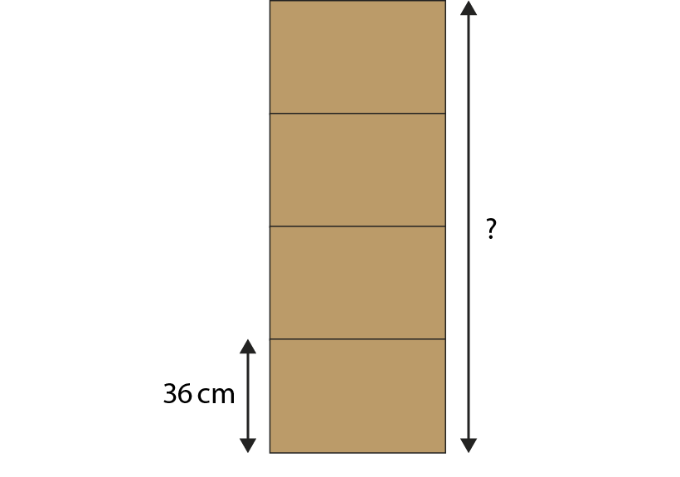
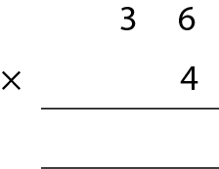
2.14 Short multiplication Step 2:15
If all boxes are the same height, how tall is the stack of boxes?
144 cm
1
4
4
2

Slide 55
Year 5, Unit 4, Learning Outcome 13
Learning Outcome 13
Pupils multiply a three-digit number by a single-digit number using partitioning and representations
The following slides have been collated to support the teaching of this learning outcome.

Slide 56
Year 5, Unit 4, Learning Outcome 13
Additional teacher guidance for this outcome should be read first and can be found in this segment of the NCETM Primary Mastery Professional Development Materials:
2.14 Multiplication: partitioning leading to short multiplication
The spine materials are divided into ‘teaching points’ and ‘steps in learning’.
Teaching point | Steps in learning | Pages
3 | 3:1-3:2 | 30-31

Slide 57
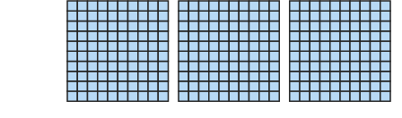

2.14 Short multiplication Step 3:1
321 × 3 =
963
321 = 300 + 20 + 1
321 × 3 = 300 × 3 + 20 × 3 + 1 × 3
= 900 + 60 + 3
= 963
Notes:
Step 1 – partition 321.
Steps 2 and 3 – gather three sets of 321, multiply the
hundreds, tens and ones and recombine.

Slide 58
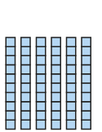

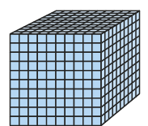




2.14 Short multiplication Step 3:2
423 × 3 =
1,269
423 = 400 + 20 + 3
423 × 3 = 400 × 3 + 20 × 3 + 3 × 3
= 1,200 + 60 + 9
= 1,000 + 200 + 60 + 9
= 1,269
Notes:
Step 1 – partition 423.
Steps 2 and 3 – take three sets of 423, multiply the
Hundreds, tens and ones and recombine.
Step 4 – regroup the hundreds into thousands and hundreds.

Slide 59





2.14 Short multiplication Step 3:2
521 × 3 =
1,563
521 = 500 + 20 + 1
521 × 3 = 500 × 3 + 20 × 3 + 1 × 3
= 1,500 + 60 + 3
= 1,000 + 500 + 60 + 3
= 1,563
Notes:
Step 1 – partition 521.
Steps 2 and 3 – gather three sets of 521, multiply the
Hundreds, tens and ones and recombine.
Step 4 – regroup the hundreds into thousands and hundreds.

Slide 60
Year 5, Unit 4, Learning Outcome 14
Learning Outcome 14
Pupils multiply a three-digit number by a single-digit number using partitioning
The following slides have been collated to support the teaching of this learning outcome.

Slide 61
Year 5, Unit 4, Learning Outcome 14
Additional teacher guidance for this outcome should be read first and can be found in this segment of the NCETM Primary Mastery Professional Development Materials:
2.14 Multiplication: partitioning leading to short multiplication
The spine materials are divided into ‘teaching points’ and ‘steps in learning’.
Teaching point | Steps in learning | Pages
3 | 3:3-3:4 | 32-33

Slide 62


2.14 Short multiplication Step 3:3
201 × 4 =
804
804
200 × 4 = 800
1 × 4 = 4
800 + 4 = 804

Slide 63
2.14 Short multiplication Step 3:3
427 × 3 =
1,281
= 400 × 3 + 20 × 3 + 7 × 3
= 1,200 + 60 + 21
= 1,281

Slide 64
Year 5, Unit 4, Learning Outcome 15
Learning Outcome 15
Pupils multiply a three-digit number by a single-digit number using expanded and short multiplication (no regroups)
The following slides have been collated to support the teaching of this learning outcome.

Slide 65
Year 5, Unit 4, Learning Outcome 15
Additional teacher guidance for this outcome should be read first and can be found in this segment of the NCETM Primary Mastery Professional Development Materials:
2.14 Multiplication: partitioning leading to short multiplication
The spine materials are divided into ‘teaching points’ and ‘steps in learning’.
Teaching point | Steps in learning | Pages
4 | 4:1-4:2 | 34-35

Slide 66



2. 2.14 Short multiplication Step 4:1
321 × 3 =
963
3
2
1
×
3
3
3 × 1 ones = 3 ones
6
0
3 × 2 tens = 6 tens
9
0
0
3 × 3 hundreds =
9 hundreds
9
6
3
9
6
3

Slide 67
Year 5, Unit 4, Learning Outcome 16
Learning Outcome 16
Pupils multiply a three-digit number by a single-digit number using expanded and short multiplication (one regroup)
The following slides have been collated to support the teaching of this learning outcome.

Slide 68
Year 5, Unit 4, Learning Outcome 16
Additional teacher guidance for this outcome should be read first and can be found in this segment of the NCETM Primary Mastery Professional Development Materials:
2.14 Multiplication: partitioning leading to short multiplication
The spine materials are divided into ‘teaching points’ and ‘steps in learning’.
Teaching point | Steps in learning | Pages
4 | 4:3 | 35-36

Slide 69

2.14 Short multiplication Step 4:3
521 × 3 =
1,563
5
2
1
×
3
3 × 1 ones = 3 ones
3
3 × 2 tens = 6 tens
6
0
3 × 5 hundreds = 15 hundreds
1
5
0
0
= 1 thousand + 5 hundreds
1
5
6
3

Slide 70

2.14 Short multiplication Step 4:3

Slide 71
Year 5, Unit 4, Learning Outcome 17
Learning Outcome 17
Pupils multiply a three-digit number by a single-digit number using expanded and short multiplication (multiple regroups)
The following slides have been collated to support the teaching of this learning outcome.

Slide 72
Year 5, Unit 4, Learning Outcome 17
Additional teacher guidance for this outcome should be read first and can be found in this segment of the NCETM Primary Mastery Professional Development Materials:
2.14 Multiplication: partitioning leading to short multiplication
The spine materials are divided into ‘teaching points’ and ‘steps in learning’.
Teaching point | Steps in learning | Pages
4 | 4:4-4:5 | 36-39

Slide 73





2.14 Short Multiplication Step 4:4
367 × 4 =
1,468
3
6
7
×
4
4 × 7 ones = 28 ones
2
8
= 2 tens + 8 ones
4 × 6 tens = 24 tens
2
4
0
= 2 hundreds + 4 tens
4 × 3 hundreds = 12 hundreds
1
2
0
0
= 1 thousand + 2 hundreds
1
4
6
8

Slide 74

2.14 Short Multiplication Step 4:4
367 × 4 =
1,468
1
4
6
8
2
2
Notes:
First write the largest factor: “367”
Then write the smallest factor below, lining up the digits: “4”
Now multiply, starting with the ones: four times seven ones is equal to twenty-eight ones…
… and regroup: twenty-eight ones is equal to two tens and eight ones;
write “8” in the ones column and “2” below the tens column.
Then move to the tens: four times six tens is equal to twenty-four tens…
… and regroup: twenty-four tens is equal to two hundreds and four tens…
… and add the two tens from regrouping to give two hundreds and six tens:
write “6” in the tens column and “2” below the hundreds column.
Then move to the hundreds: four times three hundreds is equal to twelve hundreds…
… and regroup: twelve hundreds is equal to one thousand and two hundreds…
… and add the two hundreds from regrouping to give one thousand and
four hundreds; write “1” in the thousands column and “4” in the hundreds column.

Slide 75
5MD-3 Multiply using a formal written method
321 × 3 =
963
3
2
1
×
3
3
3 × 1 ones = 3 ones
6
0
3 × 2 tens = 6 tens
9
0
0
3 × 3 hundreds = 9 hundreds
9
6
3
9
6
3

Slide 76
5MD-3 Multiply using a formal written method
Children should refer to the place value counters used in the previous example throughout the step-by-step progressions shown, circling the appropriate sections of counters as they appear.
Identify what each digit represents and why it has been recorded in certain locations.
Now practise calculating a three-digit number by a single-digit number to develop fluency.
367 × 4 =
1,468
4 x 7 = 28
4 times 7 ones = 28 ones.
28 ones = 2 tens and 8 ones.
2 is recorded below the tens column and 8 is recorded in the ones column.
1
4
6
8
2
2
Notes:
First write the largest factor: “367”
Then write the smallest factor below, lining up the digits: “4”
Now multiply, starting with the ones: four times seven ones is equal to twenty-eight ones…
… and regroup: twenty-eight ones is equal to two tens and eight ones;
write “8” in the ones column and “2” below the tens column.
Then move to the tens: four times six tens is equal to twenty-four tens…
… and regroup: twenty-four tens is equal to two hundreds and four tens…
… and add the two tens from regrouping to give two hundreds and six tens:
write “6” in the tens column and “2” below the hundreds column.
Then move to the hundreds: four times three hundreds is equal to twelve hundreds…
… and regroup: twelve hundreds is equal to one thousand and two hundreds…
… and add the two hundreds from regrouping to give one thousand and
four hundreds; write “1” in the thousands column and “4” in the hundreds column.

Slide 77
Year 5, Unit 4, Learning Outcome 18
Learning Outcome 18
Pupils use estimation to support accurate calculation
The following slides have been collated to support the teaching of this learning outcome.

Slide 78
Year 5, Unit 4, Learning Outcome 18
Additional teacher guidance for this outcome should be read first and can be found in this segment of the NCETM Primary Mastery Professional Development Materials:
2.14 Multiplication: partitioning leading to short multiplication
The spine materials are divided into ‘teaching points’ and ‘steps in learning’.
Teaching point | Steps in learning | Pages
4 | 4:6-4:7 | 40-41

Slide 79
2.14 Short multiplication Step 4:6
242 × 3
200
<
242
<
300
200 × 3
<
242 × 3
<
300 × 3
600
<
242 × 3
<
900

Slide 80
2.14 Short multiplication Step 4:6
4 × 383
300
<
383
<
400
4 × 300
<
4 × 383
<
4 × 400
1,200
<
4 × 383
<
1,600

Slide 81
Year 5, Unit 4, Learning Outcome 19
Learning Outcome 19
Pupils divide a two-digit number by a single-digit number using partitioning and representations (no remainders, no exchanging)
The following slides have been collated to support the teaching of this learning outcome.

Slide 82

Year 5, Unit 4, Learning Outcome 19
Additional teacher guidance for this outcome should be read first and can be found in this segment of the NCETM Primary Mastery Professional Development Materials:
2.15 Division: partitioning leading to short division
The spine materials are divided into ‘teaching points’ and ‘steps in learning’.
Teaching point | Steps in learning | Pages
1 | 1:1-1:2 and 1:7 | 3 and 12-13

Slide 83


2.15 Short division Step 1:1
8 sticks shared equally between 4 children.
How many sticks each?
4
4
4
4
8 ÷ 4 =
2
Notes:
One four is one each. That’s four.
Two fours is two each. That’s eight.
Eight divided between four is equal to two each.
So, each child gets two sticks.

Slide 84


2.15 Short division Step 1:2
84 sticks shared equally between 4 children. How many sticks each?
84 ÷ 4 =
8 tens ÷ 4 = 2 tens
Notes:
Four tens are one ten each. That’s forty.
Eight tens are two tens each. That’s eighty.
Eight tens divided between four is equal to two tens each.

Slide 85
2.15 Short division Step 1:2
84 sticks shared equally between 4 children. How many sticks each?
84 ÷ 4 =
8 tens ÷ 4 = 2 tens
4 ones ÷ 4 = 1 one
Notes:
Four ones is one each. That’s four.
Four ones divided by four is equal to one one each.

Slide 86
2.15 Short division Step 1:2
84 sticks shared equally between 4 children. How many sticks each?
84 ÷ 4 =
21
8 tens ÷ 4 = 2 tens
4 ones ÷ 4 = 1 one
84 ÷ 4 = 21
Notes:
Eight tens and four ones divided between four is equal to two tens and one one.
Each child gets twenty-one sticks.

Slide 87

2.15 Short division Step 1:7
Notes:
Decide which way of partitioning the dividend
is helpful for the calculation “85 ÷ 6”.
Explain why.

Slide 88
Year 5, Unit 4, Learning Outcome 20
Learning Outcome 20
Pupils divide a two-digit number by a single-digit number using partitioning and representations (with exchanging)
The following slides have been collated to support the teaching of this learning outcome.

Slide 89
Year 5, Unit 4, Learning Outcome 20
Additional teacher guidance for this outcome should be read first and can be found in this segment of the NCETM Primary Mastery Professional Development Materials:
2.15 Division: partitioning leading to short division
The spine materials are divided into ‘teaching points’ and ‘steps in learning’.
Teaching point | Steps in learning | Pages
1 | 1:3-1:4 and 1:7 | 4-9 and 12-13

Slide 90

2.15 Short division Step 1:3
72 sticks shared equally between 3 children. How many sticks each?
72 ÷ 3 =
7 tens ÷ 3 = 2 tens r 1 ten
Notes:
Three tens are one ten each. That’s thirty.
Six tens are two tens each. That’s sixty.
There is one ten left over.
Seven tens divided between three is equal to two tens each, with a
remainder of one ten.

Slide 91
2.15 Short division Step 1:3
72 sticks shared equally between 3 children. How many sticks each?
72 ÷ 3 =
7 tens ÷ 3 = 2 tens r 1 ten
12 ones ÷ 3 = 4 ones
Notes:
One ten is equal to ten ones.
So, one ten and two ones is equal to twelve ones.
Three ones are one each. That’s three.
Six ones are two each. That’s six.
Nine ones are three each. That’s nine.
Twelve ones are four each. That’s twelve.
Twelve ones divided between three is equal to four ones each.

Slide 92

2.15 Short division Step 1:3
72 sticks shared equally between 3 children. How many sticks each?
72 ÷ 3 =
24
7 tens ÷ 3 = 2 tens r 1 ten
12 ones ÷ 3 = 4 ones
Notes:
Each child gets twenty-four sticks.

Slide 93



2.15 Short division Step 1:4
81 marbles shared equally between 3 children. How many marbles each?
81 ÷ 3 =
8 tens ÷ 3 = 2 tens r 2 tens
Notes:
Three tens are one ten each. That’s thirty.
Six tens are two tens each. That’s sixty.
There are two tens left over.
Eight tens divided between three is equal to two tens each, with a
remainder of two tens.

Slide 94
2.15 Short division Step 1:4
81 marbles shared equally between 3 children. How many marbles each?
81 ÷ 3 =
8 tens ÷ 3 = 2 tens r 2 tens
21 ones ÷ 3 = 7 ones
Notes:
Two tens and one one is equal to twenty-one ones.
Three ones are one each. That’s three.
Six ones are two each. That’s six…
Twenty-one ones are seven each. That’s twenty-one.
Twenty-one ones divided between three is equal to seven ones each.

Slide 95

2.15 Short division Step 1:4
81 marbles shared equally between 3 children. How many marbles each?
81 ÷ 3 =
27
8 tens ÷ 3 = 2 tens r 2 tens
21 ones ÷ 3 = 7 ones
Notes:
Each child gets twenty-seven marbles.

Slide 96
2.15 Short division Step 1:7
Notes:
Decide which way of partitioning the dividend
is helpful for the calculation “85 ÷ 6”.
Explain why.

Slide 97
Year 5, Unit 4, Learning Outcome 21
Learning Outcome 21
Pupils divide a two-digit number by a single-digit number using partitioning and representations (with exchanging and remainders)
The following slides have been collated to support the teaching of this learning outcome.

Slide 98
Year 5, Unit 4, Learning Outcome 21
Additional teacher guidance for this outcome should be read first and can be found in this segment of the NCETM Primary Mastery Professional Development Materials:
2.15 Division: partitioning leading to short division
The spine materials are divided into ‘teaching points’ and ‘steps in learning’.
Teaching point | Steps in learning | Pages
1 | 1:5 and 1:7 | 10-13

Slide 99


2.15 Short division Step 1:5
73 marbles shared equally between 3 children. How many marbles each?
73 ÷ 3 =
7 tens ÷ 3 = 2 tens r 1 ten
Notes:
Seven tens divided between three is equal to two tens each, with a
remainder of one ten.

Slide 100
2.15 Short division Step 1:5
73 marbles shared equally between 3 children. How many marbles each?
73 ÷ 3 =
7 tens ÷ 3 = 2 tens r 1 ten
13 ones ÷ 3 = 4 ones r 1 one
Notes:
One ten and three ones is equal to thirteen ones.
Thirteen ones divided between three is equal to four ones each, with a
remainder of one one.

Slide 101

2.15 Short division Step 1:5
73 marbles shared equally between 3 children. How many marbles each?
73 ÷ 3 =
24 r 1
7 tens ÷ 3 = 2 tens r 1 ten
13 ones ÷ 3 = 4 ones r 1 one
Notes:
Each child gets twenty-four marbles; there is one marble left over.

Slide 102
2.15 Short division Step 1:7
Notes:
Decide which way of partitioning the dividend
is helpful for the calculation “85 ÷ 6”.
Explain why.

Slide 103
Year 5, Unit 4, Learning Outcome 22
Learning Outcome 22
Pupils divide a two-digit number by a single-digit number using short division (no exchanging, no remainders)
The following slides have been collated to support the teaching of this learning outcome.

Slide 104
Year 5, Unit 4, Learning Outcome 22
Additional teacher guidance for this outcome should be read first and can be found in this segment of the NCETM Primary Mastery Professional Development Materials:
2.15 Division: partitioning leading to short division
The spine materials are divided into ‘teaching points’ and ‘steps in learning’.
Teaching point | Steps in learning | Pages
2 | 2:1-2:4 and 2:10 | 14-16 and 21-22

Slide 105
2.15 Short division Step 2:1
84 sticks shared equally between 4 children. How many sticks each?
84 ÷ 4 =
Step 1 – write the divisor and dividend:
10s
1s
84 divided by 4.

Slide 106
2.15 Short division Step 2:1
84 sticks shared equally between 4 children. How many sticks each?
84 ÷ 4 =
Step 1 – write the divisor and dividend:
Step 2 – share the 10s:
10s
1s
8 tens ÷ 4 = 2 tens
8 tens divided by 4 is equal to 2 tens.
84 divided by 4.

Slide 107
2.15 Short division Step 2:1
84 sticks shared equally between 4 children. How many sticks each?
84 ÷ 4 =
Step 2 – share the 10s:
Step 3 – share the 1s:
10s
1s
8 tens ÷ 4 = 2 tens
4 ones ÷ 4 = 1 one
4 ones divided by 4 is equal to 1 one.
8 tens divided by 4 is equal to 2 tens.

Slide 108
2.15 Short division Step 2:1
84 sticks shared equally between 4 children. How many sticks each?
84 ÷ 4 =
Step 3 – share the 1s:
Summary
10s
1s
8 tens ÷ 4 = 2 tens
4 ones ÷ 4 = 1 one
4 ones divided by 4 is equal to 1 one.
Each child gets 21 sticks.

Slide 109



2.15 Short division Step 2:1
84 sticks shared equally between 4 children. How many sticks each?
84 ÷ 4 =
21
Summary
10s
1s
2
2
1
1
4
8
8
4
4
8 tens ÷ 4 = 2 tens
4 ones ÷ 4 = 1 one
Each child gets 21 sticks.
Notes:
Eight tens and four ones divided by four is equal to two tens and one one.
Each child gets twenty-one sticks.

Slide 110
2.15 Short division Step 2:2
84 | ÷ | 4 | = | 21
dividend | ÷ | divisor | = | quotient

Slide 111

5MD-4 Divide using a formal written method

Slide 112
Year 5, Unit 4, Learning Outcome 23
Learning Outcome 23
Pupils divide a two-digit number by a single-digit number using short division (with exchanging)
The following slides have been collated to support the teaching of this learning outcome.

Slide 113
Year 5, Unit 4, Learning Outcome 23
Additional teacher guidance for this outcome should be read first and can be found in this segment of the NCETM Primary Mastery Professional Development Materials:
2.15 Division: partitioning leading to short division
The spine materials are divided into ‘teaching points’ and ‘steps in learning’.
Teaching point | Steps in learning | Pages
2 | 2:5-2:6 and 2:10 | 17-19 and 21-22

Slide 114



2.15 Short division Step 2:5
72 sticks shared equally between 3 children. How many sticks each?
72 ÷ 3 =
Step 1 – write the divisor and the dividend:
3
Notes:
Seventy-two divided by three.

Slide 115

2.15 Short division Step 2:5
72 sticks shared equally between 3 children. How many sticks each?
72 ÷ 3 =
Step 1 – write the divisor and the dividend:
Step 2 – share the 10s:
2
3
7 tens ÷ 3 = 2 tens r 1 ten
Notes:
Write ‘2’ in the tens column…

Slide 116
2.15 Short division Step 2:5
72 sticks shared equally between 3 children. How many sticks each?
72 ÷ 3 =
Step 2 – share the 10s:
Step 3 – exchange:
2
3
7 tens ÷ 3 = 2 tens r 1 ten
Notes:
… and write ‘1’ to the left of the ones digit of the dividend to make twelve ones.

Slide 117

2.15 Short division Step 2:5
72 sticks shared equally between 3 children. How many sticks each?
72 ÷ 3 =
24
Step 4 – share the 1s:
Step 3 – exchange:
2
4
3
7 tens ÷ 3 = 2 tens r 1 ten
12 ones ÷ 3 = 4 ones
Notes:
Write ‘4’ in the ones column.

Slide 118
Year 5, Unit 4, Learning Outcome 24
Learning Outcome 24
Pupils divide a two-digit number by a single-digit number using short division (with exchanging and remainders)
The following slides have been collated to support the teaching of this learning outcome.

Slide 119
Year 5, Unit 4, Learning Outcome 24
Additional teacher guidance for this outcome should be read first and can be found in this segment of the NCETM Primary Mastery Professional Development Materials:
2.15 Division: partitioning leading to short division
The spine materials are divided into ‘teaching points’ and ‘steps in learning’.
Teaching point | Steps in learning | Pages
2 | 2:7-2:10 | 19-22

Slide 120

2.15 Short division Step 2:7
73 sticks shared equally between 3 children. How many sticks each?
73 ÷ 3 =
Step 1 – write the divisor and the dividend:
3
Notes:
Seventy-three divided by three.

Slide 121
2.15 Short division Step 2:7
73 sticks shared equally between 3 children. How many sticks each?
73 ÷ 3 =
Step 1 – write the divisor and the dividend:
Step 2 – share the 10s:
2
3
7 tens ÷ 3 = 2 tens r 1 ten
Notes:
Write ‘2’ in the tens column…

Slide 122
2.15 Short division Step 2:7
73 sticks shared equally between 3 children. How many sticks each?
73 ÷ 3 =
Step 2 – share the 10s:
Step 3 – exchange:
2
3
7 tens ÷ 3 = 2 tens r 1 ten
Notes:
… and write ‘1’ to the left of the ones digit of the dividend to
make thirteen ones.

Slide 123
2.15 Short division Step 2:7
73 sticks shared equally between 3 children. How many sticks each?
73 ÷ 3 =
24 r 1
Step 4 – share the 1s:
Step 3 – exchange:
2
4
r 1
3
7 tens ÷ 3 = 2 tens r 1 ten
13 ones ÷ 3 = 4 ones r 1 one
Notes:
Write ‘4 r1’ in the ones column.

Slide 124
Year 5, Unit 4, Learning Outcome 25
Learning Outcome 25
Pupils divide a three-digit number by a single-digit number using partitioning and representations (no exchanging, no remainders)
The following slides have been collated to support the teaching of this learning outcome.

Slide 125
Year 5, Unit 4, Learning Outcome 25
Additional teacher guidance for this outcome should be read first and can be found in this segment of the NCETM Primary Mastery Professional Development Materials:
2.15 Division: partitioning leading to short division
The spine materials are divided into ‘teaching points’ and ‘steps in learning’.
Teaching point | Steps in learning | Pages
3 | 3:1 and 3:4 | 23-24 and 26-27

Slide 126




2.15 Short division Step 3:1
848 pencils shared equally between 4 year groups. How many pencils each?
848 ÷ 4 =
Step 1 – presenting the problem:

Slide 127
2.15 Short division Step 3:1
848 pencils shared equally between 4 year groups. How many pencils each?
848 ÷ 4 =
Step 1 – presenting the problem:
Step 2 – sharing the 100s:
8 hundreds ÷ 4 = 2 hundreds
Notes:
Eight hundreds divided between four is equal to two hundreds each.

Slide 128
2.15 Short division Step 3:1
848 pencils shared equally between 4 year groups. How many pencils each?
848 ÷ 4 =
Step 2 – sharing the 100s:
Step 3 – sharing the 10s:
8 hundreds ÷ 4 = 2 hundreds
4 tens ÷ 4 = 1 ten
Notes:
Four tens divided between four is equal to one ten each.

Slide 129
2.15 Short division Step 3:1
848 pencils shared equally between 4 year groups. How many pencils each?
848 ÷ 4 =
Step 4 – sharing the 1s:
Step 3 – sharing the 10s:
8 hundreds ÷ 4 = 2 hundreds
4 tens ÷ 4 = 1 ten
8 ones ÷ 4 = 2 ones
Notes:
Eight ones divided between four is equal to two ones each.

Slide 130

2.15 Short division Step 3:1
848 pencils shared equally between 4 year groups. How many pencils each?
848 ÷ 4 =
212
Step 4 – sharing the 1s:
Step 5 – adding:
8 hundreds ÷ 4 = 2 hundreds
4 tens ÷ 4 = 1 ten
8 ones ÷ 4 = 2 ones
Notes:
Each year group gets two hundred and twelve pencils.

Slide 131
Year 5, Unit 4, Learning Outcome 26
Learning Outcome 26
Pupils divide a three-digit number by a single-digit number using partitioning and representations (one exchange, no remainders)
The following slides have been collated to support the teaching of this learning outcome.

Slide 132
Year 5, Unit 4, Learning Outcome 26
Additional teacher guidance for this outcome should be read first and can be found in this segment of the NCETM Primary Mastery Professional Development Materials:
2.15 Division: partitioning leading to short division
The spine materials are divided into ‘teaching points’ and ‘steps in learning’.
Teaching point | Steps in learning | Pages
3 | 3:2 and 3:4 | 24-27

Slide 133

2.15 Short division Step 3:2
705 pencils shared equally between 5 year groups. How many pencils each?
705 ÷ 5 =
Step 1 – presenting the problem:

Slide 134
2.15 Short division Step 3:2
705 pencils shared equally between 5 year groups. How many pencils each?
705 ÷ 5 =
Step 1 – presenting the problem:
Step 2 – sharing the 100s:
7 hundreds ÷ 5 = 1 hundred r 2 hundreds
Notes:
Seven hundreds divided between five is equal to one hundred each,
with a remainder of two hundreds.

Slide 135
2.15 Short division Step 3:2
705 pencils shared equally between 5 year groups. How many pencils each?
705 ÷ 5 =
Step 3 – exchanging the remaining hundreds for tens:
Step 2 – sharing the 100s:
7 hundreds ÷ 5 = 1 hundred r 2 hundreds
2 hundreds = 20 tens
Notes:
Two hundreds is equal to twenty tens.

Slide 136
2.15 Short division Step 3:2
705 pencils shared equally between 5 year groups. How many pencils each?
705 ÷ 5 =
Step 3 – exchanging the remaining hundreds for tens:
Step 4 – sharing the 10s:
7 hundreds ÷ 5 = 1 hundred r 2 hundreds
2 hundreds = 20 tens
20 tens ÷ 5 = 4 tens
Notes:
Twenty tens divided between five is equal to four tens each.

Slide 137
2.15 Short division Step 3:2
705 pencils shared equally between 5 year groups. How many pencils each?
705 ÷ 5 =
Step 4 – sharing the 10s:
Step 5 – sharing the 1s:
7 hundreds ÷ 5 = 1 hundred r 2 hundreds
2 hundreds = 20 tens
20 tens ÷ 5 = 4 tens
5 ones ÷ 5 = 1 one
Notes:
Five ones divided between five is equal to one one each.

Slide 138

2.15 Short division Step 3:2
705 pencils shared equally between 5 year groups. How many pencils each?
705 ÷ 5 =
141
Step 6 – adding:
Step 5 – sharing the 1s:
7 hundreds ÷ 5 = 1 hundred r 2 hundreds
2 hundreds = 20 tens
20 tens ÷ 5 = 4 tens
5 ones ÷ 5 = 1 one
Notes:
Each year group gets one hundred and forty-one pencils.

Slide 139
Year 5, Unit 4, Learning Outcome 27
Learning Outcome 27
Pupils divide a three-digit number by a single-digit number using partitioning and representations (with exchanging and remainders)
The following slide supports the teaching of this learning outcome.

Slide 140
Year 5, Unit 4, Learning Outcome 27
Additional teacher guidance for this outcome should be read first and can be found in this segment of the NCETM Primary Mastery Professional Development Materials:
2.15 Division: partitioning leading to short division
The spine materials are divided into ‘teaching points’ and ‘steps in learning’.
Teaching point | Steps in learning | Pages
3 | 3:3-3:4 | 26-27

Slide 141
Year 5, Unit 4, Learning Outcome 28
Learning Outcome 28
Pupils divide a three-digit number by a single-digit number using short division
The following slides have been collated to support the teaching of this learning outcome.

Slide 142
Year 5, Unit 4, Learning Outcome 28
Additional teacher guidance for this outcome should be read first and can be found in this segment of the NCETM Primary Mastery Professional Development Materials:
2.15 Division: partitioning leading to short division
The spine materials are divided into ‘teaching points’ and ‘steps in learning’.
Teaching point | Steps in learning | Pages
4 | 4:1-4:4 and 4:10 | 29-31 and 35-36

Slide 143



2.15 Short division Step 4:1
848 pencils shared equally between 4 year groups. How many pencils each?
848 ÷ 4 =
Step 1 – writing the divisor and the dividend:
4
Notes:
Eight-hundred and forty-eight divided by four.

Slide 144

2.15 Short division Step 4:1
848 pencils shared equally between 4 year groups. How many pencils each?
848 ÷ 4 =
Step 1 – writing the divisor and the dividend:
Step 2 – sharing the 100s:
2
4
8 hundreds ÷ 4 = 2 hundreds
Notes:
Write ‘2’ in the hundreds column.

Slide 145

2.15 Short division Step 4:1
848 pencils shared equally between 4 year groups. How many pencils each?
848 ÷ 4 =
Step 2 – sharing the 100s:
Step 3 – sharing the 10s:
2
1
4
8 hundreds ÷ 4 = 2 hundreds
4 tens ÷ 4 = 1 ten
Notes:
Write ‘1’ in the tens column.

Slide 146

2.15 Short division Step 4:1
848 pencils shared equally between 4 year groups. How many pencils each?
848 ÷ 4 =
212
Step 3 – sharing the 10s:
Step 4 – sharing the 1s:
2
1
2
4
8 hundreds ÷ 4 = 2 hundreds
4 tens ÷ 4 = 1 ten
8 ones ÷ 4 = 2 ones
Notes:
Write ‘2’ in the ones column.

Slide 147
2.15 Short division Step 4:3
705 books shared equally between 5 year groups. How many books each?
705 ÷ 5 =
Step 1 – writing the divisor and dividend:
5
Notes:
Seven hundred and five divided by five.

Slide 148



2.15 Short division Step 4:3
705 books shared equally between 5 year groups. How many books each?
705 ÷ 5 =
Step 1 – writing the divisor and dividend:
Step 2 – sharing the 100s:
1
5
5
7 hundreds ÷ 5 = 1 hundred r 2 hundreds
Notes:
Write ‘1’ in the hundreds column…

Slide 149
2.15 Short division Step 4:3
705 books shared equally between 5 year groups. How many books each?
705 ÷ 5 =
Step 2 – sharing the 100s:
Step 3 – exchanging:
1
5
7 hundreds ÷ 5 = 1 hundred r 2 hundreds
2 hundred = 20 tens
Notes:
… and write ‘2’ to the left of the tens digit of the dividend to make twenty tens.

Slide 150
2.15 Short division Step 4:3
705 books shared equally between 5 year groups. How many books each?
705 ÷ 5 =
Step 3 – exchanging:
Step 4 – sharing the 10s:
1
4
5
7 hundreds ÷ 5 = 1 hundred r 2 hundreds
2 hundred = 20 tens
20 tens ÷ 5 = 4 tens
Notes:
Write ‘4’ in the tens column.

Slide 151
2.15 Short division Step 4:3
705 books shared equally between 5 year groups. How many books each?
705 ÷ 5 =
141
Step 5 – sharing the 1s:
Step 4 – sharing the 10s:
1
4
1
5
7 hundreds ÷ 5 = 1 hundred r 2 hundreds
2 hundred = 20 tens
20 tens ÷ 5 = 4 tens
5 ones ÷ 5 = 1 one
Notes:
Write ‘1’ in the ones column.

Slide 152
Year 5, Unit 4, Learning Outcome 29
Learning Outcome 29
Pupils divide a three-digit number by a single-digit number using short division (with exchanging and remainders)
The following slides have been collated to support the teaching of this learning outcome.

Slide 153
Year 5, Unit 4, Learning Outcome 29
Additional teacher guidance for this outcome should be read first and can be found in this segment of the NCETM Primary Mastery Professional Development Materials:
2.15 Division: partitioning leading to short division
The spine materials are divided into ‘teaching points’ and ‘steps in learning’.
Teaching point | Steps in learning | Pages
4 | 4:5-4:6 and 4:10 | 31-33 and 35-36

Slide 154

2.15 Short division Step 4:5
612 ÷ 4 =
Step 1 – writing the divisor and the dividend:
4
Notes:
Six hundred and twelve divided by four.

Slide 155
2.15 Short division Step 4:5
612 ÷ 4 =
Step 1 – writing the divisor and the dividend:
Step 2 – sharing the 100s:
1
4
6 hundreds ÷ 4 = 1 hundred r 2 hundreds
Notes:
Write ‘1’ in the hundreds column…

Slide 156
2.15 Short division Step 4:5
612 ÷ 4 =
Step 2 – sharing the 100s:
Step 3 – exchanging:
1
4
6 hundreds ÷ 4 = 1 hundred r 2 hundreds
2 hundreds = 20 tens
Notes:
… and write ‘2’ to the left of the tens digit of the dividend to make twenty-one tens.

Slide 157
2.15 Short division Step 4:5
612 ÷ 4 =
Step 4 – sharing the 10s:
Step 3 – exchanging:
1
5
4
6 hundreds ÷ 4 = 1 hundred r 2 hundreds
2 hundreds = 20 tens
21 tens ÷ 4 = 5 tens r 1 ten
Notes:
Write ‘5’ in the tens column…

Slide 158
2.15 Short division Step 4:5
612 ÷ 4 =
Step 4 – sharing the 10s:
Step 5 – exchanging:
1
5
4
6 hundreds ÷ 4 = 1 hundred r 2 hundreds
2 hundreds = 20 tens
21 tens ÷ 4 = 5 tens r 1 ten
1 ten = 10 ones
Notes:
… and write ‘1’ to the left of the ones digit of the dividend to make twelve ones.

Slide 159
2.15 Short division Step 4:5
612 ÷ 4 =
153
Step 6 – sharing the 1s:
Step 5 – exchanging:
1
5
3
4
6 hundreds ÷ 4 = 1 hundred r 2 hundreds
2 hundreds = 20 tens
21 tens ÷ 4 = 5 tens r 1 ten
1 ten = 10 ones
12 ones ÷ 4 = 3 ones
Notes:
Write ‘3’ in the ones column.

Slide 160
Year 5, Unit 4, Learning Outcome 30
Learning Outcome 30
Pupils solve short division problems accurately when the hundreds digit is smaller than the divisor
The following slides have been collated to support the teaching of this learning outcome.

Slide 161
Year 5, Unit 4, Learning Outcome 30
Additional teacher guidance for this outcome should be read first and can be found in this segment of the NCETM Primary Mastery Professional Development Materials:
2.15 Division: partitioning leading to short division
The spine materials are divided into ‘teaching points’ and ‘steps in learning’.
Teaching point | Steps in learning | Pages
4 | 4:7-4:10 | 34-36

Slide 162

2.15 Short division Step 4:7
215 ÷ 5 =
Step 1 – writing the dividend and divisor:
5
Notes:
Two hundred and fifteen divided by five.

Slide 163
2.15 Short division Step 4:7
215 ÷ 5 =
Step 1 – writing the dividend and divisor:
Step 2 – sharing the 100s:
0
5
2 hundreds ÷ 5 = 0 hundreds r 2 hundreds
Notes:
Write ‘0’ in the hundreds column…

Slide 164

2.15 Short division Step 4:7
215 ÷ 5 =
Step 2 – sharing the 100s:
Step 3 – exchanging:
0
5
2 hundreds ÷ 5 = 0 hundreds r 2 hundreds
2 hundreds = 20 tens
Notes:
… and write ‘2’ to the left of the tens digit of the dividend to make twenty-one tens.

Slide 165
2.15 Short division Step 4:7
215 ÷ 5 =
Step 4 – sharing the 10s:
Step 3 – exchanging:
0
4
5
2 hundreds ÷ 5 = 0 hundreds r 2 hundreds
2 hundreds = 20 tens
21 tens ÷ 5 = 4 tens r 1 ten
Notes:
Write ‘4’ in the tens column…

Slide 166
2.15 Short division Step 4:7
215 ÷ 5 =
Step 4 – sharing the 10s:
Step 5 – exchanging:
0
4
5
2 hundreds ÷ 5 = 0 hundreds r 2 hundreds
2 hundreds = 20 tens
21 tens ÷ 5 = 4 tens r 1 ten
1 ten = 10 ones
Notes:
… and write ‘1’ to the left of the ones digit of the dividend to make fifteen ones.

Slide 167
2.15 Short division Step 4:7
215 ÷ 5 =
43
Step 6 – sharing the 1s:
Step 5 – exchanging:
0
4
3
5
2 hundreds ÷ 5 = 0 hundreds r 2 hundreds
2 hundreds = 20 tens
21 tens ÷ 5 = 4 tens r 1 ten
1 ten = 10 ones
15 ones ÷ 5 = 3 ones
Notes:
Write ‘3’ in the ones column.

Slide 168
2.15 Short division Step 4:8
6
800 ÷ 5
648 ÷ 6
8
5
6
426 ÷ 6
712 ÷ 4
4
7
6
4
8 > 5
6 = 6
4 < 6
7 > 4
three-digit quotient
three-digit quotient
three-digit quotient
two-digit quotient

Slide 169
Year 5, Unit 4, Learning Outcome 31
Learning Outcome 31
Pupils will use efficient strategies of division to solve problems
The following slides have been collated to support the teaching of this learning outcome.

Slide 170
Year 5, Unit 4, Learning Outcome 31
Additional teacher guidance for this outcome should be read first and can be found in this segment of the NCETM Primary Mastery Professional Development Materials:
2.15 Division: partitioning leading to short division
The spine materials are divided into ‘teaching points’ and ‘steps in learning’.
Teaching point | Steps in learning | Pages
4 | 4:11 | 37

Slide 171


5MD-4 Divide using a formal written method
It is now really important to practise with other examples without resources to build fluency.
Complete these calculations.

