Slide 1
Modelling real life situations graphically
KS3 Mastery PD Materials: Exemplified Key Ideas
Materials for use in the classroom or to support professional development discussions
(from 4.2 Graphical representations)
Summer 2021

Slide 2
About this resource
These slides are designed to complement the 4.2 Graphical representations Core Concept document and its associated Theme Overview document 4 Sequences and Graphs, both found in the Secondary Mastery Professional Development pages.
These slides re-present the key examples from the Core Concept document so that the examples can be used either directly in the classroom or with a group of teachers. There are prompt questions alongside the examples, and further clarification in the notes.
These slides do not fully replicate the Core Concept document, so should be used alongside it. Reference to specific page numbers, and to other useful NCETM resources, can be found in the notes for each slide.
This slide deck is not designed to be a complete PD session, rather it is a selection of resources that you can adapt and use as needed when planning a session with a group of teachers.

Slide 3


About this resource
The slides are structured as follows:
The big picture:
Where does this fit in?
What do students need to understand?
Why is this key idea important?
Prior learning
Misconceptions
Exemplified key ideas
Reflection questions
Appendices:
Key vocabulary
Representations and structure
Previous and Future learning
Useful links
The exemplified key idea slides have the following symbols to indicate how they have been designed to be used:
Into the classroom
The examples are presented on these slides so that they could be used in PD, but also directly in the classroom. The notes feature suggested questions and things teachers might consider when using with students.
PD discussion prompts
These slides look at the examples in more detail, with question prompts to promote discussion among maths teachers. The notes feature reference to further information and guidance within the Core Concepts document.

Slide 4
Where does this fit in?
The NCETM has identified a set of six ‘mathematical themes’ within Key Stage 3 mathematics that bring together a group of ‘core concepts’.
The fourth of these themes is Sequences and graphs, which covers the following interconnected core concepts:
4.1 Sequences
4.2 Graphical representations
Notes:
Linked on this slide is the Theme Overview document of Sequences and graphs. This document includes why it is important, the key underpinning knowledge and links to prior and future learning. There is also guidance about how the five big ideas of Teaching for Mastery relate specifically to this theme.

Slide 5
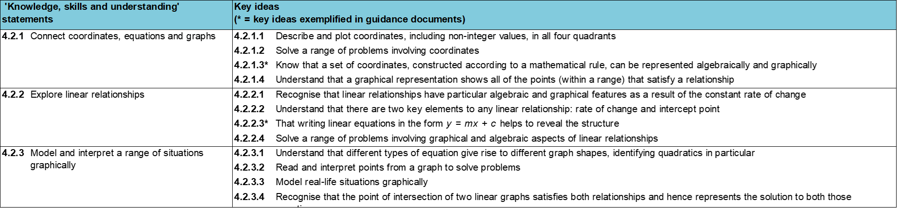
Where does this fit in?
Within this core concept, 4.2 Graphical representations, there are three statements of knowledge, skills and understanding.
These, in turn, are broken down into twelve key ideas. The highlighted key idea is exemplified in this slide deck.
Notes:
For key ideas marked with an asterisk, we exemplified the common difficulties and misconceptions that students might have and included elements of what teaching for mastery may look like. We have provided examples of possible student tasks and teaching approaches.
Within these slides are ‘classroom-ready’ versions of the examples for the key idea that has been highlighted. There are also slides that may be useful for discussion in a professional development session.

Slide 6
What do students need to understand?
4.2.3.3 Model real life situations graphically
Understand and interpret the gradient in context.
Understand and interpret the intercept in context.
Understand and interpret a graph in context.
What prior knowledge might your students already have?
What language might they use to describe this key idea?
What questions might you want to ask to assess their prior learning?

Slide 7
Why is this key idea important?
In Key Stage 3, a key focus will be thinking about x- and y-coordinates as the input and output respectively of a function or rule, and appreciating that the set of coordinates generated and the line joining them can be thought of as a graphical representation of that function.
The move from seeing a graph as a finite collection of coordinates that satisfy a relationship to a single mathematical object which encapsulates an infinite set of points, is an important one.
Students should explore graphs in given contexts, such as distance–time graphs, and be able to match graphs with specific scenarios. They should also not only develop algebraic and graphical fluency when understanding linear functions, but also experience simple quadratic functions.
Notes:
A more detailed overview of the core concept 4.2 Connect coordinates, equations and graphs can be found on pages 7-8 of the 4.2 Core Concept document.
The background to each key idea is also explored in more detail on the following pages:
4.2.1 Connect coordinates, equations and graphs – pages 7 and 8
4.2.2 Explore linear relationships – pages 8 and 9
4.2.3 Model and interpret a range of situations graphically – page 9

Slide 8
Prior learning
What prior knowledge might your students already have?
What language or representations might they use for this key idea?
What questions might you want to ask to assess their prior learning?
How does this fit in with your curriculum progression?
Upper Key Stage 2 Learning Outcome
Describe positions on the full coordinate grid (all four quadrants)
Find pairs of numbers that satisfy an equation with two unknowns
Enumerate possibilities of combinations of two variables
Key Stage 3 Learning Outcome
1.4.1 Understand and use the conventions and vocabulary of algebra, including forming and interpreting algebraic expressions and equations
1.4.5 Rearrange formulae to change the subject
Please note: Numerical codes refer to statements of knowledge, skills and understanding in the NCETM breakdown of Key Stage 3 mathematics.
Notes:
You may find it useful to speak to your partner schools to see how the above has been covered and the language used.
You can find further details regarding prior learning in the following segments of the NCETM primary mastery professional development materials (linked on final slide):
Year 5: 1.27 Negative numbers: counting, comparing and calculating
Year 5: 1.28 Common structures and the part–part–whole relationship
Within the 4 Sequences and graphs Theme Overview document, you can also find a broader description of students’ potential previous learning (page 2), alongside further information about key underpinning knowledge (page 3).

Slide 9
Checking prior learning
The following slides contain questions for checking prior learning.
What representations might students use to support their understanding of these questions?
What variation might you put in place for these questions to fully assess students’ understanding of the concept?
How might changing the language of each question change the difficulty?
Why are these such crucial pre-requisites for this key idea?

Slide 10
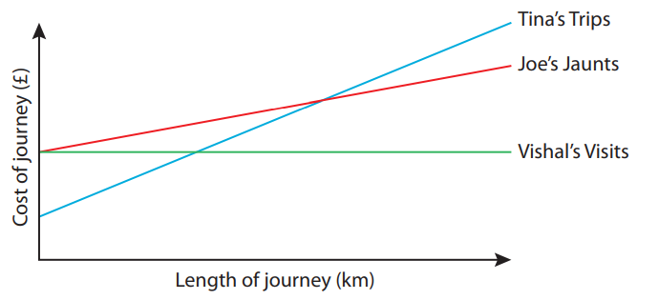
Checking prior learning (1)
a)
Three taxi companies each work out the cost of a journey in different ways. I have taken lots of journeys with each of the companies, and have recorded each time how long the journey was (in km) and the cost of the journey (in £). I have represented these data on this graph.
What’s the same and what’s different about the ways in which the three companies work out the cost of a journey?
Which might you choose if you wanted to book a taxi to make a journey?
Explain your reasoning.
Notes:
References to the questions (links on final slide):
a) NCETM Primary assessment materials, Year 6 Page 39 (Mastery with greater depth column)

Slide 11
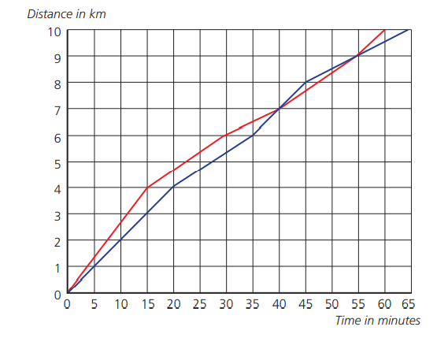
Checking prior learning (2)
b)
Two women, Rose and Violet, are running a 10km road race. Rose is shown in red and Violet is shown in blue.
Who starts off faster? How do you know?
Do they ever run at the same speed? How do you know?
Did one ever overtake the other? When?
Who wins the race?
How far behind her was the loser?
Notes:
References to the questions (links on final slide):
b) NCETM Secondary assessment materials, Page 19

Slide 12
Common difficulties and misconceptions
What aspects of this key idea might students find challenging?
What misconceptions might students have?
When teaching this topic, you may find students encounter difficulties with…
Interpreting the ‘story’ from a journey
More information, and some suggestions for overcoming these challenges, can be found on the following slides.

Slide 13
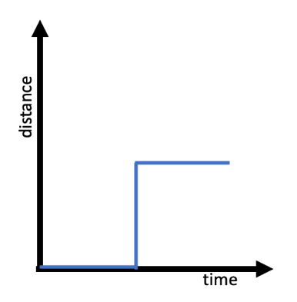
Common difficulties and misconceptions (1)
Students are often familiar with plotting graphs from an equation or from given data but can still find interpreting the ‘story’ told by the graphs a challenge.
Hart (1981) explored students’ understanding of distance–time graphs: while they were able to identify key features of these graphs (such as ‘different rates of travel’ and ‘arrival times’), several had ‘incorrect perceptual interpretations of the graph’ and identified the graphs as a ‘picture’ of the journey.
For example, rather than identifying the graph above as an impossible journey, they offered descriptions based on the shape such as, “went along a corridor, then up in a lift, then along another corridor” or “going east, then due north, then east”.
Challenging students to interpret real life graphs which do not describe a journey, or identifying non-examples of journeys such as the one above, may support students in identifying the key points while also connecting the graphical representation to the context that it models.
Notes:
Children’s understanding of mathematics: 11-16 (1981) editor Hart, p128 author D. Kerslake
More detail can be found on page 25 of the 4.2 Core Concept document.

Slide 14
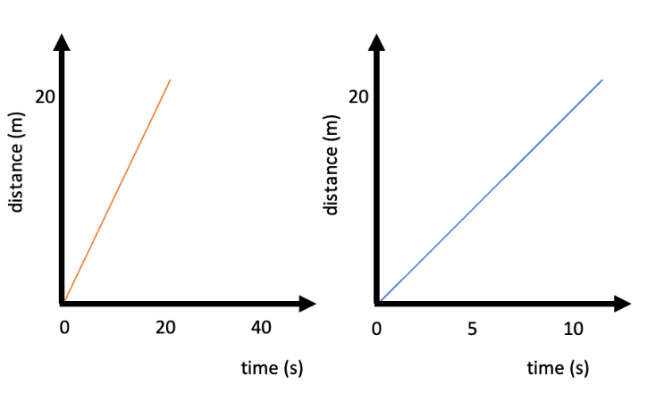
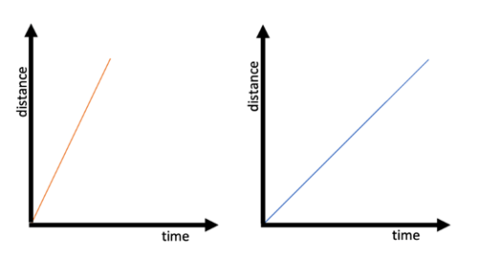
Understand and interpret the gradient in context
Example 1
Tilly is 11 years old, and Willow is 4 years old. They run a race over 20m.
Which graph do you think belongs to Tilly, and which to Willow?
Here are the same graphs with some more information. Which graph do you think belongs to Tilly, and which to Willow?
Notes:
This slide is animated. Parts a) and b) appear separately so students are not influenced by the scales in b) when considering their initial response to a).
Suggested questioning:
What does a steeper gradient tell you about someone’s speed?
What is the same/different about the graphs in part a?
What has changed in part b?
How do the scales given in part b change your interpretation of the graphs?
Things for you to think about:
Example 1 offers an opportunity to explore the meaning of the gradient and consider what it means to describe the ‘steeper’ line. In part a) students are likely to assume that Tilly is the faster (and so older) child and that the red line describes her race because the line is steeper. Part b) then uses the same graphs but with additional information, showing that the scales are not the same and in fact the blue line represents the faster runner. To interpret the meaning of the gradient in this context, the students must identify that if the blue line was plotted on the same axis it would be steeper because the runner has travelled the same distance in a shorter time. Ask students to consider whether straight lines are likely in this context and give them an opportunity to sketch how more accurate lines might look.

Slide 15
Understand and interpret the gradient in context
Example 1
Tilly is 11 years old, and Willow is 4 years old. They run a race over 20m.
Which graph do you think belongs to Tilly, and which to Willow?
Here are the same graphs with some more information. Which graph do you think belongs to Tilly, and which to Willow?
The inclusion of scales in part b) is designed to surprise students. What is the effect of challenging students’ assumptions in this way?
Do you use this strategy to introduce any other concepts?
Notes:
Due to space constraints, the image on this PD discussion slide is very small. PD Leads might like to use or print the ‘in the classroom’ version of this slide for teachers to access during discussions.
This example can be found on page 25 of the 4.2 Core Concept document.

Slide 16
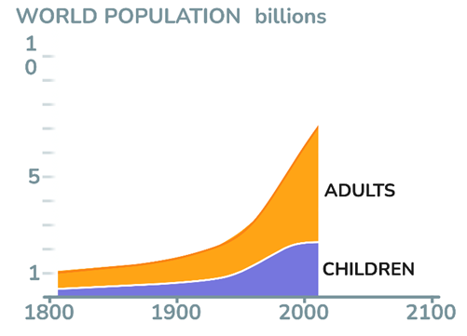
Understand and interpret the gradient in context
Example 2
This graph shows the change in the world population over about 200 years.
Between 1800 and 1900, which grew faster – the number of adults or the number of children?
Which is now growing faster, the number of adults or the number of children?
Why do you think this might be?
(Source: free material from www.gapminder.org)
Notes:
Suggested questioning:
What is the same and different about the shapes of the orange and purple curves?
What is the same and different about the gradients at 1900, 1950 and 2000?
What changes have happened over the last 100 years that might have led to this change?
Things for you to think about:
In this graph the context of population growth is used to demonstrate gradient as a rate of change. Encourage students to refer to the gradient of the lines to describe how they know the number of adults is growing faster than the number of children. Challenge them to explain why a faster growth rate results in a steeper graph. Part a) of Example 2 should draw students’ attention to the way the lines share the same gradient, meaning that the growth rate is almost the same for adults and children. This offers a useful comparison to more recent years where the rate of change for adults is significantly greater than that for children.
(Source: free material from www.gapminder.org)

Slide 17
Understand and interpret the gradient in context
Example 2
This graph shows the change in the world population over about 200 years.
Between 1800 and 1900, which grew faster – the number of adults or the number of children?
Which is now growing faster, the number of adults or the number of children?
Why do you think this might be?
What are the benefits and challenges of using a real-life graph such as this?
What non-mathematical knowledge might students need to interpret this graph? How will you manage this in discussions?
Notes:
Due to space constraints, the image on this PD discussion slide is very small. PD Leads might like to use or print the ‘in the classroom’ version of this slide for teachers to access during discussions.
This example can be found on page 26 of the 4.2 Core Concept document.

Slide 18
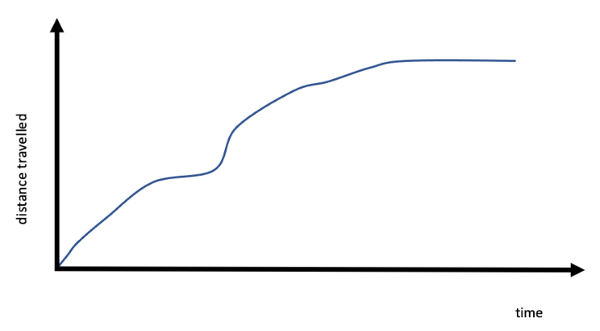
Understand and interpret the gradient in context
Example 3 (a-c)
Nicola goes out for a bike ride.
This graph shows the distance she travels.
There is a very steep hill on Nicola’s route.
Where on the graph do you think she is going uphill?
Where do you think she’s going downhill?
Explain how you know.
Notes:
Suggested questioning:
Does the steepest part of the graph represent the steepest hill? Why not?
Will she be going faster or slower when she goes downhill? What will this look like on the graph?
How can this graph show downhills and uphills when the gradient is positive or horizontal throughout?
Things for you to think about:
Example 3 is designed to explicitly address the misconception students may have about the shape of the line mapping out the journey. The episodes of travelling uphill and downhill can be identified by Nicola’s speed, and some students may find it counterintuitive that the gradient is least when Nicola is travelling uphill.

Slide 19
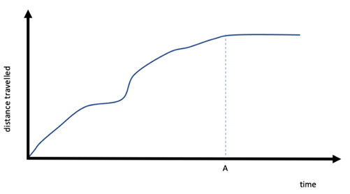
Understand and interpret the gradient in context
Example 3 (d)
Nicola goes out for a bike ride.
This graph shows the distance she travels.
Nicola’s bike ride takes her about an hour.
Use this information to estimate what time is represented by A on this second graph.
Notes:
Suggested questioning:
What does a horizontal line represent on a distance-time graph?
Use your answer to d) to estimate at what time she went up and down the hill.
Things for you to think about:
In part d), students should be aware that the line is horizontal after time A. This means Nicola is no longer travelling, and so time A can be estimated to be the end of her bike ride after about 1 hour.

Slide 20
Understand and interpret the gradient in context
Example 3
Nicola goes out for a bike ride.
This graph shows the distance she travels.
There is a very steep hill on Nicola’s route.
Where on the graph do you think she is going uphill?
Where do you think she’s going downhill?
Explain how you know.
Nicola’s bike ride takes her about an hour.
Use this information to estimate what time is represented by A.
What misconceptions might students have around the gradients of the graph and the gradients of Nicola’s route?
How might you unpick and correct these misconceptions?
Notes:
Due to space constraints, the image on this PD discussion slide is very small. PD Leads might like to use or print the ‘in the classroom’ version of this slide for teachers to access during discussions.
This example can be found on page 26 of the 4.2 Core Concept document.

Slide 21
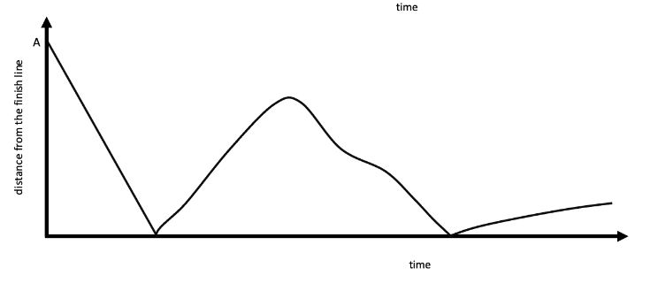
Understand and interpret the intercept in context
Example 4
This graph shows the final 10m of a sprint race.
What is the value of the point marked A?
Priya says, ‘That’s odd! The graph shows that the runner reached the finish line then instantly turned around and ran back a few metres.’
Priya is not correct. What do you think the graph shows?
Notes:
Suggested questioning:
What happens when the line touches the x axis? How do you know?
What might be happening the second time?
Estimate how far from the finish line the runner goes before turning back.
How is speed represented on a distance-time graph?
Things for you to think about:
Example 4 requires students work with the y-axis of the graph. Initially students need to recognise that the intercept identifies the distance from the finish line at the start of the graph and connect this with the text above. In part b) they might expect the line to continue below the horizontal axis. This is another opportunity to stress that the line is not a ‘picture’ of the situation, rather it is a mathematical construct. Although the focus of this example is the intercept and interpretation of the y-axis, students might be asked to consider the speed of the runner at different points. For example, what is different about the gradient when the runner crosses the line for the second time?

Slide 22
Understand and interpret the intercept in context
Example 4
This graph shows the final 10m of a sprint race.
What is the value of the point marked A?
Priya says, ‘That’s odd! The graph shows that the runner reached the finish line then instantly turned around and ran back a few metres.’
Priya is not correct. What do you think the graph shows?
How will you support students to understand that the y-axis represents distance from the finish line, but that the x-axis is not a visualisation of the finish line itself?
What might students misunderstand about the points where the line touches the x-axis?
Although the main focus is on intercept, what conversations might you have about gradient in this task?
Notes:
Due to space constraints, the image on this PD discussion slide is very small. PD Leads might like to use or print the ‘in the classroom’ version of this slide for teachers to access during discussions.
This example can be found on page 27 of the 4.2 Core Concept document.

Slide 23
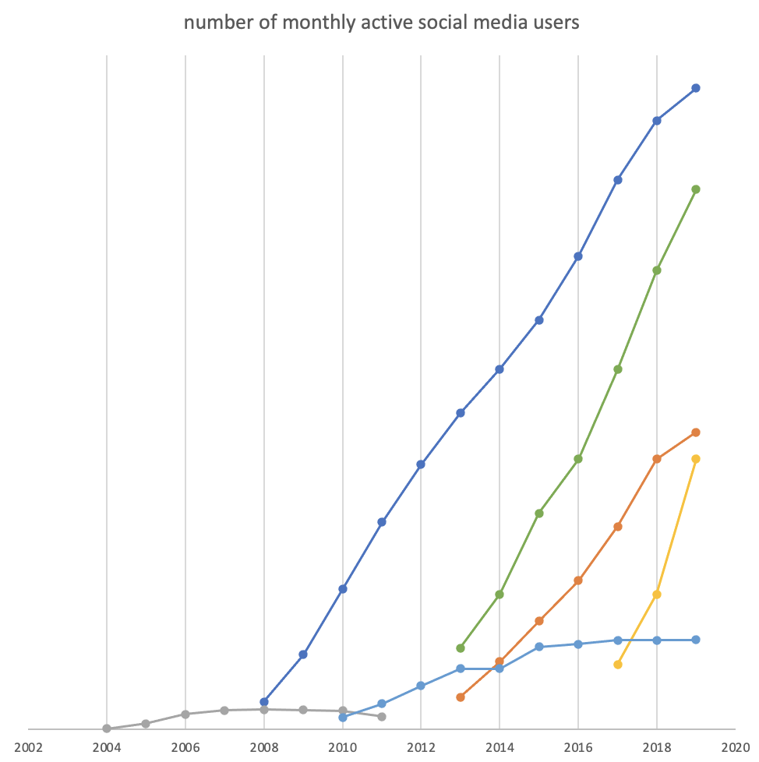
Understand and interpret the graph in context
Example 5
The graph shows the number of active social media users for different platforms between 2004 and 2019.
Which line do you think represents Facebook? Explain how you know.
Which line do you think represents TikTok? Explain how you know.
Which line do you think represents MySpace? Explain how you know.
What platforms might the other lines be? Explain how you know.
Notes:
Suggested questioning:
Which of these have you heard of? Which have you not?
Which line represents the platform that started most recently? Which represents the platform that is no longer active?
Which platform grew most rapidly? Which is most popular?
Things for you to think about:
Example 5 provides a context for students to identify key points and interpret them to make conjectures. Students may be unfamiliar with lines that stop (as in the lower line here) or that do not start at the origin. This is an opportunity to review what’s the same and what’s different between graphs plotted from real life information and those plotted from an equation.
Answers:
Dark blue – Facebook
Yellow – TikTok
Pale grey – MySpace
Green – WhatsApp; orange – instagram; light blue – twitter
Source: Esteban Ortiz-Ospina (2019) “The rise of social media”. Published online at OurWorldInData.org. Retrieved from: ‘https://ourworldindata.org/rise-of-social-media

Slide 24
Understand and interpret the graph in context
Example 5
The graph shows the number of active social media users for different platforms between 2004 and 2019.
Which line do you think represents Facebook? Explain how you know.
Which line do you think represents TikTok? Explain how you know.
Which line do you think represents MySpace? Explain how you know.
What platforms might the other lines be? Explain how you know.
Three lines on the graph have been used as a focus for parts a), b) and c). What features might you draw attention to from these lines? What other features might you draw attention to from the remaining lines?
Notes:
Due to space constraints, the image on this PD discussion slide is very small. PD Leads might like to use or print the ‘in the classroom’ version of this slide for teachers to access during discussions.
This example can be found on pages 27 and 28 of the 4.2 Core Concept document.

Slide 25
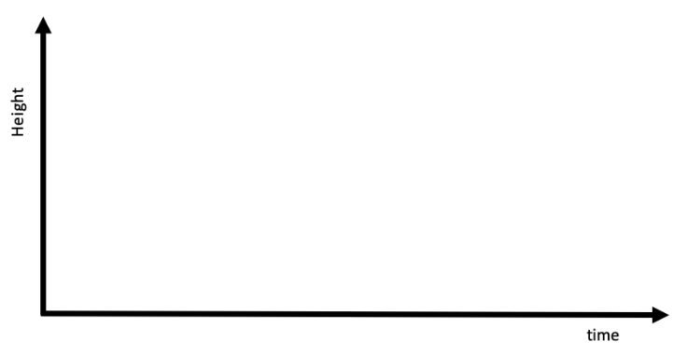
Understand and interpret the graph in context
Example 6
Sachin throws a ball straight up in the air and catches it again. On this set of axes, sketch how the height changes with time.
Sachin then throws the ball to Catriona who is standing close by. On the same set of axes, sketch how the height changes with time.
Notes:
Suggested questioning:
What is the same and different about your graphs?
How would your graph change if you learned that Sachin and Catriona’s were different heights?
Will the ball reach the same height with a horizontal and vertical throw?
What have you assumed to be ‘zero height’ in your graphs?
Things for you to think about:
Example 6 provides an opportunity to explore how students either understand graphs as representations or misunderstand them as a ‘picture’ of the situation. For the situations in parts a) and b), the graph is likely to look similar. However, some students may sketch the first situation (with the vertical throw) with a narrower base than the second situation, mirroring the horizontal distance travelled by the ball rather than the time elapsed since the ball was released (see next slide). Students might also usefully consider whether the different heights of Catriona and Sachin would impact on the shape of the graph and how this would be represented. What has been assumed to be ‘zero height’ in this example?

Slide 26
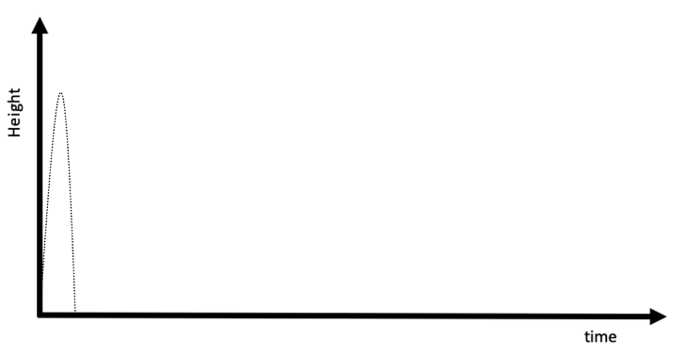
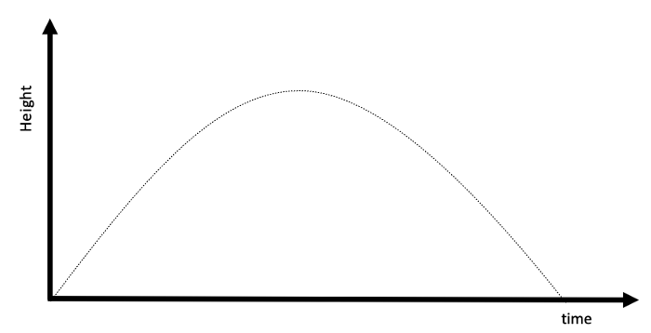
Understand and interpret the graph in context
Example 6 (cont)
These two sketches show possible graphs for Sachin’s two throws.
What do you notice? What have these students misunderstood about the x-axis?
Sachin throws a ball straight up in the air and catches it again.
Sachin then throws the ball to Catriona who is standing close by.
Notes:
Some students may sketch the first situation (with the vertical throw) with a narrower base than the second situation, mirroring the horizontal distance travelled by the ball rather than the time elapsed since the ball was released. This slide gives example sketches of these for discussion.
Students might also usefully consider whether the different heights of Catriona and Sachin would impact on the shape of the graph and how this would be represented. What has been assumed to be ‘zero height’ in this example?

Slide 27
Understand and interpret the graph in context..
Example 6
Sachin throws a ball straight up in the air and catches it again. On this set of axes, sketch how the height changes with time.
Sachin then throws the ball to Catriona who is standing close by. On the same set of axes, sketch how the height changes with time.
Predict some of the different graphs that you might expect to see students draw. What might they reveal about their understanding?
How might you support students to see these graphs as a representation of height in relation to time rather than a ‘picture’ of the situation?
Notes:
Due to space constraints, the image on this PD discussion slide is very small. PD Leads might like to use or print the ‘in the classroom’ version of this slide for teachers to access during discussions.
This example can be found on page 28 of the 4.2 Core Concept document.

Slide 28
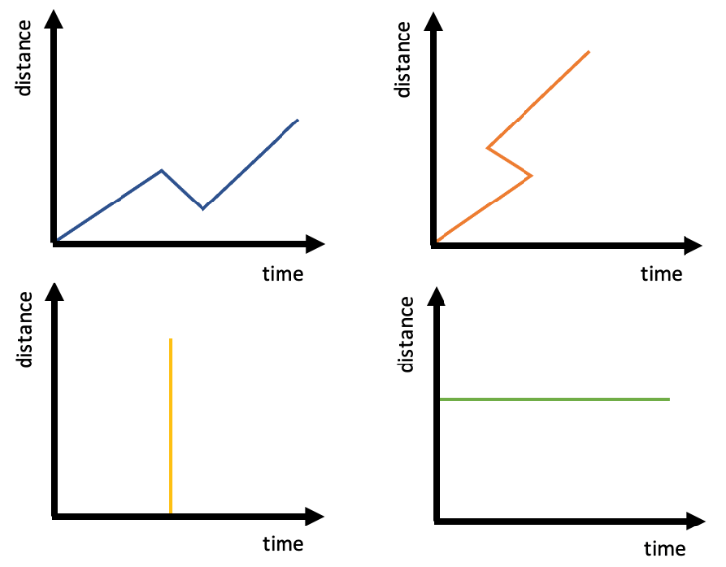
Understand and interpret the graph in context
Example 7
Which of these graphs show journeys that are impossible?
Notes:
Suggested questioning:
Which shows someone who hasn’t moved?
Which shows someone who has travelled back towards their starting point?
Why are the impossible graphs not possible?
Which shows some impossible time travel/teleportation?!
Things for you to think about:
Example 7 (which draws on examples used by Hart, 1981) gives another opportunity to explore whether students understand that a graph is not a ‘picture’ of a situation. They should interpret that the situations with the orange and the yellow line are impossible, as they either involve travelling backwards through time, or instantaneously changing distance. The key idea to stress is that the line is not a sketch of a path.
Reference: Kerslake, D. (2004) p 128, in Hart, K.M., College, C. and Al, E. Children’s understanding of mathematics : 11-16. Eastbourne, Angleterre: Anthony Rowe Publishing.

Slide 29
Understand and interpret the graph in context.
Example 7
How might considering non-examples such as the yellow and orange graphs help students to understand distance-time graphs?
What might students still misunderstand about the blue and green graphs? What questions might you ask to check their understanding?
Which of these graphs show journeys that are impossible?
Notes:
Due to space constraints, the image on this PD discussion slide is very small. PD Leads might like to use or print the ‘in the classroom’ version of this slide for teachers to access during discussions.
This example can be found on page 29 of the 4.2 Core Concept document.

Slide 30
Reflection questions
What other mathematical concepts will be supported by students’ stronger understanding of this key idea?
What mathematical language will you continue to use to support pupils to make connections with other areas?
Which representations might you continue to use to further develop students’ understanding?

Slide 32
Appendices
You may choose to use the following slides when planning or delivering a PD session. They cover:
Key vocabulary
Representations and structure
Previous learning
Future learning
Library of links

Slide 33
Key vocabulary (1)
Term | Definition
Cartesian coordinate system | A system used to define the position of a point in 2- or 3-dimensional space: Two axes at right angles to each other are used to define the position of a point in a plane. The usual conventions are to label the horizontal axis as the x-axis and the vertical axis as the y-axis, with the origin at the intersection of the axes. The ordered pair of numbers (x, y) that defines the position of a point is the coordinate pair. The origin is the point (0, 0); positive values of x are to the right of the origin and negative values are to the left of the origin; positive values of y are above the origin and negative values below the origin. Each of the numbers is a coordinate. The numbers are also known as ‘Cartesian coordinates’, after the French mathematician, René Descartes (1596–1650). Three mutually perpendicular axes, conventionally labelled x, y and z, and coordinates (x, y, z) can be used to define the position of a point in space.

Slide 34
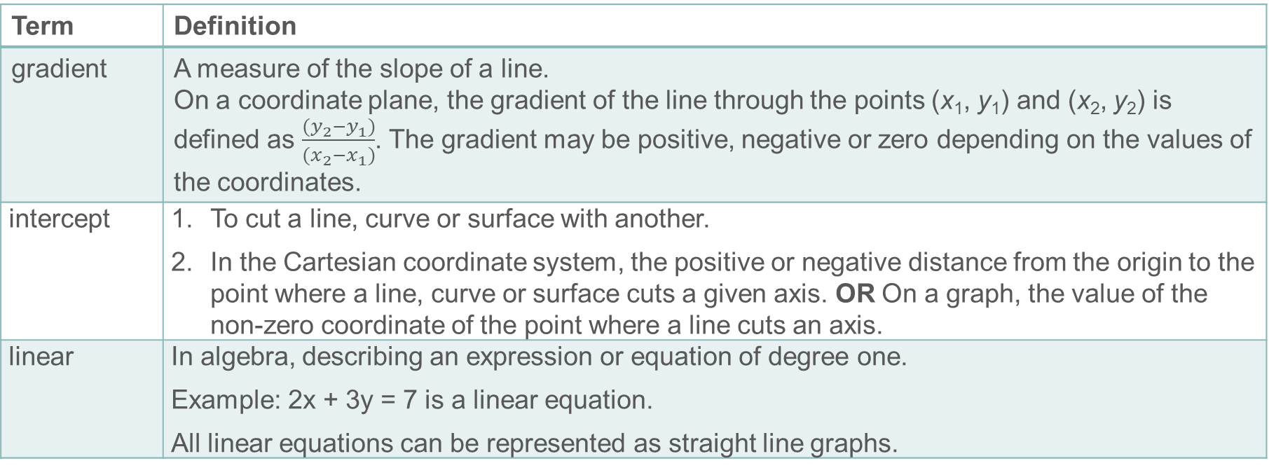
Key vocabulary (2)
Term | Definition
gradient | A measure of the slope of a line. On a coordinate plane, the gradient of the line through the points (x₁, y₁) and (x₂, y₂) is defined as $\frac{(y_{2}−y_{1})}{(x_{2}−x_{1})}$. The gradient may be positive, negative or zero depending on the values of the coordinates.
intercept | To cut a line, curve or surface with another. In the Cartesian coordinate system, the positive or negative distance from the origin to the point where a line, curve or surface cuts a given axis. OR On a graph, the value of the non-zero coordinate of the point where a line cuts an axis.
linear | In algebra, describing an expression or equation of degree one. Example: 2x + 3y = 7 is a linear equation. All linear equations can be represented as straight line graphs.

Slide 35
Key vocabulary (3)
Term | Definition
quadratic | Describing an expression of the form ax² + bx + c where a, b and c are real numbers. The function y = ax² + bx + c is a quadratic function; its graph is a parabola.
simultaneous equations | Two linear equations that apply simultaneously to given variables. The solution to the simultaneous equations is the pair of values for the variables that satisfies both equations. The graphical solution to simultaneous equations is a point where the lines representing the equations intersect. Example: x + y = 6 and y = 2x is a set of simultaneous equations. The solution is the value of x and y which satisfies both simultaneously – i.e. x = 2 and y = 4.

Slide 36
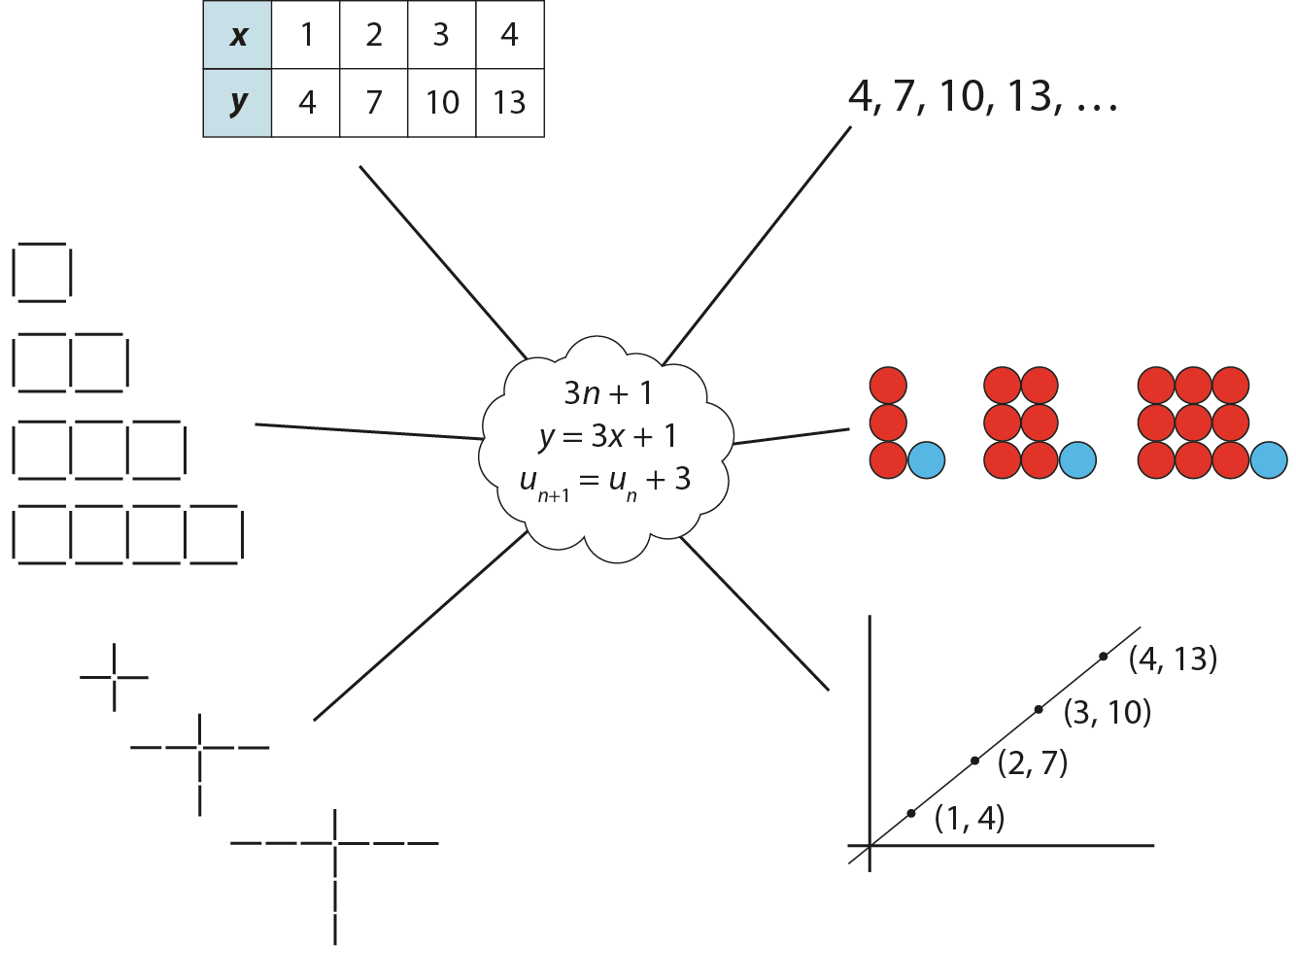
Representations and structure
There are a number of different representations that you may wish to use to support students’ understanding of this key idea. These might include:
Tables of values, graphs, sequences and structured pictorial arrangements
It is important for students to see multiple representations of the same structure, as in the diagram, and to connect them. Prompts such as ‘Where is the 3 in this representation?’ and ‘Where is the 1?’ can support students in making these connections and understanding that each representation has the same underpinning structure.
Notes:
More information about the representations and structure involved in this key idea can be found:
On page 5 of the 4 Sequences and graphs Theme Overview document
Links to all of these can be found on the final slide.

Slide 37
Previous learning
From Upper Key Stage 2, students will bring experience of:
using simple formulae
generating and describing linear number sequences
describing positions on the full coordinate grid (all four quadrants).
Notes:
Theme 4 Sequences and graphs

Slide 38
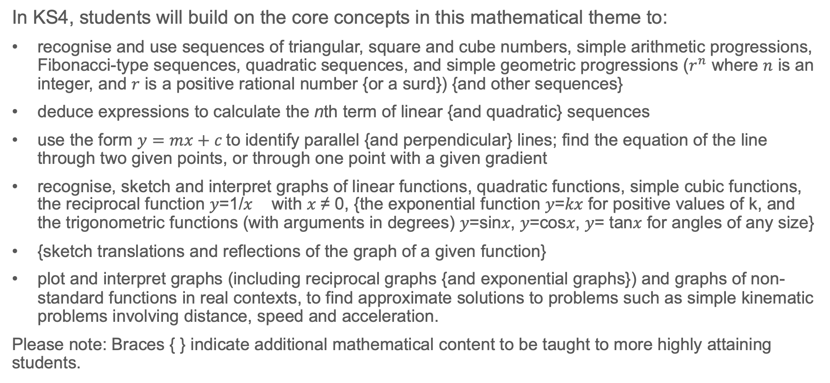
Future learning
In KS4, students will build on the core concepts in this mathematical theme to:
recognise and use sequences of triangular, square and cube numbers, simple arithmetic progressions, Fibonacci-type sequences, quadratic sequences, and simple geometric progressions ($r^{n}$ where $n$ is an integer, and $r$ is a positive rational number {or a surd}) {and other sequences}
deduce expressions to calculate the nth term of linear {and quadratic} sequences
use the form $y=mx+c$to identify parallel {and perpendicular} lines; find the equation of the line through two given points, or through one point with a given gradient
recognise, sketch and interpret graphs of linear functions, quadratic functions, simple cubic functions, the reciprocal function 𝑦=1/𝑥 with 𝑥 ≠ 0, {the exponential function 𝑦=𝑘𝑥 for positive values of k, and the trigonometric functions (with arguments in degrees) 𝑦=sin𝑥, 𝑦=cos𝑥, 𝑦= tan𝑥 for angles of any size}
{sketch translations and reflections of the graph of a given function}
plot and interpret graphs (including reciprocal graphs {and exponential graphs}) and graphs of non-standard functions in real contexts, to find approximate solutions to problems such as simple kinematic problems involving distance, speed and acceleration.
Please note: Braces { } indicate additional mathematical content to be taught to more highly attaining students.
Notes:
Theme 4 Sequences and graphs

Slide 39
Library of links
The following resources from the NCETM website have been referred to within this slide deck:
NCETM Secondary Mastery Professional Development
4 Sequences and Graphs Theme Overview Document
4.2 Graphical representations Core Concept Document
1.4 Simplifying and manipulating expressions, equations and formulae Core Concept Document
NCETM primary mastery professional development materials
NCETM primary assessment materials
NCETM secondary assessment materials
There are also references to the following:
Hart, K.M., College, C. and Al, E. (2004). Children’s understanding of mathematics : 11-16. Eastbourne, Angleterre: Anthony Rowe Publishing.
www.gapminder.org
https://ourworldindata.org/rise-of-social-media

