Slide 1
Numberblocks
Support Materials
Series 2, Episode 8
Counting Sheep

Slide 2
Practitioner Notes

Slide 3
Episode Description
Six has six sheep who don’t want to go to sleep. She plays games with them, rolling a dice and getting them to rearrange themselves in different patterns. When she counts them, she falls asleep and they escape, running off in two directions, so she splits into two Threes to round them up. She falls asleep again, they escape and she has to split into three Twos - and then six Ones - to get them back into their pen. Finally, she gets them to count her blocks and they fall asleep.

Slide 4
Maths in the Episode
Equal Groups
The concept of ‘equal groups’ is introduced as Six arranges 6 sheep into equal groups.
Equivalence
Six repeatedly mentions where quantities are ‘the same as’ (equivalent to), e.g. ‘6 is the same as 3 plus 3’. The concept of equivalence is very important to understanding the meaning of the equals symbol in an equation.
Repeated Addition
In this episode the equal groups are represented using repeated addition. This will lay the foundation for understanding multiplication at a later stage.
Factors of 6
This episode provides children with the experience that 6 can be partitioned into a number of different equal groups. This will lay the foundation for understanding factors of numbers at a later stage.

Slide 5
Using Mathematical Language
In this episode children experience the language of equal groups. Encourage the children to practise these stem sentences when talking about equal groups.
For example:
“There are 3 equal groups of 2.”
“There are three 2s.”
“6 is the same as 2 and 2 and 2.”

Slide 6
Talk and Discuss Together

Slide 7
Talk and Discuss Together
Watch the episode of Numberblocks. First ask the children what they noticed and allow them to talk to you and each other. The following slides are designed to stimulate children and adults to talk about the episode and draw out some key aspects of the mathematics.

Slide 8


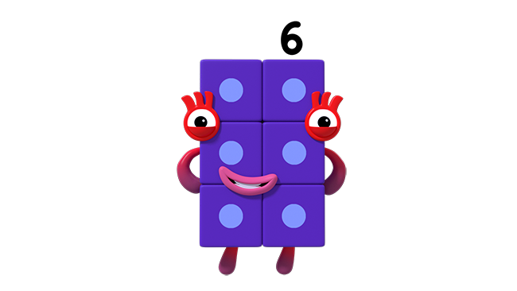
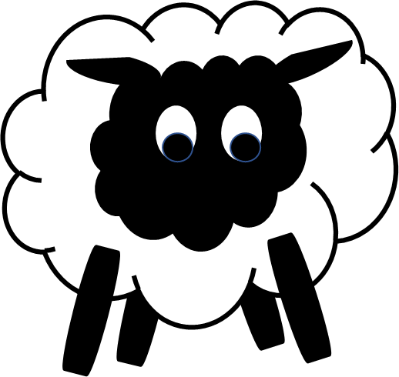
Images © 2017 Alphablocks Ltd. All Rights Reserved.
Notes:
Discuss the episode and what the children noticed.
Organise the children into groups of 6. If there are children left over, let them take turns with different groups, or assign them to be ‘checkers’.
Use this slide to imitate rolling the dice, use the line from the programme to instruct what to do:
OK sheep, listen to me, I want you all in groups of 3.
See how the children get into groups of 3. (Do they get into 3 groups or 2 groups? Are the groups equal?)

Slide 9
Click on the dice.
Images © 2017 Alphablocks Ltd. All Rights Reserved.
Notes:
Click on the dice: sheep get into groups of 3. How many in each equal group? How many equal groups?
Say the next line from the episode:
Well done sheep, it’s clear to see, 6 is the same as 3 plus 3.

Slide 10

Images © 2017 Alphablocks Ltd. All Rights Reserved.
Notes:
Use this slide to imitate rolling the dice, use the line from the programme to instruct what to do:
OK sheep, here’s what to do, arrange yourselves in groups of 2.
See how the children get into groups of 2. (Do they get into 3 groups or 2 groups? Are the groups equal?)

Slide 11
Click on the dice.
Images © 2017 Alphablocks Ltd. All Rights Reserved.
Notes:
Check the groups by running the animation.
Click on the dice: sheep get into groups of 2. How many in each equal group? How many equal groups?
Say the next line from the episode:
Six is the same as 3 lots of 2, I know that now, thanks to you.

Slide 12

Images © 2017 Alphablocks Ltd. All Rights Reserved.
Notes:
Use this slide to imitate rolling the dice, use the line from the programme to instruct what to do:
Oh, I see time for tricks, arrange yourself in a group of six.
See how the children get into groups of 6. (Do they get into 1 group or 6 groups? Are the groups equal?)

Slide 13
Click on the dice.
Images © 2017 Alphablocks Ltd. All Rights Reserved.
Notes:
Check the groups by watching the animation.
Click on the dice: Sheep get into a group of 6. How many in each equal group? How many equal groups?

Slide 14
Notes:
This slide provides the opportunity to explore equivalence.
Compare the two images - asking what’s the same and what’s different?
Draw out the fact that they both have 6 sheep, therefore:
“2 groups of 3 is the same as six”
and “3 groups of 2 is the same as six.”
This slide is animated to make the sheep appear.

Slide 15
Enabling Environments

Slide 16
Enabling Environments
Playing and Exploring
Leave out resources for making 6 sheep with cotton wool balls and googly eyes, then stick them onto a green piece of paper to represent different equal groups of 6.
Active Learning
Notice how children rearrange small quantities into equal groups. Prompt how equal groups can be laid out in an array formation.
Creating and Thinking Critically
Leave out a dice labelled with 1, 2, 2, 3, 3, 6, pieces of green A4 paper, a bag of cotton wool and some fencing from the small world farm. Encourage the children to invent a game that involves grouping 6 into equal groups.

Slide 17
Learning Together in Y1

Slide 18



There are equal groups of
OK sheep,
Listen to me.
I want you all in groups of 3.
(Click on Six)
equal groups of are .
Images © 2017 Alphablocks Ltd. All Rights Reserved.
Notes:
Use this slide to discuss what ‘equal groups’ means.
This slide is animated.
Click 1: dice rolls and lands on 3. Speech bubble appears. Read together.
Click on Six to see the sheep get in to 2 groups of 3 as they did in the episode.
Click 2: first sentence appears with missing numbers.
What do these words say? What is missing from the empty boxes? Practise saying together.
Click 3: numbers revealed; re-read.
Click 4: second sentence appears with missing numbers. What do these words say? What is missing from the empty boxes? Practise saying together.
Click 5: numbers revealed; re-read.

Slide 19
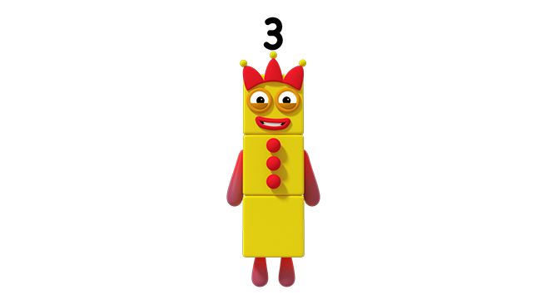
Images © 2017 Alphablocks Ltd. All Rights Reserved.
Notes:
Use this slide to see how Six is the same as Three and Three.
This slide is animated:
Click 1: Three and Another Three appear, they jump to the side and then separate.
Ask the children – what did you notice? What is the same and different about this and the previous slide?
Discuss that six sheep split into two groups of 3 and in this slide Six splits in to Three and another Three.
“Six is the same as Three and Another Three.”
Ask the children to model this with cubes.

Slide 20




Images © 2017 Alphablocks Ltd. All Rights Reserved.
Notes:
Ask:
What do you notice?
Discuss how the counters are arranged like the spots on a dice, like Six is in the picture.
Can you spot 2 groups of 3?
This slide is animated.
Click 1: the equation is unfolded and the parts of the equation are emphasised in the model.
Watch the animation.
What did you see? What does this sentence say? What does this sentence mean? What does the 6 mean? What does the 3 mean? What does the other 3 mean?

Slide 21

There are equal groups of
OK sheep, here’s what to do.
Arrange yourselves in groups of 2.
(Click on Six)
equal groups of are .
Images © 2017 Alphablocks Ltd. All Rights Reserved.
Notes:
Use this slide to discuss what ‘equal groups’ means.
This slide is animated.
Click 1: dice rolls and lands on 2. Speech bubble appears. Read together.
Click on Six to see the sheep get in to 3 groups of 2 as they did in the programme.
Click 2: the first sentence appears with missing numbers. What do these words say? What is missing from the empty boxes? Practise saying together.
Click 3: numbers revealed; re-read.
Click 4: the second sentence appears with missing numbers. What do these words say? What is missing from the empty boxes? Practise saying together.
Click 5: numbers revealed; re-read.

Slide 22

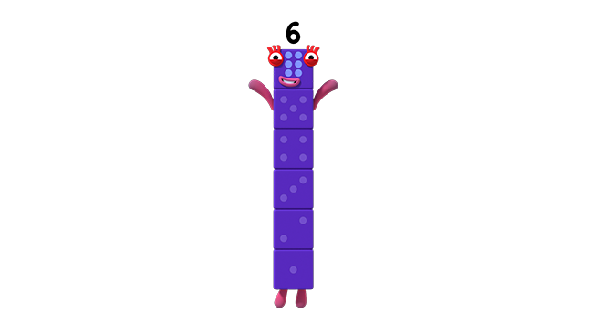
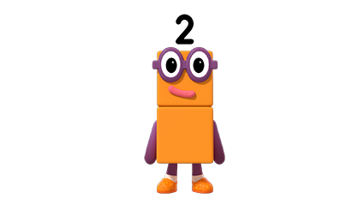

Images © 2017 Alphablocks Ltd. All Rights Reserved.
Notes:
Use this slide to see how Six is the same as Two and Two and Two.
This slide is animated:
Click 1: Six changes shape.
Click 2: Two and another Two and another Two appear, they jump to the side and then separate.
Ask the children – what did you notice? What is the same and different about the this and the previous slide?
Discuss that six sheep split into 3 groups of 2 and in this slide Six splits into three Twos.
“Six is the same as Two and another Two and another Two.”
Ask the children to model this with cubes.

Slide 23

Images © 2017 Alphablocks Ltd. All Rights Reserved.
Notes:
Ask:
What do you notice? Discuss how the counters are arranged like the spots on a dice. How could we make Six look the same?
Can you spot 3 groups of 2?
This slide is animated.
Click 1: the equation is unfolded and the parts of the equation are emphasised in the model.
Watch the animation.
What did you see? What does this sentence say? What does this sentence mean? What does the 6 mean? What does the 2 mean? What does the other 2 mean? What does the other 2 mean?
“6 is the same as 3 groups of 2.”
“6 is the same as 3 2s.”
“Six is the sum of 3 2s.” etc.
Read the number sentence aloud.

Slide 24






There are equal groups of .
equal groups of are .
Notes:
Use this for individual work. Children complete the missing pictures or the missing numbers.

Slide 25




Images © 2017 Alphablocks Ltd. All Rights Reserved.
Notes:
Challenge:
What do you notice?
There are 3 of the same shape. The triangle has a value. Each triangle represents an equal group.
There are 2 of the same shape. The star has a value.
This slide is animated:
Click 1: the triangle and star each appear with an answer box.
What is the value of the triangle? Why?
What is the value of the star? Why?
Click 2: The answers are revealed.

