Slide 1
Making Progress in Multiplication
Multiplication by 6
Part 3 of the lesson

Slide 2
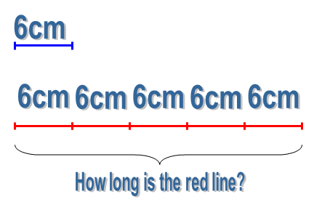
This represents another way of looking at multiples
of 6.
Notice the teacher’s questioning.
What does the 6 represent?
What does the 5 represent?
The meaning of the 5 and the 6 within the multiplication sentence is determined by the context.

Slide 3
Moving between the concrete and the abstract
Children link the abstract number sentences with the concrete contexts.
Key to mastery is the ability to move with fluency between the two aspects.
Notice how the teacher keeps checking that the children understand the meaning of each part of the abstract number sentences.

Slide 4
Small Steps
“By doing those small steps it makes such a difference to the children’s understanding, their security and their confidence as mathematicians.” (class teacher)
Notice the small steps that are taken throughout the lesson.

