Slide 1
2.10 Connecting multiplication and division, and the distributive law
Representations | Year 4
Multiplication and Division

Slide 2
How to use this presentation
You can find the teacher guide 2.10 Connecting multiplication and division, and the distributive law by following the link below.

Slide 3
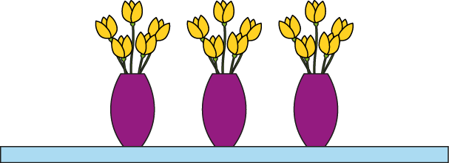
2.10 Making connections; the distributive law Step 1:1
Two multiplication equations?
3 × 5 = 15
5 × 3 = 15
3 groups of 5 are equal to 15.
Five, 3 times, is equal to 15.
3 × 5 = 5 × 3
Notes:
Write two multiplication equations to represent this picture.
What’s the same? In both equations, three and five are factors and fifteen is the product.
What’s different? The factors are written in a different order.

Slide 4
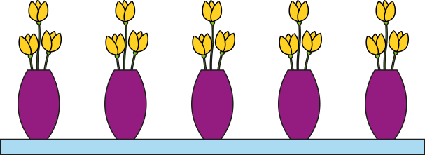
2.10 Making connections; the distributive law Step 1:1
3 × 5 = 15
A
B
3 groups of 5 are equal to 15.
5 groups of 3 are equal to 15.
Three, 5 times, is equal to 15.
3 groups of 5 is equal to 5 groups of 3.
Notes:
What’s the same? Both pictures show fifteen flowers.
What’s different?
Picture A shows three groups of five flowers.
Picture B shows five groups of three flowers (or three, five times).

Slide 5
2.10 Making connections; the distributive law Step 1:1
5 × 3 = 15
A
B
3 groups of 5 are equal to 15.
5 groups of 3 are equal to 15.
Five, 3 times, is equal to 15.
3 groups of 5 is equal to 5 groups of 3.

Slide 6
2.10 Making connections; the distributive law Step 1:1
 | Products equal?
2 × 3 and 3 × 2
5 × 4 and 4 × 5
5 × 5 and 6 × 5
12 × 3 and 13 × 2
3 × 22 and 23 × 2
✓
✓
✗
✗
✗

Slide 7
2.10 Making connections; the distributive law Step 1:2
15 flowers, 5 in each vase. How many vases?
3
× 5 = 15
3
5 × = 15
Which calculation?
15 ÷ 5 =
3
✓
5 ÷ 15 =
✗

Slide 8
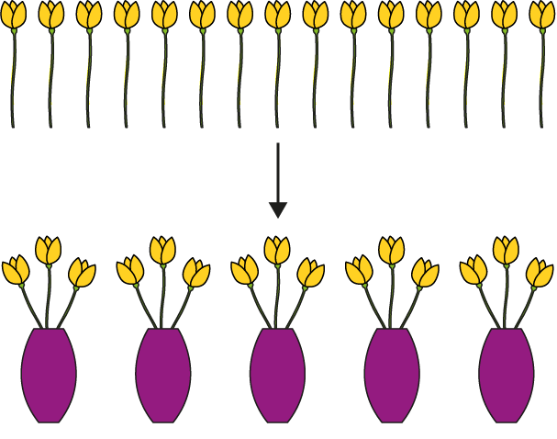
2.10 Making connections; the distributive law Step 1:3
15 flowers, 3 in each vase. How many vases?
5
× 3 = 15
5
3 × = 15
Which calculation?
15 ÷ 3 = 5
✓
15 ÷ 5 = 3
✗
Notes:
15 ÷ 3 Equation is correct; does represent the problem.
15 ÷ 5 Equation is correct; but 15 ÷ 5 is not the calculation we need to perform.

Slide 9
2.10 Making connections; the distributive law Step 1:4
15 flowers
5 in each vase, how many vases? | 3 in each vase, how many vases?
3
× 5 = 15
5 × = 15
3
5
× 3 = 15
3 × = 15
5
15 ÷ 5 =
3
15 ÷ 3 =
5
factor × ? = product
? × factor = product
↓
dividend ÷ divisor = quotient

Slide 10
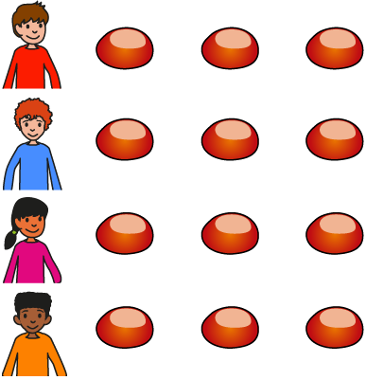
2.10 Making connections; the distributive law Step 1:5
12 conkers shared between 4 children. How many conkers each?
3
× 4 = 12
3
4 × = 12
12 ÷ 4 =
3

Slide 11
2.10 Making connections; the distributive law Step 1:5
12 conkers shared between 3 children. How many conkers each?
4
× 3 = 12
4
3 × = 12
12 ÷ 3 =
4

Slide 12
2.10 Making connections; the distributive law Step 1:5

Slide 13
2.10 Making connections; the distributive law Step 1:7
0 × 1 = 0 | 0 ÷ 1 = 0
0 × 2 = 0 | 0 ÷ 2 = 0
0 × 3 = 0 | 0 ÷ 3 = 0
0 × 4 = 0 | 0 ÷ 4 = 0
0 × 5 = 0 | 0 ÷ 5 = 0
0 × 10 = 0 | 0 ÷ 10 = 0
Notes:
When the dividend is zero, the quotient is zero.

Slide 14
2.10 Making connections; the distributive law Step 1:8
Connect matching multiplication and division equations.
15 = 3 × 5 |  | 24 ÷ 6 = 4
24 = 8 × 3 |  | 0 ÷ 7 = 0
22 = 2 × 11 |  | 15 ÷ 3 = 5
0 = 7 × 0 |  | 7 ÷ 7 = 1
24 = 12 × 2 |  | 11 = 22 ÷ 2
7 = 7 × 1 |  | 24 ÷ 8 = 3
4 × 6 = 24 |  | 2 = 24 ÷ 12

Slide 15
2.10 Making connections; the distributive law Step 2:1
5 × 8
= 4 × 8 + 8
= 40
4 × 8 = 32
+ 8

Slide 16
2.10 Making connections; the distributive law Step 2:1
4 × 8
= 5 × 8 − 8
= 32
− 8

Slide 17
2.10 Making connections; the distributive law Step 2:2
5 × 8
8
8
8
8
8
5 = 4 + 1
5 × 8 = 4 × 8 + 1 × 8
= 32 + 8
= 40
Notes:
Five is equal to four plus one, so
five times eight is equal to
four times eight plus one times eight.

Slide 18
2.10 Making connections; the distributive law Step 2:2
5 × 8
8
8
8
8
8
4 = 5 − 1
4 × 8 = 5 × 8 − 1 × 8
= 40 − 8
= 32
Notes:
Four is equal to five minus one, so
four times eight is equal to
five times eight minus one times eight.

Slide 19
2.10 Making connections; the distributive law Step 2:2
5 × 8
5 × 8
8
8
8
8
8
8
8
8
8
8
5 = 4 + 1
4 = 5 − 1
5 × 8 = 4 × 8 + 1 × 8
4 × 8 = 5 × 8 − 1 × 8
= 32 + 8
= 40 − 8
= 40
= 32

Slide 20
2.10 Making connections; the distributive law Step 2:2
4 + 1 = 5
4 = 5 − 1
5 × 8 = 4 × 8 + 1 × 8
4 × 8 = 5 × 8 − 1 × 8

Slide 21
2.10 Making connections; the distributive law Step 2:3
5 × 8
8
8
8
8
8
5 = 3 + 2
5 × 8 = 3 × 8 + 2 × 8
= 24 + 16
= 40
Notes:
Five is equal to three plus two, so
five times eight is equal to
three times eight plus two times eight.

Slide 22
2.10 Making connections; the distributive law Step 2:3
5 × 8
8
8
8
8
8
3 = 5 − 2
3 × 8 = 5 × 8 − 2 × 8
= 40 − 16
= 24
Notes:
Three is equal to five minus two, so
three times eight is equal to
five times eight minus two times eight.

Slide 23
2.10 Making connections; the distributive law Step 2:3
5 × 8
5 × 8
8
8
8
8
8
8
8
8
8
8
5 = 3 + 2
3 = 5 − 2
5 × 8 = 3 × 8 + 2 × 8
3 × 8 = 5 × 8 − 2 × 8
= 24 + 16
= 40 − 16
= 40
= 24

Slide 24
2.10 Making connections; the distributive law Step 2:3
3 + 2 = 5
3 = 5 − 2
5 × 8 = 3 × 8 + 2 × 8
3 × 8 = 5 × 8 − 2 × 8

Slide 25
2.10 Making connections; the distributive law Step 2:4
9 × 3
3 × 9
3
3
3
3
3
3
3
3
3
3
3
3
3
3
3
3
3
3
Notes:
Nine is equal to five plus four, so
three times nine is equal to
three times five plus three times four.
Five is equal to nine minus four, so
three times five is equal to
three times nine minus three times four.

Slide 26
2.10 Making connections; the distributive law Step 2:4

Slide 27
2.10 Making connections; the distributive law Step 2:5
5
× 2
2
2
2
2
2

Slide 28
2.10 Making connections; the distributive law Step 2:5
For each solution write 3 equations.
8 × 2

Slide 29
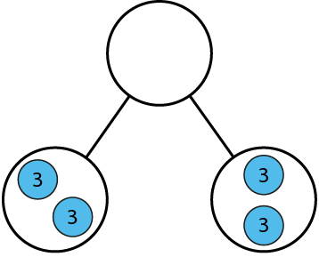
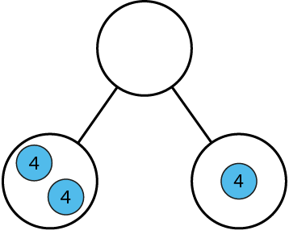
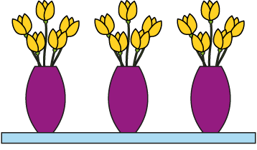
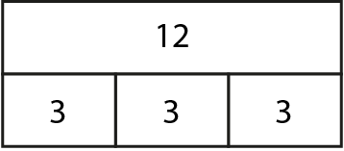
2.10 Making connections; the distributive law Step 2:5
4 × 3 = ?
✗
3 × 3 + 1 × 3
✓
2 × 4 + 4 × 1

Slide 30
2.10 Making connections; the distributive law Step 2:5
Represent with an equation.
3 × 5 + 1 × 5 = 4 × 5

Slide 31
2.10 Making connections; the distributive law Step 2:5
2 spiders crawl away. How many legs left?
Represent with an equation.
6 × 8 − 2 × 8 = 4 × 8

Slide 32
2.10 Making connections; the distributive law Step 2:6
6 = 5 + 1
4 × 6 =
6 × 4 = 5 × 4 + 1 × 4
4 × 5
+ 4 × 1
= 20 + 4
= 24
Notes:
Six is equal to five plus one, so
four times six is equal to four times five plus
four times one.
Six is equal to five plus one, so
six times four is equal to five times four plus
one times four.

Slide 33
2.10 Making connections; the distributive law Step 2:6
7 = 5 + 2
4 × 7 =
7 × 4 = 5 × 4 + 2 × 4
4 × 5
+ 4 × 2
= 20 + 8
= 28
Notes:
Seven is equal to five plus two, so
four times seven is equal to four times five plus
four times two.
Seven is equal to five plus two, so
seven times four is equal to five times four plus
two times four.

Slide 34
2.10 Making connections; the distributive law Step 2:6
9 = 10 − 1
4 × 9 =
4 × 10
− 4 × 1
9 × 4 = 10 × 4 − 1 × 4
= 40 − 4
= 36
Notes:
Nine is equal to ten minus one, so
four times nine is equal to four times ten minus
four times one.
Nine is equal to ten minus one, so
nine times four is equal to ten times four minus
one times four.

Slide 35
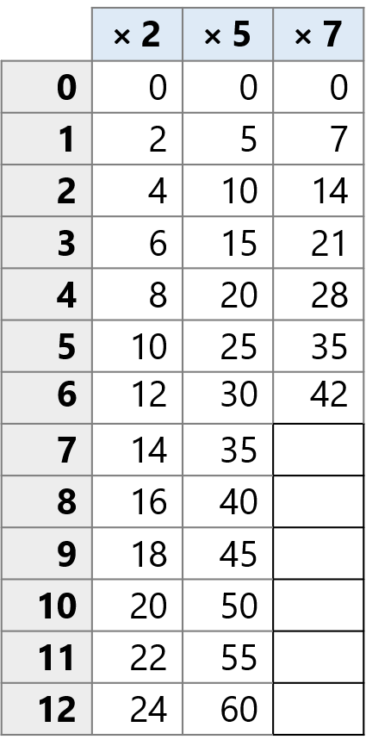
2.10 Making connections; the distributive law Step 2:8

Slide 36
2.10 Making connections; the distributive law Step 2:8

Slide 37
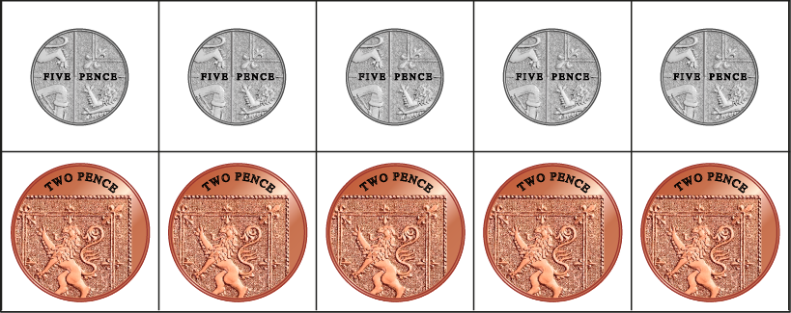
2.10 Making connections; the distributive law Step 2:8
How much money altogether?
= 35 p
5 × 5 + 2 × 5
25 + 10
= 35

Slide 38
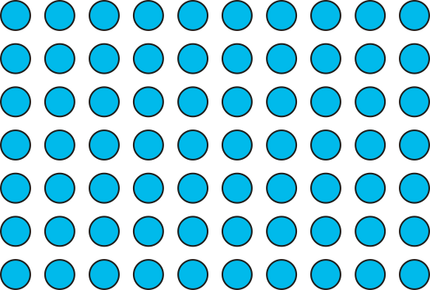
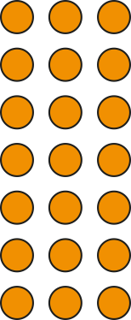
2.10 Making connections; the distributive law Step 3:1
7 × 13
= 91
10
3
7
70
21
7 × 13 = 7 × 10 + 7 × 3
= 70
+
21
= 91

Slide 39
2.10 Making connections; the distributive law Step 3:1
5 × 16
= 80
10
6
5
50
30
5 × 16 = 5 × 10 + 5 × 6
= 50 + 30
= 80

